Slide 1
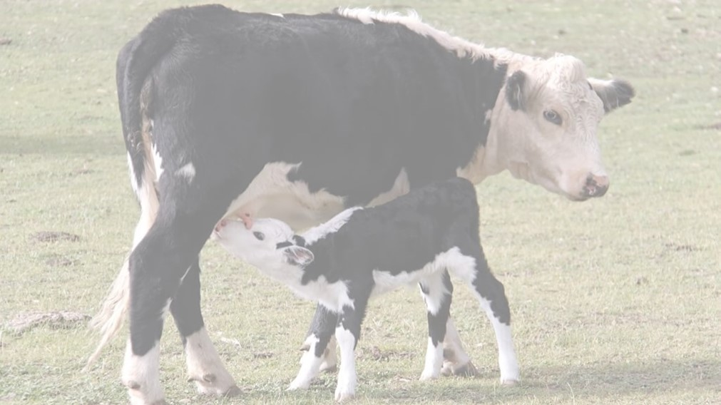
The Harvest Season
Living in the world that we have been given
Yours, Lord, is the greatness, the power,
the glory, the splendour, and the majesty;
for everything in heaven and on earth is yours.
All things come from you,
and of your own do we give you.

Slide 2
Fruitfulness amongst animals
From Day 6 of the Creation Story…
God said, “Let the earth bring forth living creatures of every kind: cattle and creeping things and wild animals of the earth of every kind.” And it was so. God made the wild animals of the earth of every kind and the cattle of every kind and everything that creeps upon the ground of every kind. And God saw that it was good.

Slide 3
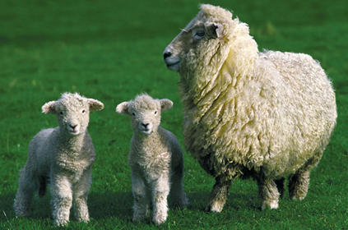
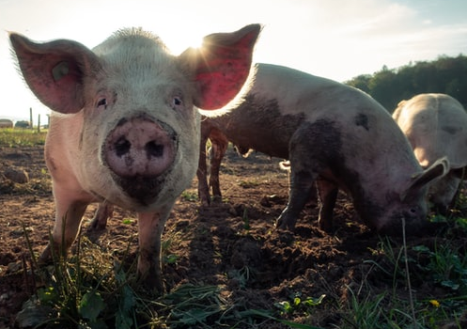
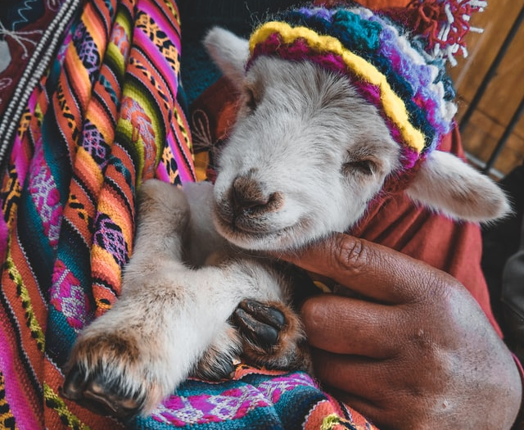
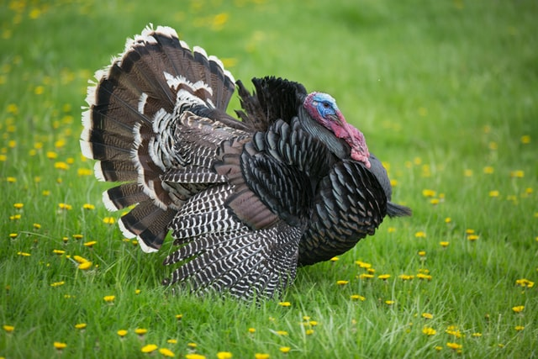
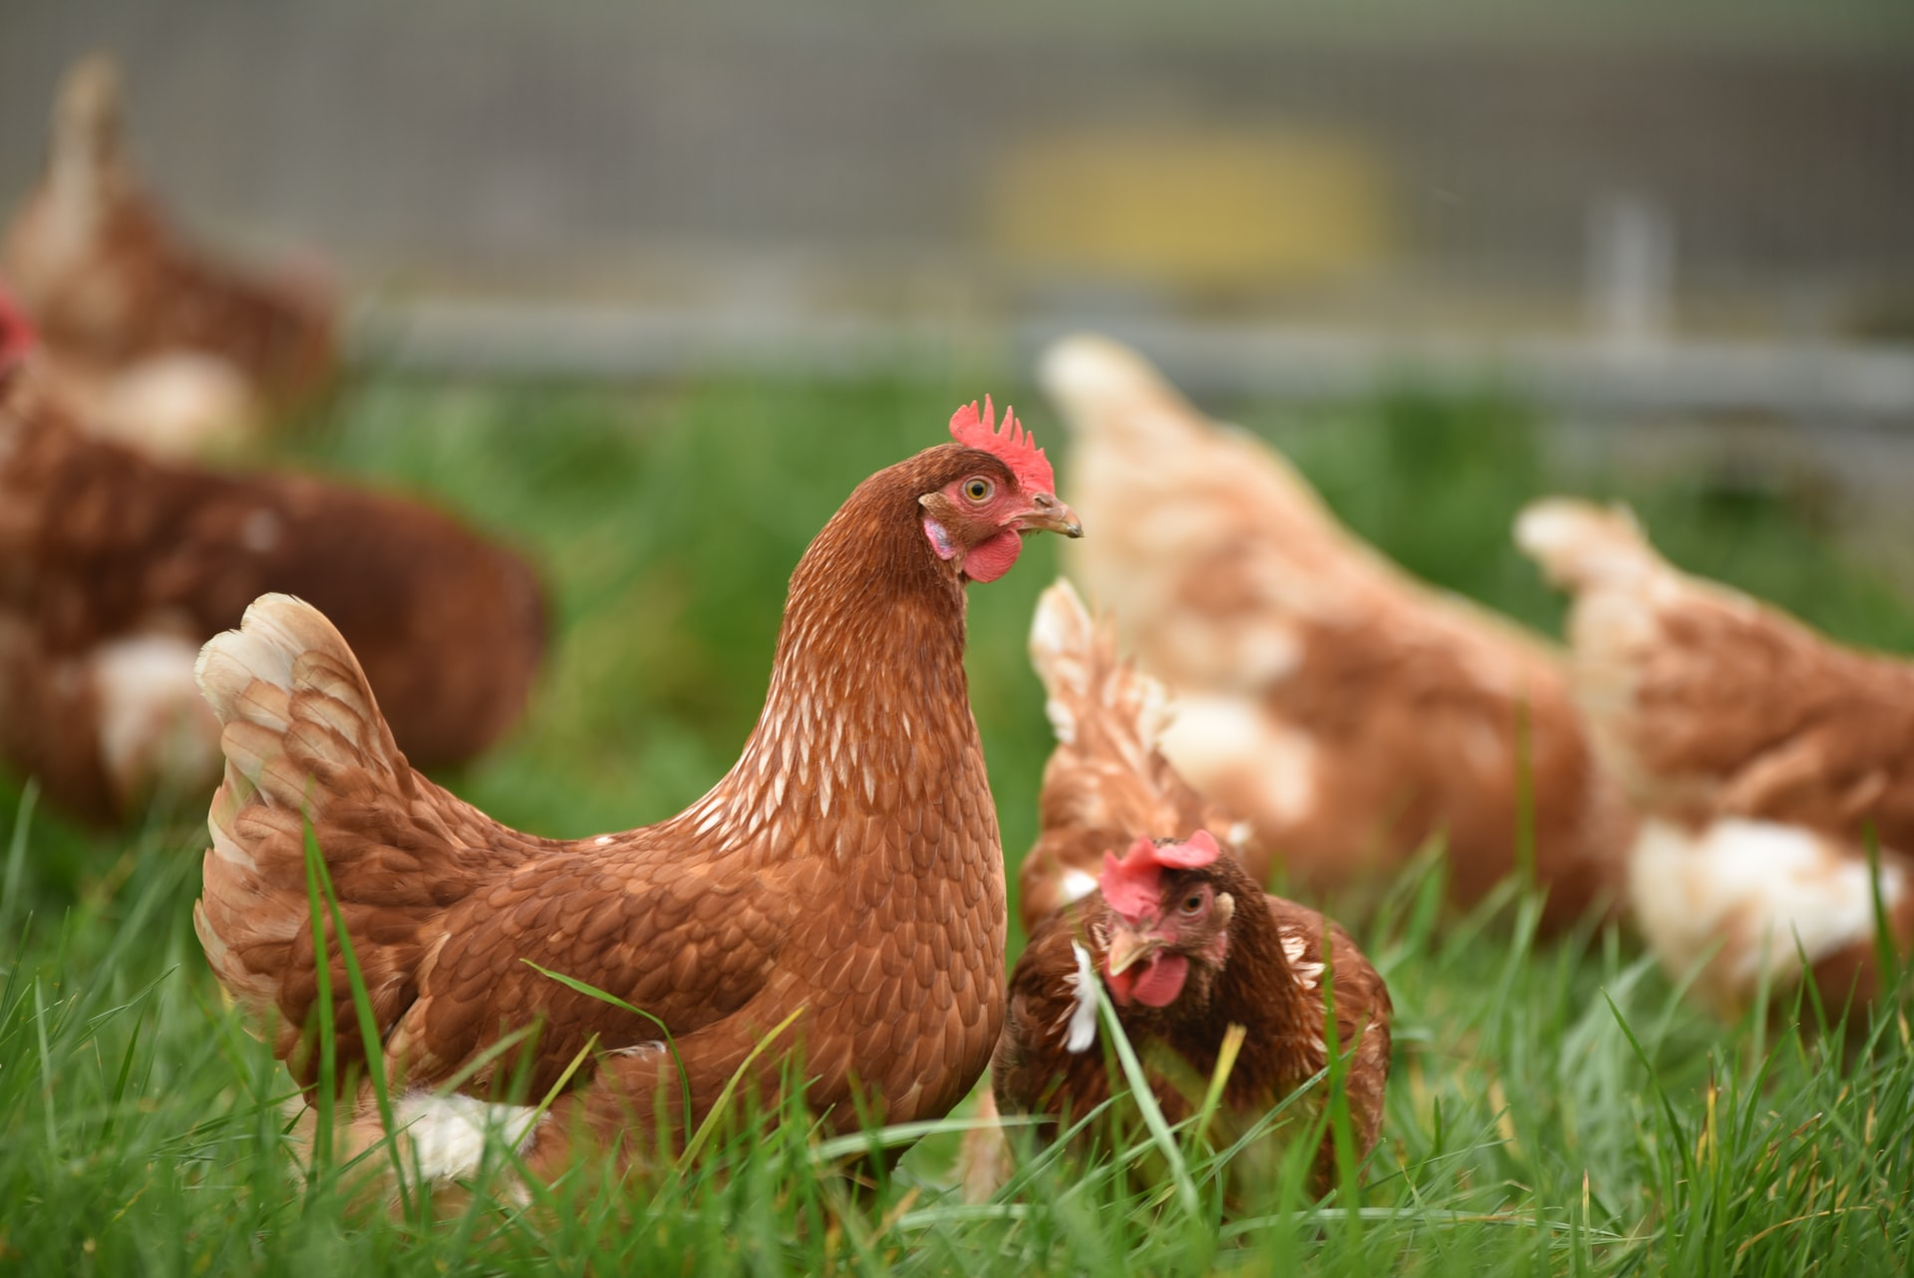
Do you have a favourite animal or animals?
Do we get a harvest from the animal?
Talk to your neighbour about it

Slide 4
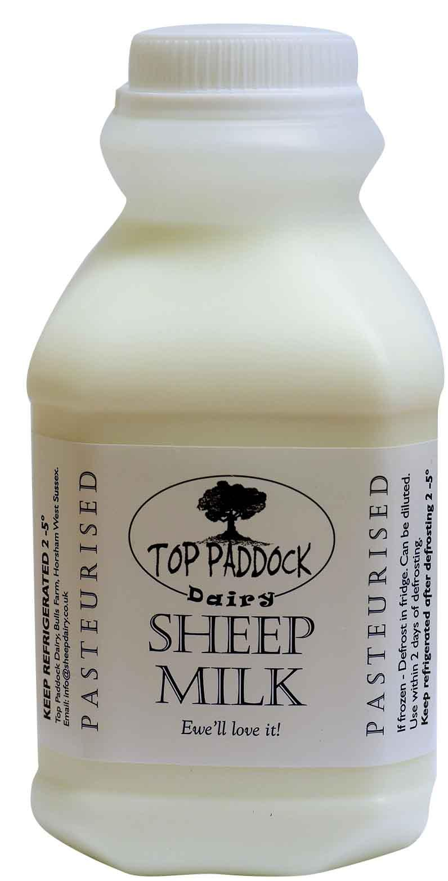
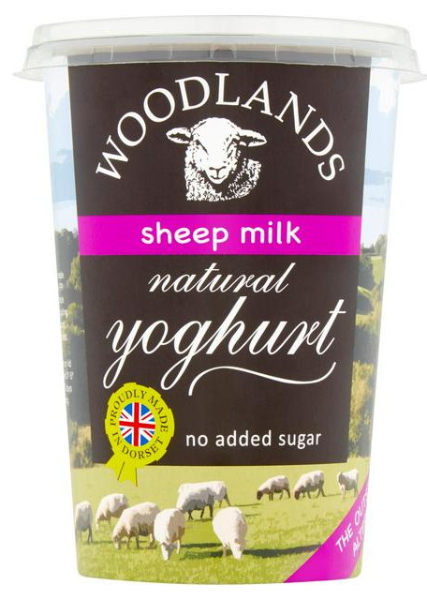
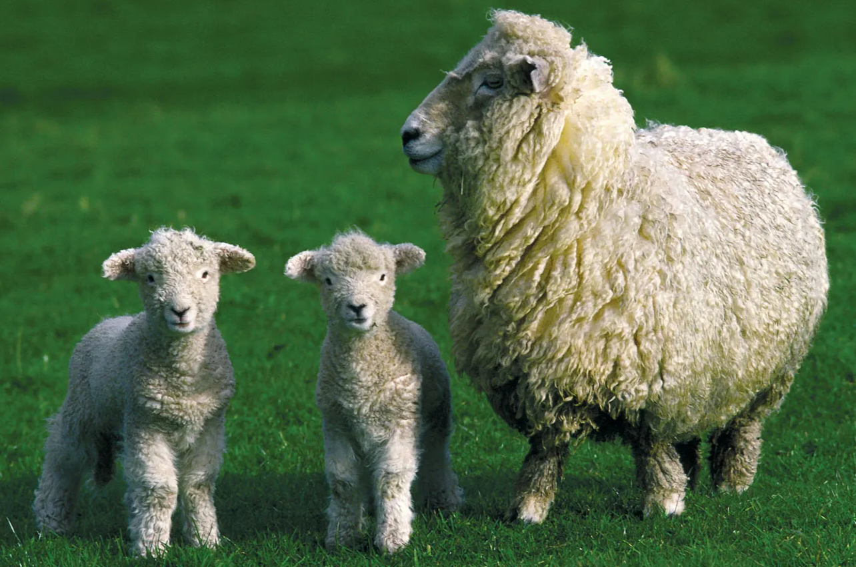
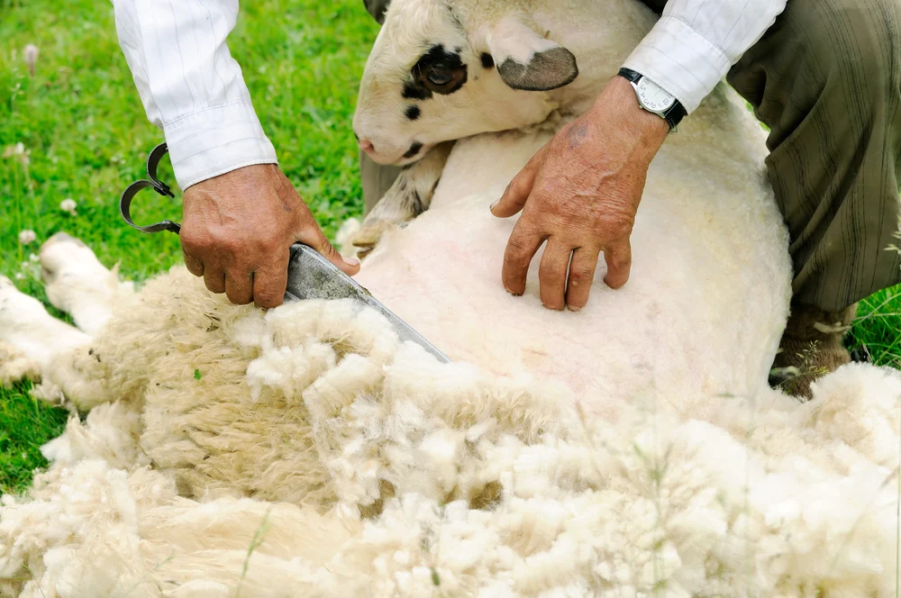
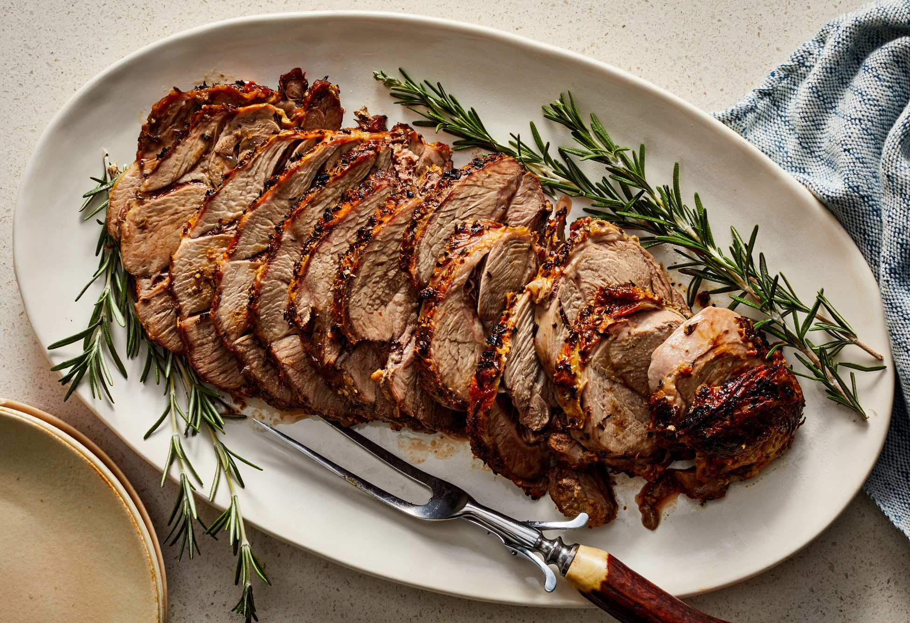
The harvest of the sheep
Notes:
The harvest of the sheep
Wool,
Milk – and yoghurt, (and cheese actually)
Meat …
and, of course, more sheep!

Slide 5
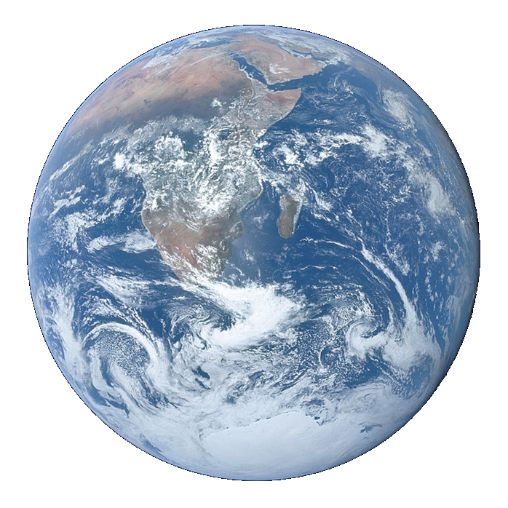
Litany of Creation
God commanded, “Let the earth produce all kinds of plants”
Plant prayers
God commanded, “Let the water be filled with many kinds of living beings, and the air filled with birds.”
Fish and bird prayers
God commanded, “Let the earth produce all kinds of animal life”
Animal prayers
God created human beings and blessed them,
People prayers
God looked at everything and was very pleased.
Thank you prayer
Notes:
An optional structure for prayer – see Developmental Prayer File page15* Pupils’ own prayers (or perhaps parents’ or staff prayers) should be inserted at the points in italics. This could be an opportunity to involve extemporary prayer or for silent prayer/reflection.
*https://www.odbe.org.uk/content/pages/documents/collectiveworship-prayerfile-doc-202175554553377.pdf

Slide 6
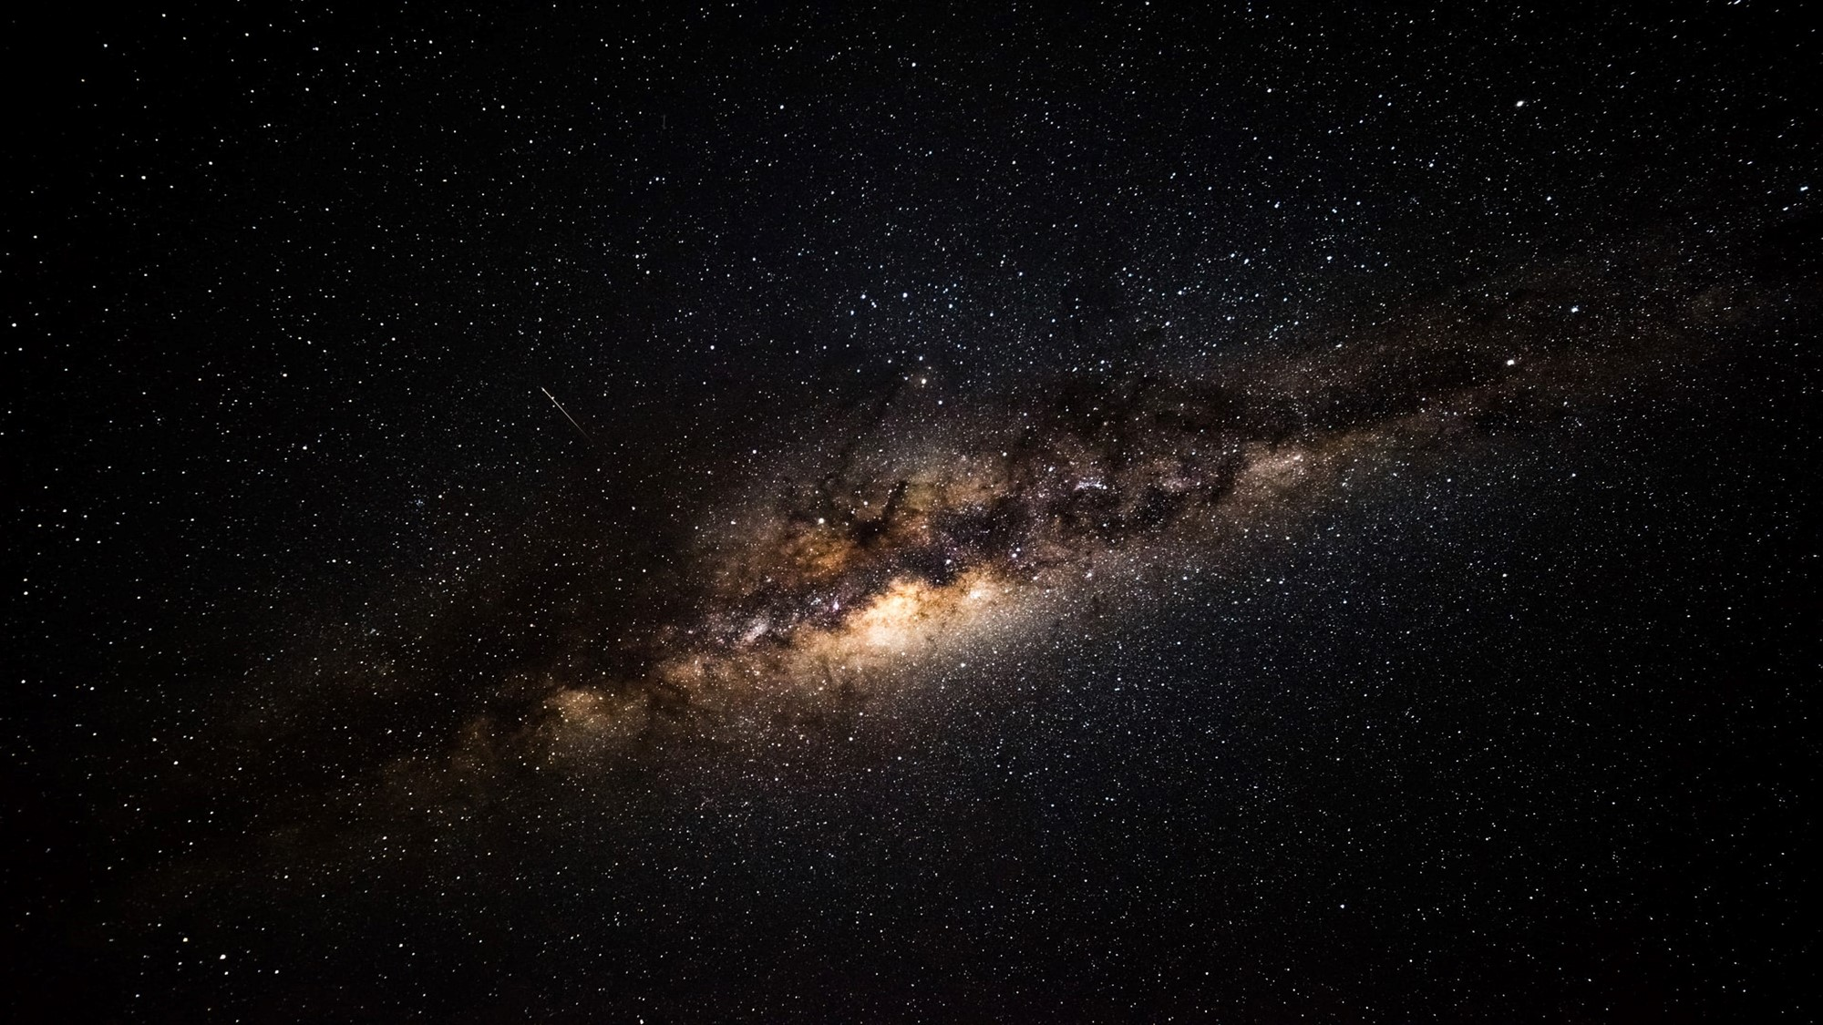
Our Father in heaven,
hallowed be your name,
your kingdom come,
your will be done,
on earth as in heaven.
Give us today our daily bread.
Forgive us our sins
as we forgive those who sin against us.
Lead us not into temptation
but deliver us from evil.
For the kingdom, the power,
and the glory are yours
now and for ever.
Amen.

