Slide 1
We say together: God’s love is with us, now and forever.
Notes:
Explore the heart shaped hands together embracing the light. It could be sunrise and a new day, or sunset and the end of a hard day’s work

Slide 2
Easter Reflection 5 Work to do What work do we have to do today?
Notes:
Explore the picture of the map of the world and people working all over it. The dotted lines show we are all connected. Take responses from pupils and staff of to do lists for today.

Slide 3
Listen now to the word and wisdom of God
Notes:
This is a familiar image to convey the message that we are going to listen to a passage from the Bible. Older pupils or other adults present might read it aloud to vary voices. Encourage stillness/focus while listening.

Slide 4
‘Go therefore, and make disciples of all nations, baptizing them in the name of the Father and of the Son and of the Holy Spirit, and teaching them to obey everything that I have commanded you. And remember, I am with you always, to the end of the age.’ Matthew 28 NRSV
Then he led them out as far as Bethany, and lifting up his hands, he blessed them. While he was blessing them, he withdrew from them and was carried up into heaven. And they worshipped him, and returned to Jerusalem with great joy, and they were continually in the temple blessing God.
Luke 24 NRSV
Notes:
If possible get another voice/ or a pupil to read this aloud. This might be read by two different voices.

Slide 5
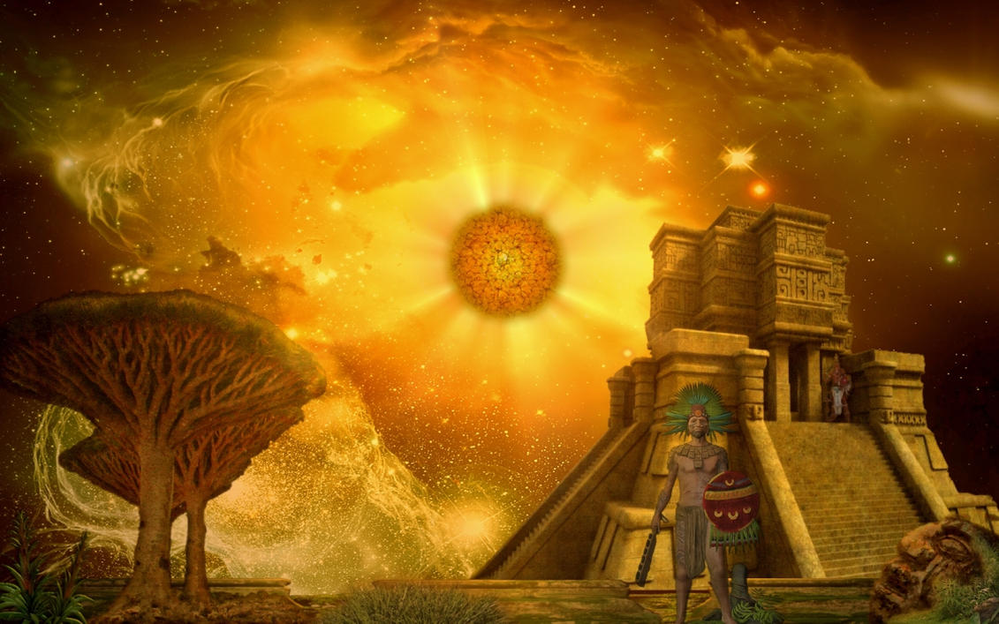
Going deeper
Thinkabouts:
What did Jesus mean by ‘making disciples’?
When might the ‘end of the age’ be?
Jesus was carried up to heaven, how might that have happened?
Let’s wonder:
Why do you think that the disciples were full of joy and praise?
Notes:
Image is from Chinese Christian tradition of art. You may wish to explore where that is in the world, linking back to the first slide. Note the significance of the hands, both Thomas’ and Jesus’. Jesus welcomes him and he looks, toches and believes. The startles expressions of theothe rdisciples tells a story too.

Slide 6
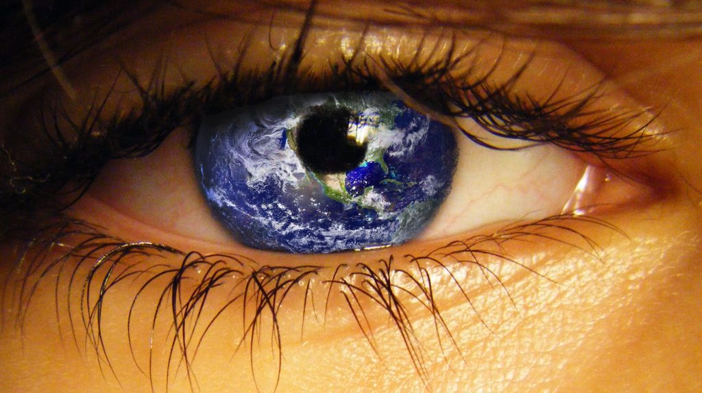
Where in the world are the disciples now?
Notes:
You might wish to go deeper and consider with older pupils what Christians may think of themselves as Disciples. There are Christians all around the world and it is the religion with the most followers in the world.

Slide 7
Reflection
Ascended Lord Jesus Christ,
Like the first disciples,
help us to follow you in our work and play,
to know that we are loved and to show love,
as you did to others everywhere.
Amen
Notes:
Ensure you invite pupils and staff present to join in or listen and reflect as they wish.

Slide 8
We say together: God’s love is with us Now and forever.
Notes:
Explore the heart shaped hands together embracing the light. It could be sunrise and a new day, or sunset and the end of a hard day’s work

