Slide 1
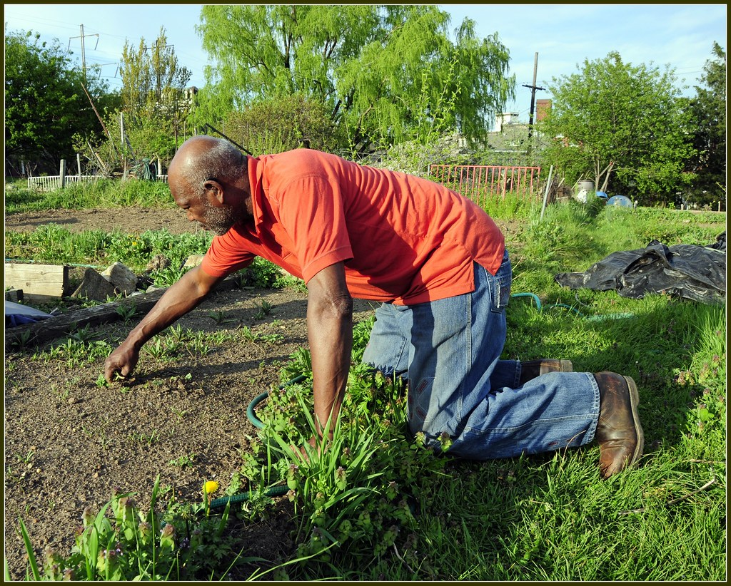
We say together:
A new day has dawned;
Fill us with faith and hope.
What do you see in this photo?
Notes:
Use greeting as call and response as you wish. Encourage responses, someone gardening, planting, weeding or harvesting. Tending the plants.

Slide 2
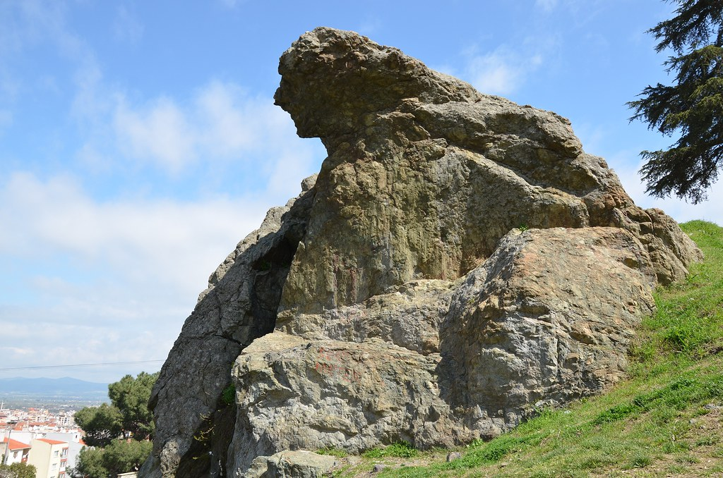
Easter Reflection 2
Mary and Jesus
What do you see in this photo?
Notes:
This rock formation is known locally as Mary watching over the Tomb (It is in South America). Looking at the outline it could be a woman lying on her side and weeping.

Slide 3
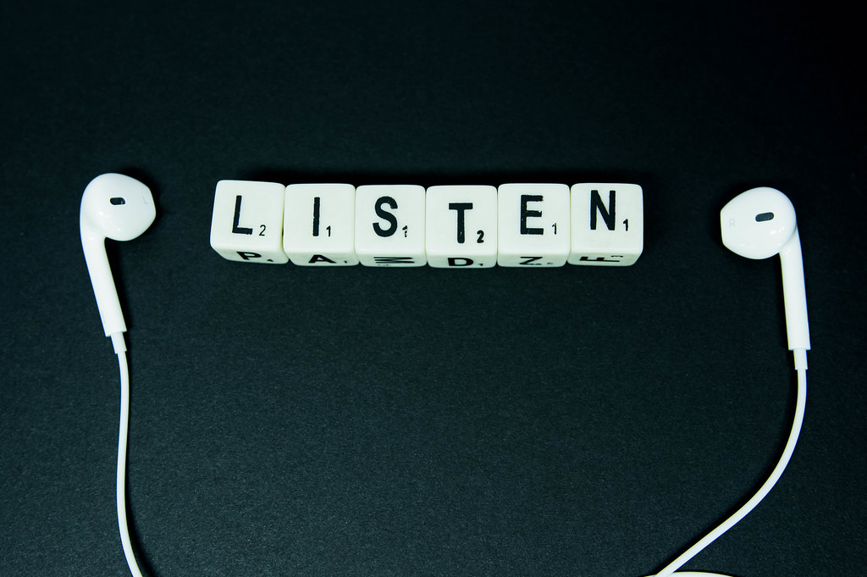
Listen now to the word and wisdom of God
Notes:
Encourage stilling. This image is used in other PPTs to indicate when a Bible reading features.

Slide 4
But Mary stood weeping outside the tomb. As she wept, she bent over to look into the tomb; and saw two angels in white, sitting where the body of Jesus had been lying, one at the head and the other at the feet. They said to her, ‘Woman, why are you weeping?’ She said to them, ‘They have taken away my Lord, and I do not know where they have laid him.’
When she had said this, she turned round and saw Jesus standing there, but she did not know that it was Jesus. Jesus said to her, ‘Woman, why are you weeping? For whom are you looking?’ Supposing him to be the gardener, she said to him, ‘Sir, if you have carried him away, tell me where you have laid him, and I will take him away.’ Jesus said to her, ‘Mary!’ She turned to him and said to him in Hebrew, ‘Rabboni!’ (which means teacher). Jesus said to her,’ Do not hold onto me because I have not yet ascended to the Father.’
John 20 NRSV
Notes:
If possible invite a second voice or more to read the passage aloud, unpacking any unfamiliar language. Invite everyone to say Rabboni. You may find pupils doling this to staff after!

Slide 5
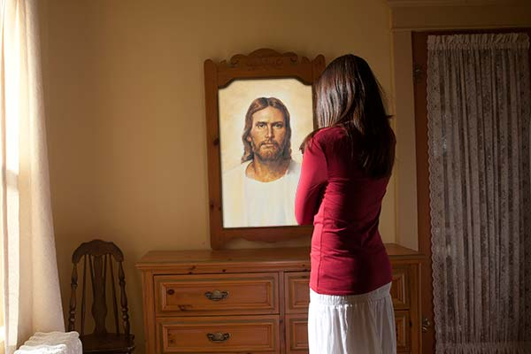
How does the Bible passage link to this picture?
Notes:
Mary does not recognise Jesus, This picture of someone looking in a mirror suggests Jesus sees who we are and we can see him in others as well as ourselves. But we may not recognise the Christ in ourselves or others.

Slide 6

Going deeper
Thinkabouts:
What did Mary think had happened to Jesus’ body?
What word did Jesus say to help Mary see who he was?
What does Jesus mean by ‘ascended’ ?
Let’s wonder:
Why do you think that Mary did not recognise that Jesus stood in front of her?
Notes:
Mary thought the body had been taken away or stolen. Jesus said her name. Ascended may be a new term. Meaning ‘to rise to heaven’.
Let’s wonder – She was not expecting to see him, believing he was gone for good. He may have looked different, been in shadow so hard to see, it may have been very early so still only half light… invite ideas.

Slide 7
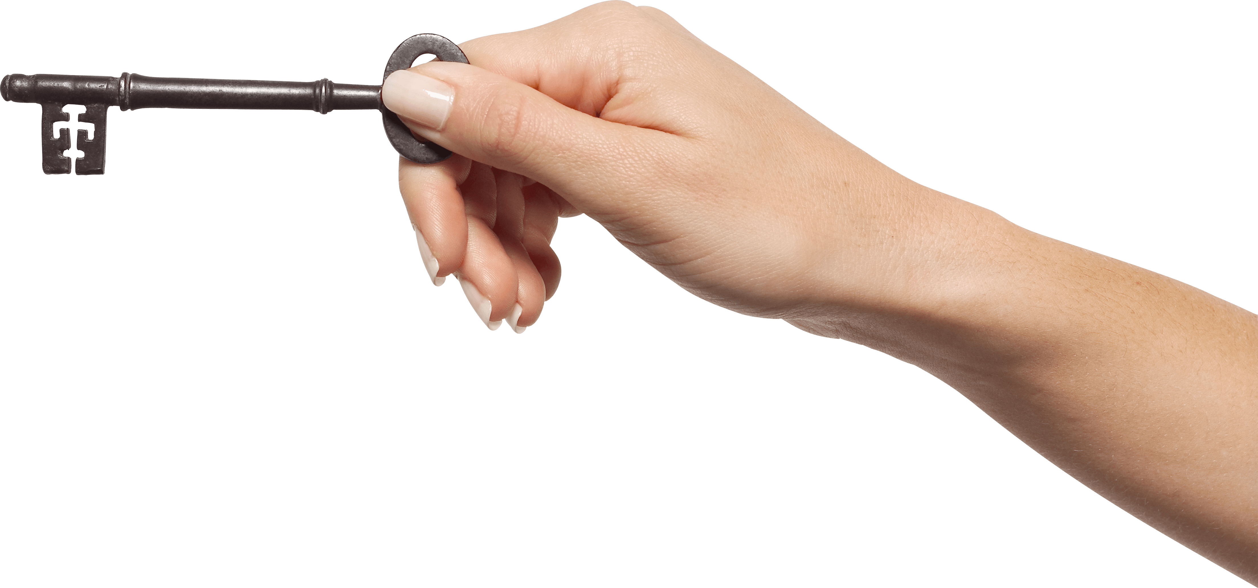
Reflection
Risen Christ,
for whom no door is locked:
open our eyes to see more clearly,
open our hearts that we may know love,
and walk the joyful path of peace.
To the praise of God the Father.
Amen
Notes:
As always, invite those present to join the prayer or listen and reflect as they choose.

Slide 8
We say together:
A new day has dawned;
fill us with faith and hope.
Notes:
Sending out, perhaps suggesting how a gardener is like Christ – nurturing, growing in faith, trusting in the wonder of the world.

