Slide 1
May God our Father give us grace and peace
Notes:
Greeting Slide

Slide 2
Letters from long ago…
Some words from a letter that John wrote to some of the first Christians.
Notes:
Opening slide Remind the participants that these sessions are about letters that were written by the first Christians. We are reading them (from the Bible) because they are very important to Christians.

Slide 3
This is how we know what love is: Christ gave his life for us. We too, then, ought to give our lives for others! If we are rich and see others in need, yet close our hearts against them, how can we claim that we love God? My children, our love should not be just words and talk; it must be true love, which shows itself in action.
1 John 3:16-18
Notes:
Bible Reading

Slide 4
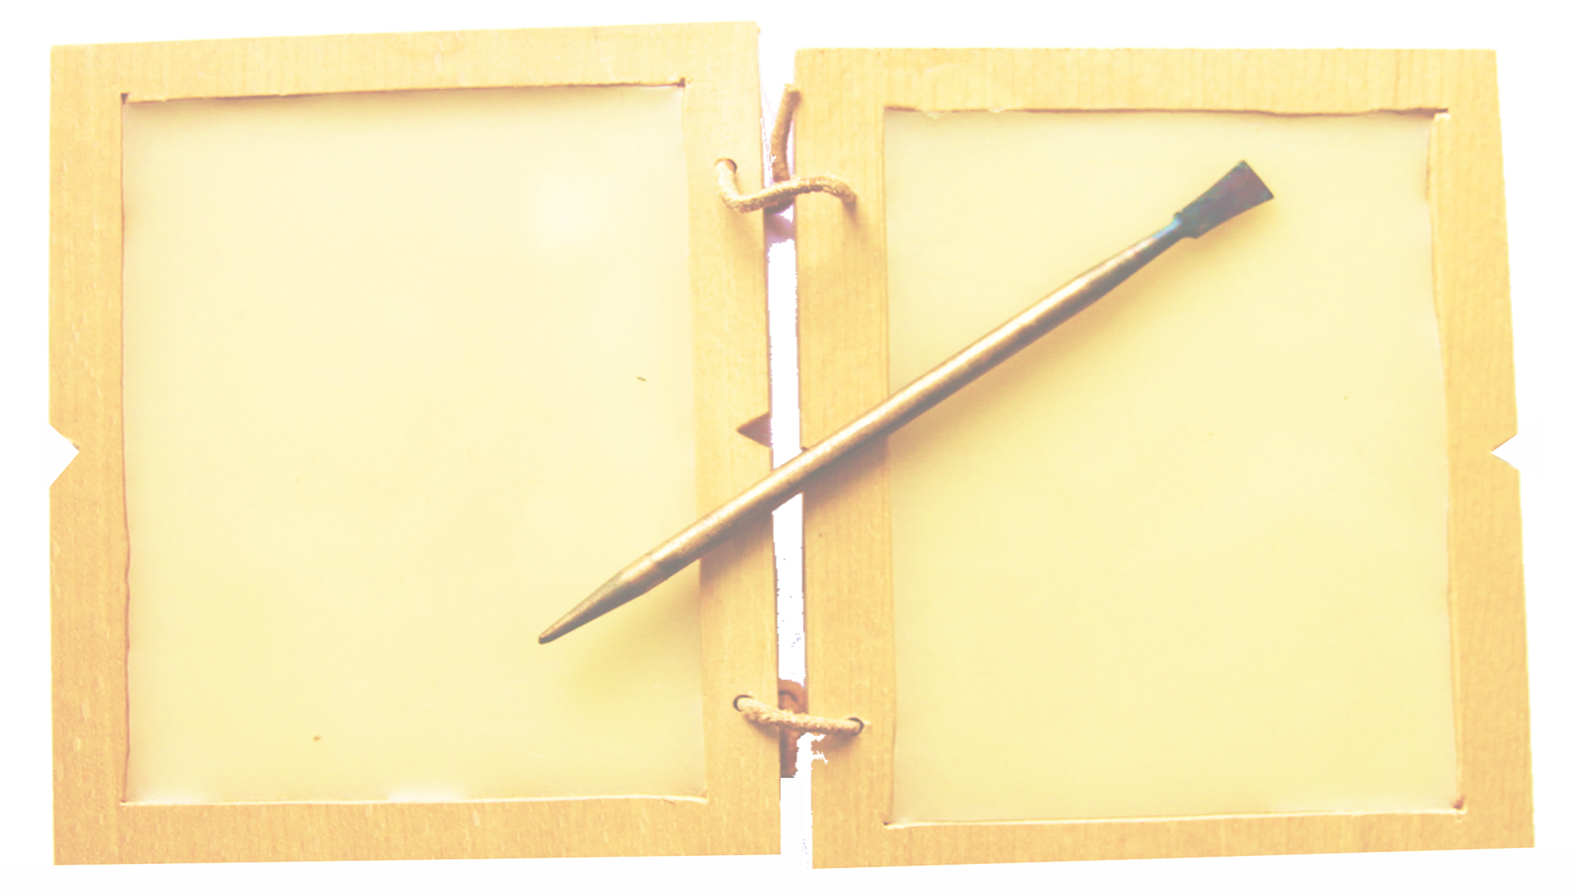
Thinkabouts:
What did the reading make us think?
Were there any words that were difficult to understand?
Notes:
Reflect on the reading
What were children’s responses?
You may choose to record the responses in some way.

Slide 5
Let’s look at some pictures…
Notes:
Introduction – you could say that the reading seemed to say a lot about love so we are going to look at some pictures.
The PowerPoint shows the pictures twice. The first pass is meant to be quite quick and the second run through should allow for comments.
You may feel that there are too many pictures. Feel free to skip over or delete one or two if you think that this is the case – remember to delete them from the first and second look!

Slide 7
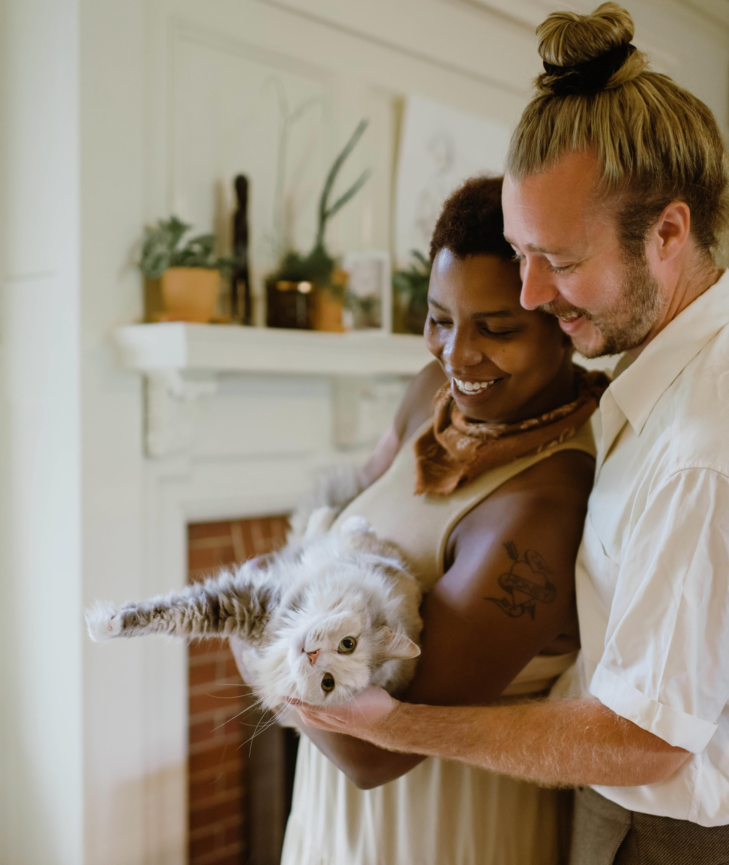

Slide 8
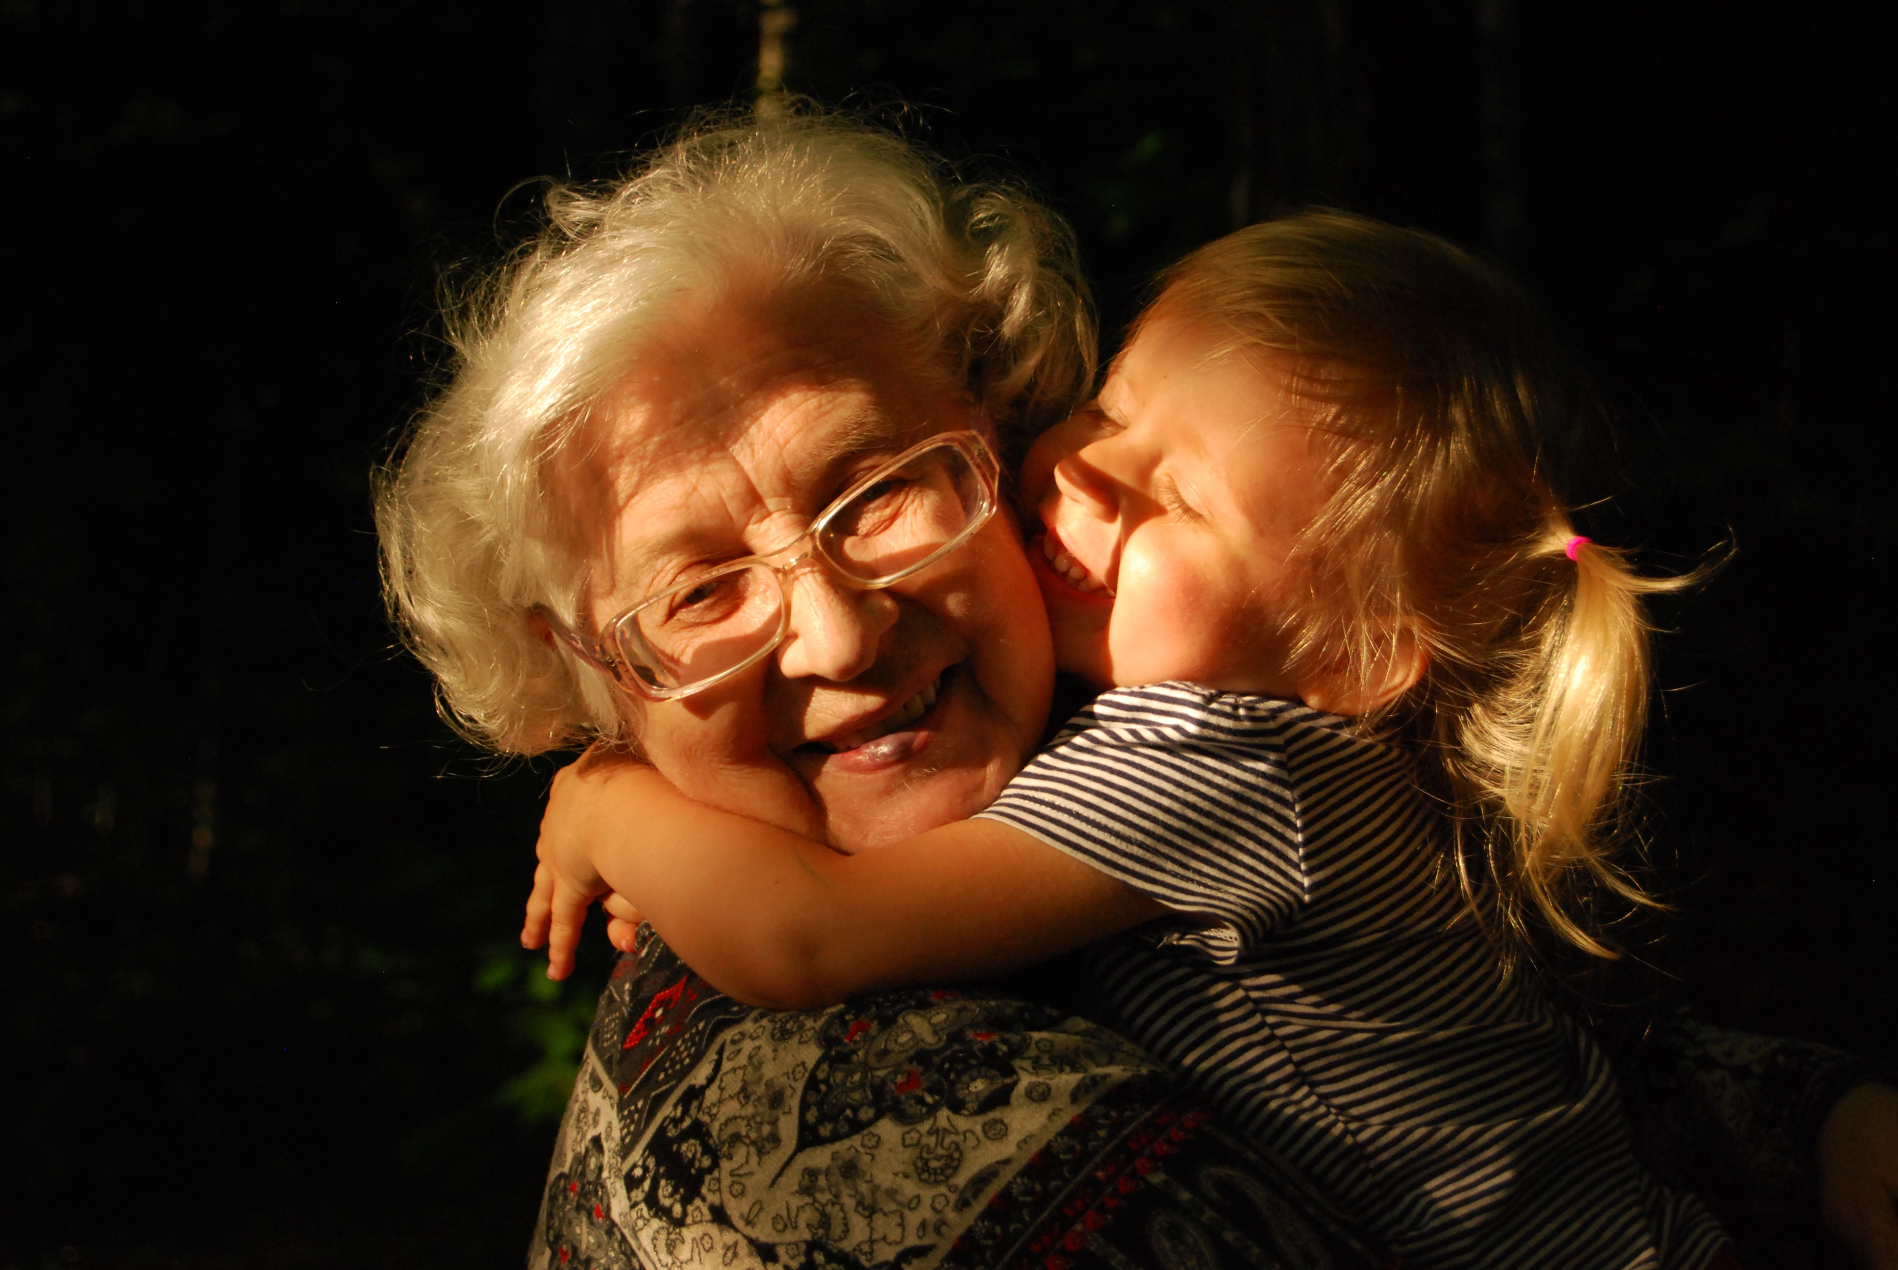

Slide 9
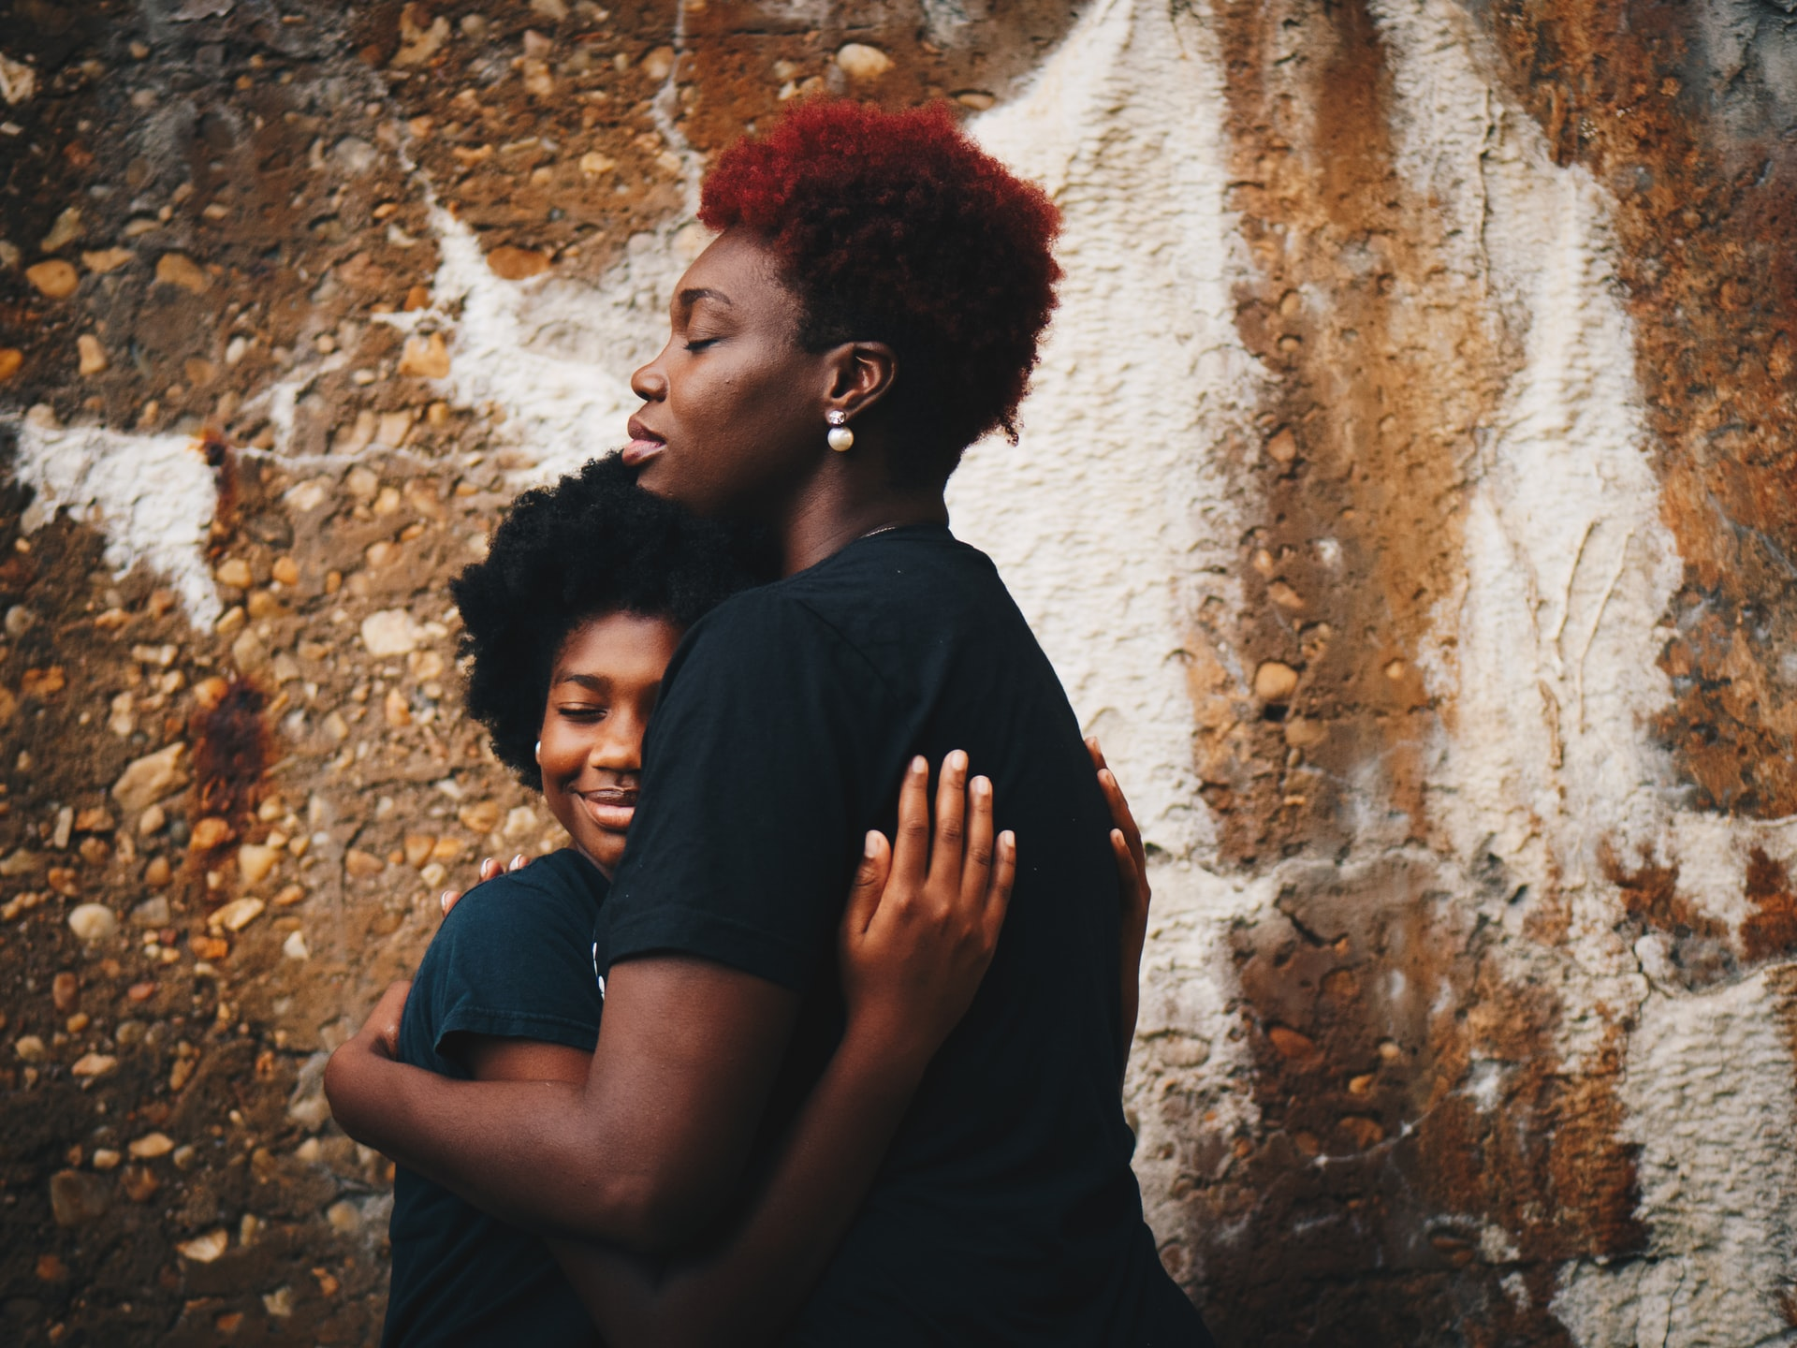

Slide 10
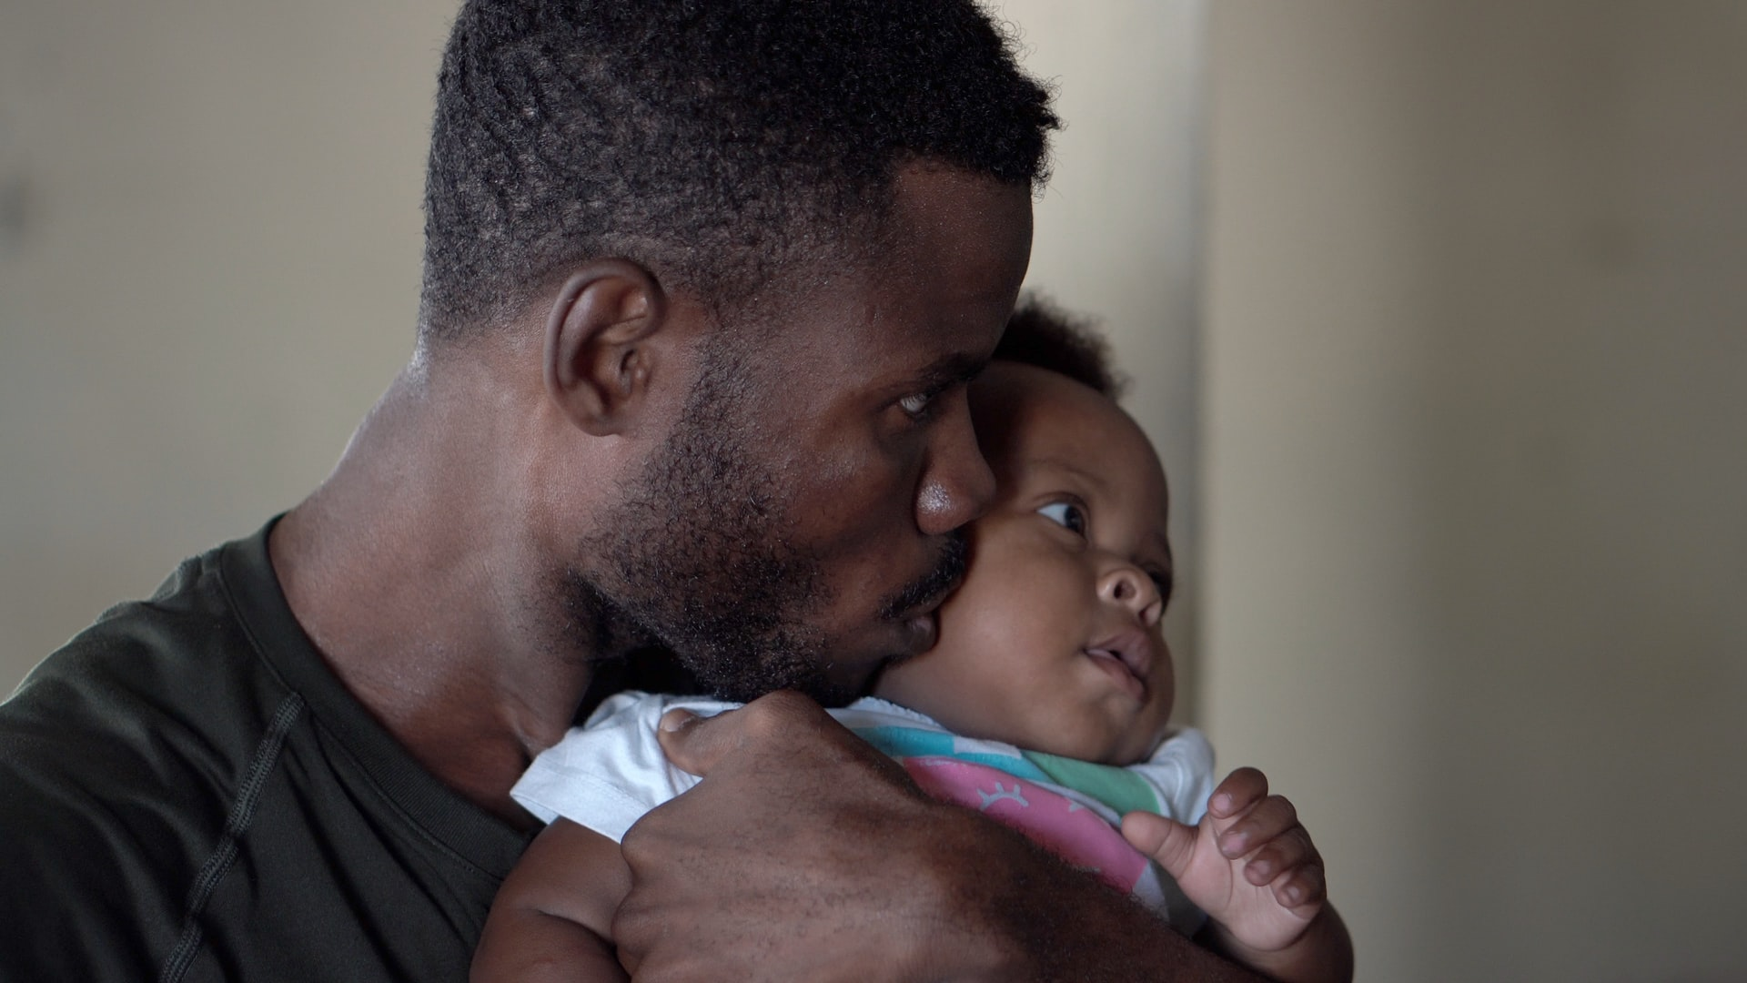

Slide 11
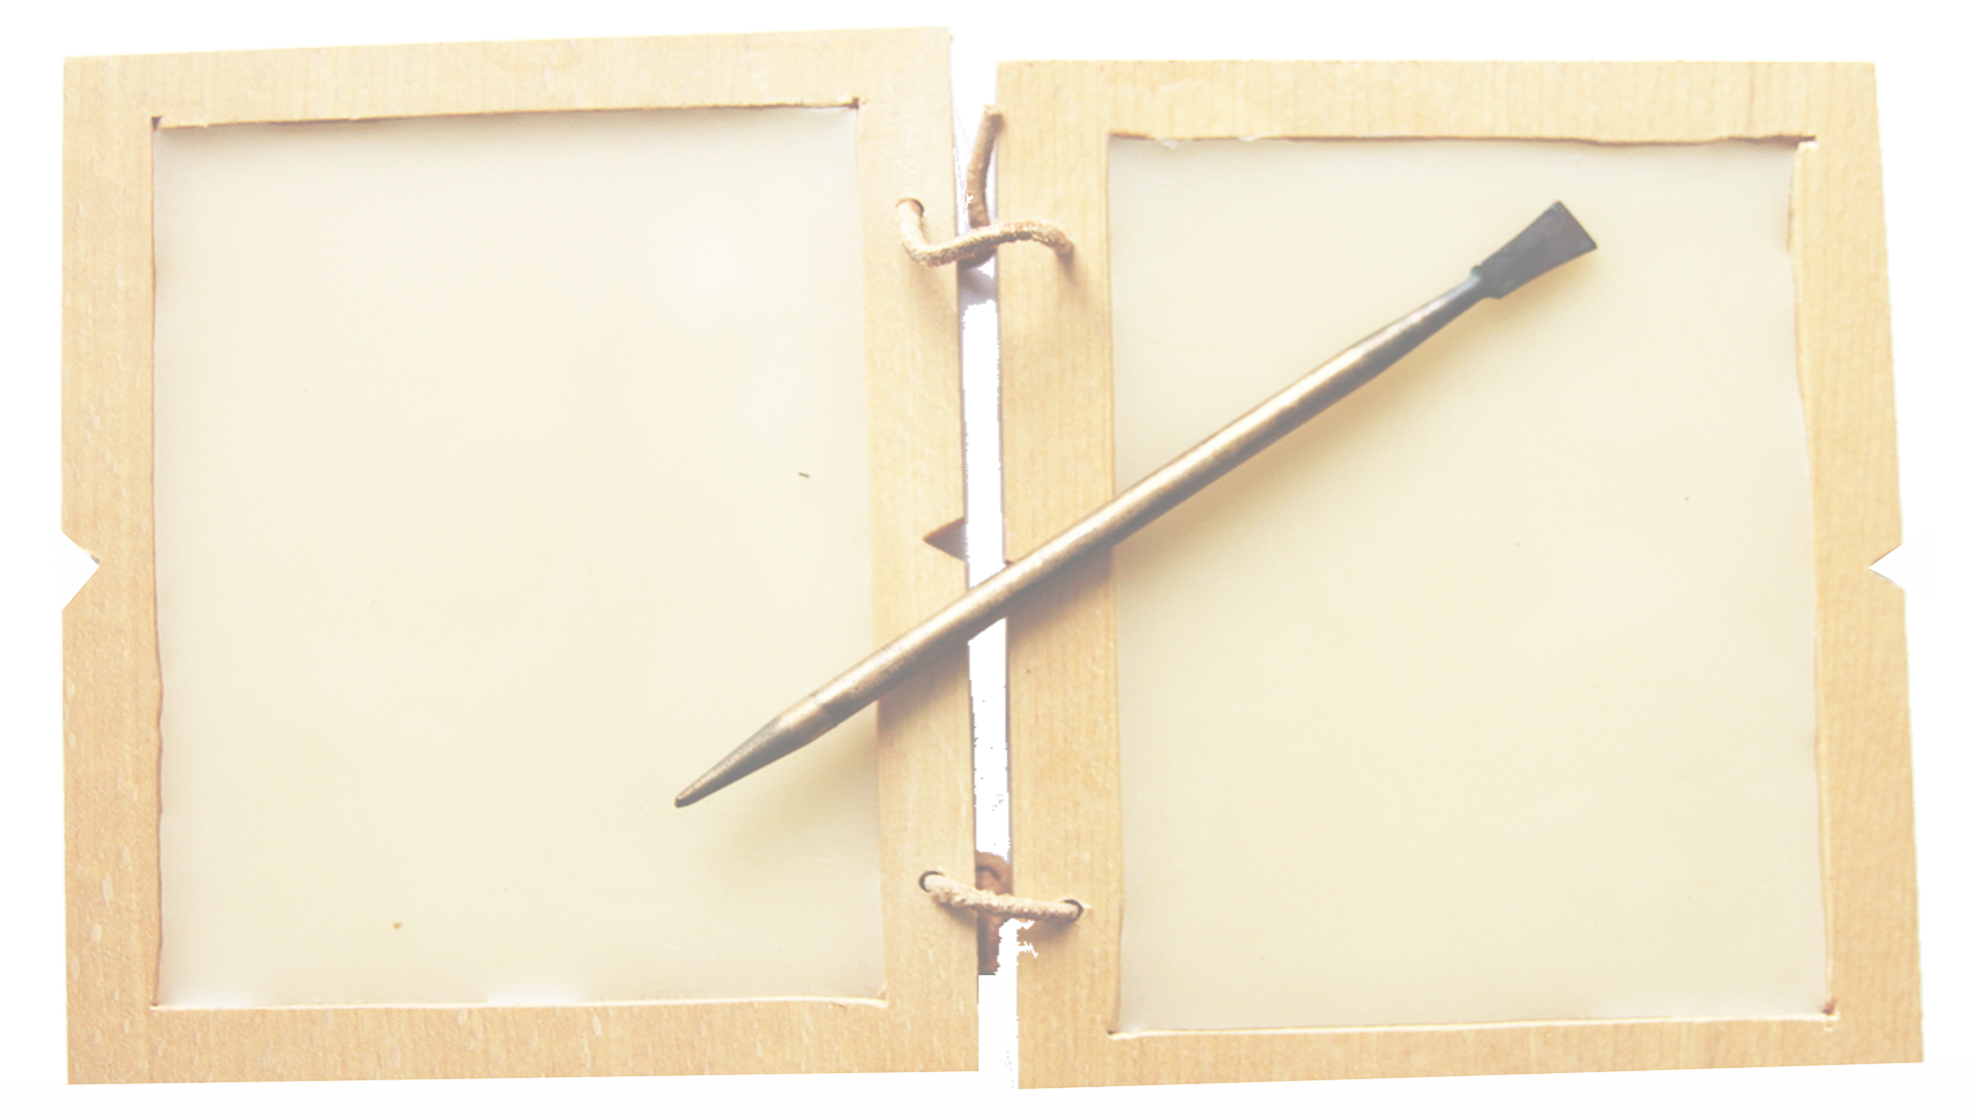
Wonderings:
John writes about love in his letter.
How was love shown in the pictures?
Let’s look again…
Notes:
Look again through the pictures –
Ask the children to respond to the pictures
Spend as long on the slides as you feel appropriate

Slide 17
Lord of love,
We know that there are many ways to show love to each other.
Help us to learn what the best ways are for us to show love in our school in our families and in our friendships.
Amen
Prayer
Notes:
The prayer picks up some ideas about love – you may wish to link these to the things that the children have offered.
Children could create their own prayers.

Slide 18
The grace of the Lord Jesus Christ, the love of God, and the fellowship of the Holy Spirit be with us all
Notes:
Closing slide

