Slide 1
May God our Father give us grace and peace
Notes:
Simple greeting
The sequence does not include a song you might include one at a place you feel appropriate.

Slide 2
Letters from long ago…
Some words from John
Notes:
Intro slide.
Some words of introduction might be helpful:
The writer of the letter purports to be John the writer of the 4th Gospel. There are some good reasons why this might well be the case, some of the language is similar to that in the gospel.

Slide 3
My friends, what good is it for one of you to say that you have faith if your actions do not prove it? Can that faith save you? Suppose there are brothers or sisters who need clothes and don't have enough to eat. What good is there in your saying to them, “God bless you! Keep warm and eat well!”—if you don't give them the necessities of life? So it is with faith: if it is alone and includes no actions, then it is dead.
James 2:14-17
Notes:
You may read this to the children – or get a child to read it.

Slide 4
What did the reading make us think?
Were there any words that were difficult to understand?

Slide 5
Thinkabouts:
One of the things that James writes about is action..
What sorts of action do you think that James means?
Let’s look again
Notes:
Allow the children to suggest ideas.
Move on to the next slide – it shows the reading again

Slide 6
My friends, what good is it for one of you to say that you have faith if your actions do not prove it? Can that faith save you? Suppose there are brothers or sisters who need clothes and don't have enough to eat. What good is there in your saying to them, “God bless you! Keep warm and eat well!”—if you don't give them the necessities of life? So it is with faith: if it is alone and includes no actions, then it is dead.
James 2:14-17
Notes:
Reading again

Slide 7
Wonderings:
What sorts of actions do people of faith take today?
Lets look at some of the things that people do.
Notes:
These wonderings link to the next three slides.
There are three different examples of social action one each from a Christian, Muslim and Sikh charity.
Encourage the children to find differences and similarities between the values and reasons in the slides. You might record these thoughts and ideas in some way.
The slides are quite ‘wordy’ because they are taken from the websites of the organisations. If you are concerned about this you might choose to use only the bold text on each slide.
The slides are only meant to be illustrations of how different faiths work, in very similar ways, to support people in need. These are not the only examples, older pupils might like to see if they can find out more about how faith groups carry out charitable work.

Slide 8
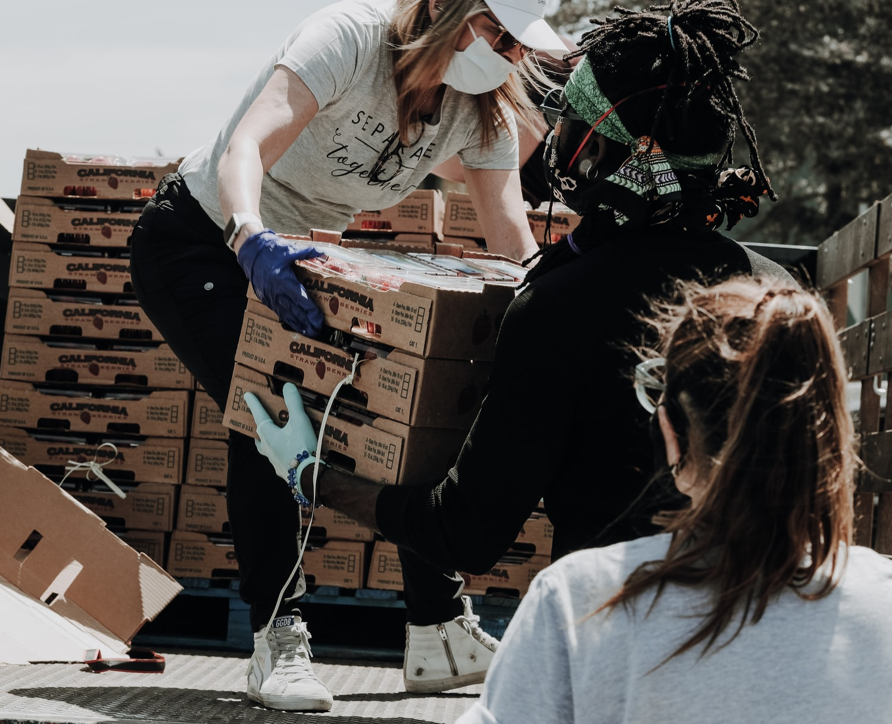
Our vision is to see people freed from poverty, living transformed lives, and fulfilling their God-given potential.
Meeting emergency needs: We respond quickly to meet needs in crises and disasters.
Mobilising churches: We empower and equip churches to help the development and transformation of communities.
Transforming communities: We support communities to become resilient and work for a better future for themselves and others.
Changing society: We Influence and change systems and policies so that the poorest communities can get what they need to thrive.
We seek to be Christ-centred, compassionate, courageous, truthful and servant-hearted in everything we do.
Notes:
Tear fund The Evangelical Alliance Relief Fund – a Christian Charity

Slide 9
At Muslim Charity, we want every child to be able to enjoy being just that, a child.
We want to protect those most vulnerable and give them a chance to thrive in a safe environment. With your help, we can provide shelter, education and a loving home and equip them with the skills and knowledge to better not only their lives but their communities too.
Working in some of the harshest environments you can imagine, we have been able to rescue thousands of children from the street where abuse and exploitation was all they have known.
We understand that every country and community is different and our projects are designed to synchronize with the society norms, culture and government policies.
Notes:
Muslim Charity

Slide 10
Sikh Welfare & Awareness Team
We are a charitable organisation based in West London.
“We have a vision where every person we meet knows they are loved and valued, lives safely, with respect, faith, hope and care for themselves and others, achieving their full potential and positively contributing to and transforming their communities”.
We work on the ethos of Guru Nanak Dev Ji’s teachings who was the first Guru of the Sikhs of:
Naam Japna, remembering God.
Kirat Karni, earning an honest living.
Vand Kay Shako; selflessly serving others, sharing income and resources
Notes:
Sikh charity
"Nishkam" refers to an action for which one has no desire for reward of any sort.

Slide 11
Lord,
We know that it is not enough just to say good words but also to do things to help people in need.
Guide us to choose the right things to do so that our good words will come to life.
Amen
Prayer
Notes:
The prayer sums up the wonderings and the themes from the reading. You could use a different prayer or encourage children to create a prayer for themselves.

Slide 12
Peace be to our whole community, and love with faith, from God
Notes:
Closing – adapted from Paul’s letter to the Ephesians 6:23

