Slide 1
May God our Father give us grace and peace
Notes:
Greeting Slide

Slide 2
Letters from long ago…
Some words from Peter
Notes:
Introduction:
This Collective Worship focuses on Peter’s 2nd letter. He writes about something that happened when he was with Jesus and the other disciples.

Slide 3
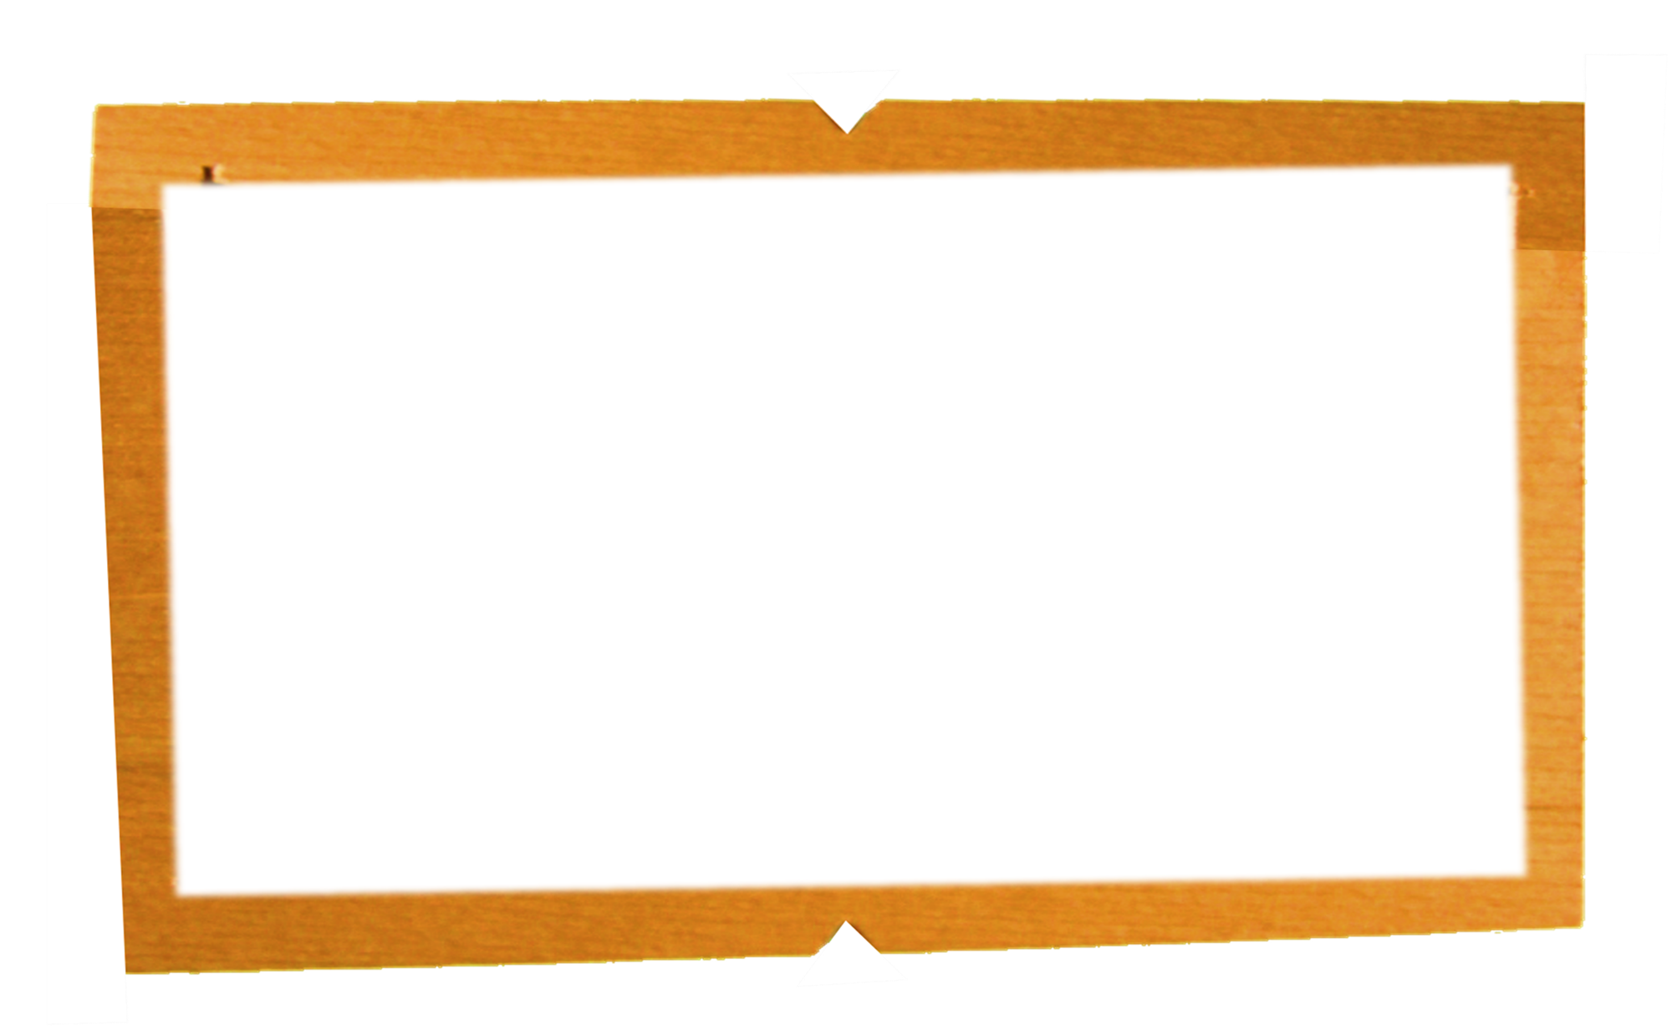
We have not depended on made-up stories in making known to you the mighty coming of our Lord Jesus Christ. With our own eyes we saw his greatness. We were there when he was given honour and glory by God the Father, when the voice came to him from the Supreme Glory, saying, “This is my own dear Son, with whom I am pleased!” We ourselves heard this voice coming from heaven, when we were with him on the holy mountain. 2 Peter 1: 16-18
Notes:
Bible Reading

Slide 4
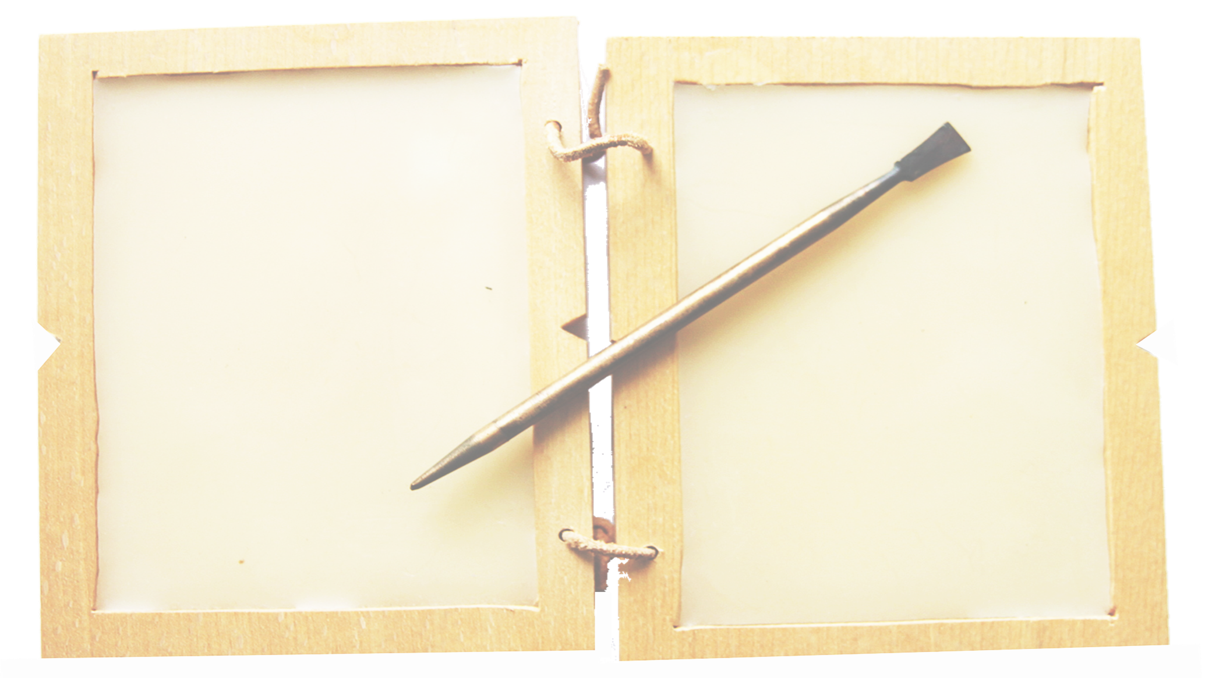
Thinkabouts
What did the reading make us think?
Were there any words that were difficult to understand?
Notes:
Encourage children to come up with any ideas that they may have. There might be suggestions as to which story Peter means. Don’t at this point affirm any suggestions if they are made.

Slide 5
Peter mentions one of the stories about Jesus …
There are two possibilities let’s look at them both
Do you know which one?
Notes:
Again – pupils may be able to guess which story Peter is referring to but simply keep any suggestion as a possibility.

Slide 6
At that time Jesus arrived from Galilee and came to John at the Jordan to be baptized by him… As soon as Jesus was baptized, he came up out of the water. Then heaven was opened to him, and he saw the Spirit of God coming down like a dove and lighting on him. Then a voice said from heaven, “This is my own dear Son, with whom I am pleased.” Matthew 2: 13 - 17
Notes:
The Baptism of Jesus – where the words quoted by Peter are heard.
The next two slides have artistic expressions of the story

Slide 7
Notes:
The baptism of Jesus from a Chinese plate. The Holy Spirit (the dove) does not have a jet engine, the artist is showing light shining down!
The baptism is a significant event in Christian calendars across the world – just as much as Christmas.

Slide 8
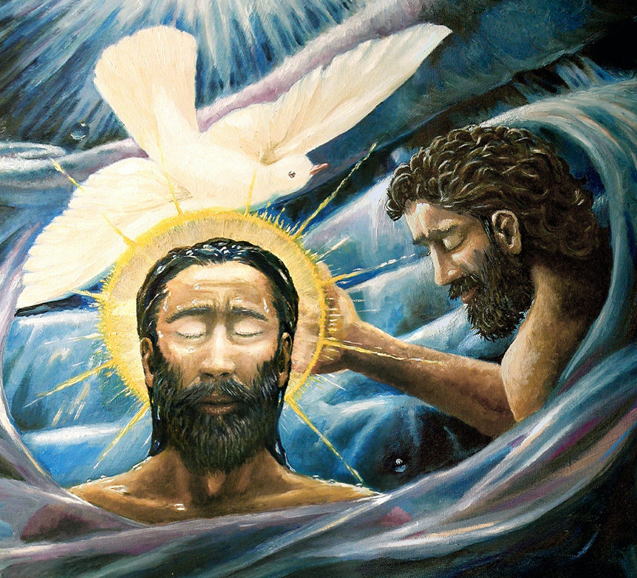
Notes:
A modern interpretation of the Baptism story. There is a gentle intimacy about the figures – all the power is in the water which envelops both Jesus and John the Baptist. The light shines from Jesus’ halo and from heaven and the two seem to be linked by the dove.

Slide 9
Jesus took with him Peter and the brothers James and John and led them up a high mountain where they were alone. As they looked on, a change came over Jesus: his face was shining like the sun, and his clothes were dazzling white. Then the three disciples saw Moses and Elijah talking with Jesus. So Peter spoke up and said to Jesus, “Lord, how good it is that we are here! If you wish, I will make three tents here, one for you, one for Moses, and one for Elijah.”
While he was talking, a shining cloud came over them, and a voice from the cloud said, “This is my own dear Son, with whom I am pleased—listen to him!” Matthew 17: 1-5
Notes:
This is the ‘Transfiguration’ from Matthew’s Gospel. Agin the words from heaven – but the giveaway is that this story is on a mountain. An essential clue from Peter’s letter.

Slide 10
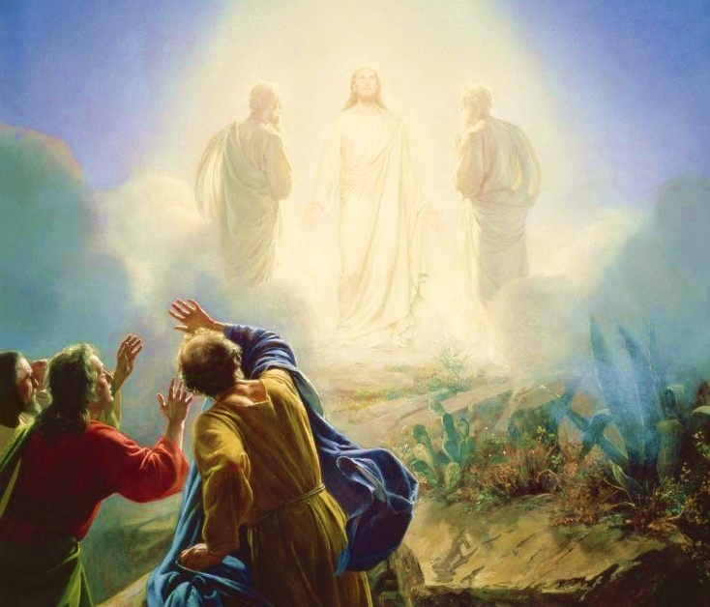
Notes:
A fairly traditional picture of the Transfiguration. Peter, James and John are shielding their eyes while Jesus, Moses and Elijah stand in the transfigured light.

Slide 11
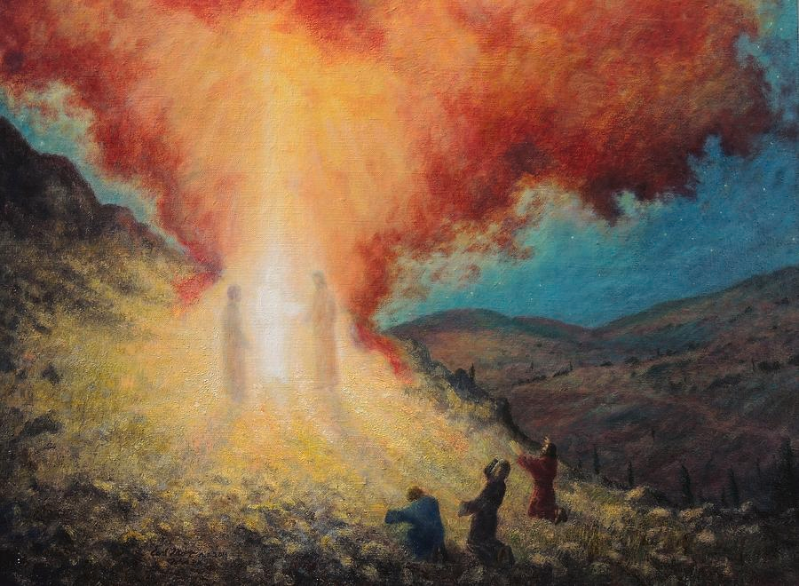
Notes:
This is a more modern interpretation of the Transfiguration. Again Peter, John and James are clearly astounded but are they just shielding their eyes here or do they look like they are worshipping?
The figure of Jesus looks a little like a volcanic eruption, the white light shoots upward into the blazing cloud.
Which picture do the pupils feel is the better interpretation?

Slide 12
Wonderings:
Which story do you think that Peter is remembering?
Which story would you remember best?
Why?
Notes:
For the question ‘Which story do you think that Peter is remembering?’ the participants need to use all the evidence, not just the word from Heaven. It must be the second story because Peter mentions that it happens on a mountain – not in a river.
For the question ‘Which story would you remember best?’ encourage the children to put themselves in the disciples’ place. These questions would work very well using a hotseat technique. A child could be ‘Peter’, they would need to have a chance to prepare beforehand.

Slide 13
Our Father in heaven,
hallowed be your name,
your kingdom come,
your will be done,
on earth as in heaven.
Give us today our daily bread.
Forgive us our sins
as we forgive those who sin against us.
Lead us not into temptation
but deliver us from evil.
For the kingdom, the power,
and the glory are yours
now and for ever.
Amen.
Prayer
Notes:
Today’s prayer is the Lord’s Prayer – one that he shared with the disciples.

Slide 14
Grace be with all of us

