Slide 1
May God our Father give us grace and peace

Slide 2
Letters from long ago…
Some words from a letter that Paul, one of Jesus’ followers wrote to Christians in a town called Corinth.
Notes:
Intro slide.
Remind the pupils that these sessions are all related to letters written to the first Christian Churches.

Slide 3
… all of us, have been baptized into the one body by the same Spirit …
For the body itself is not made up … of many parts. If the foot were to say, “Because I am not a hand, I don't belong to the body,” that would not keep it from being a part of the body. And if the ear were to say, “Because I am not an eye, I don't belong to the body,” that would not keep it from being a part of the body. If the whole body were just an eye, how could it hear? And if it were only an ear, how could it smell? from 1 Corinthians 12:13-18
Notes:
Paul was writing to a church where there were arguments about who belonged and who didn’t and about who was the most important (and more). He uses the analogy of the body to point out that this is not a sensible way to think about a church, or indeed any community, we all have our parts to play and each part is needed.

Slide 4
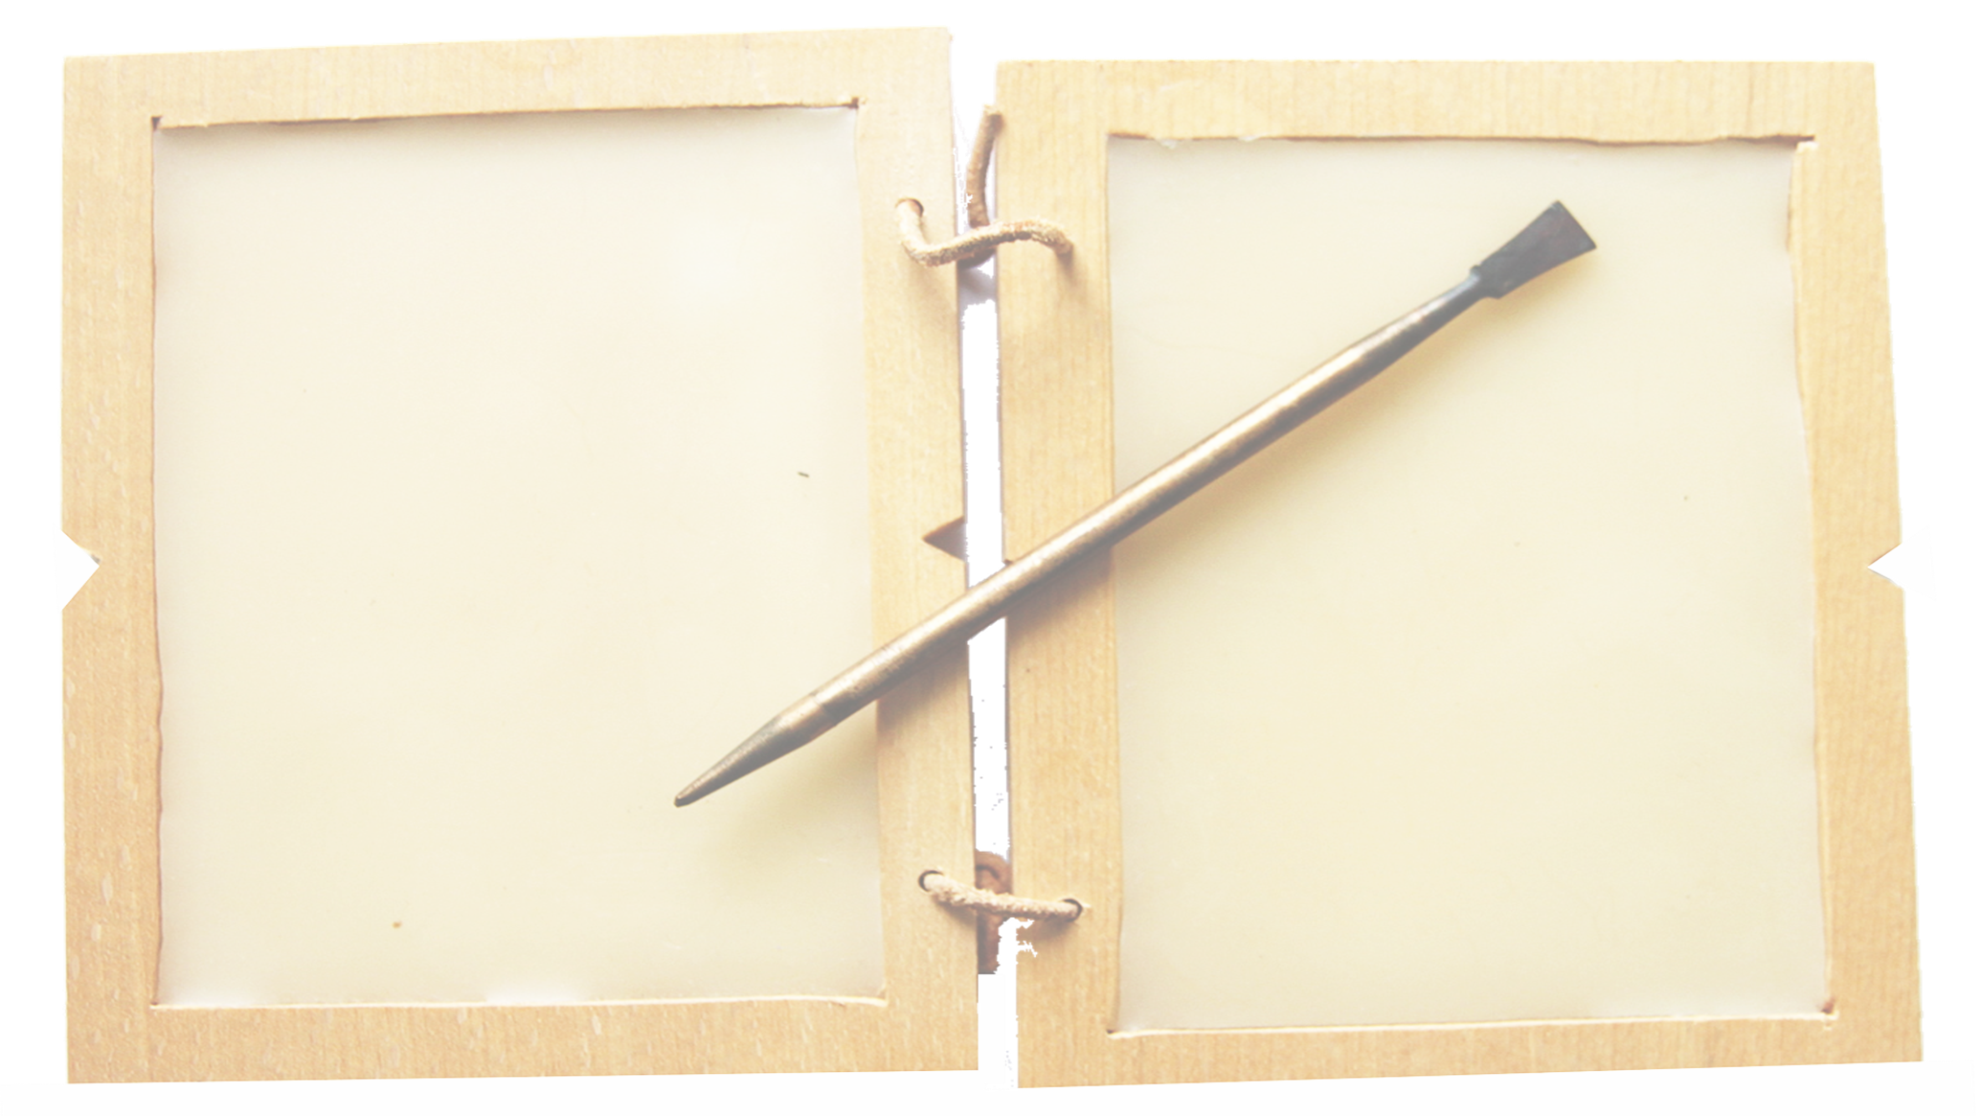
What did the reading make us think?
Were there any words that were difficult to understand?
Notes:
Prompt any immediate responses from pupils

Slide 5
Do you think that Paul is really writing about bodies?
Here are some pictures to help you think
Notes:
You may need to refer back to the reading slide here.
The picture slides just go through quite quickly – you might prompt children to suggest which part of the body they represent – there is some ambiguity, there is no ‘right’ answer.

Slide 6
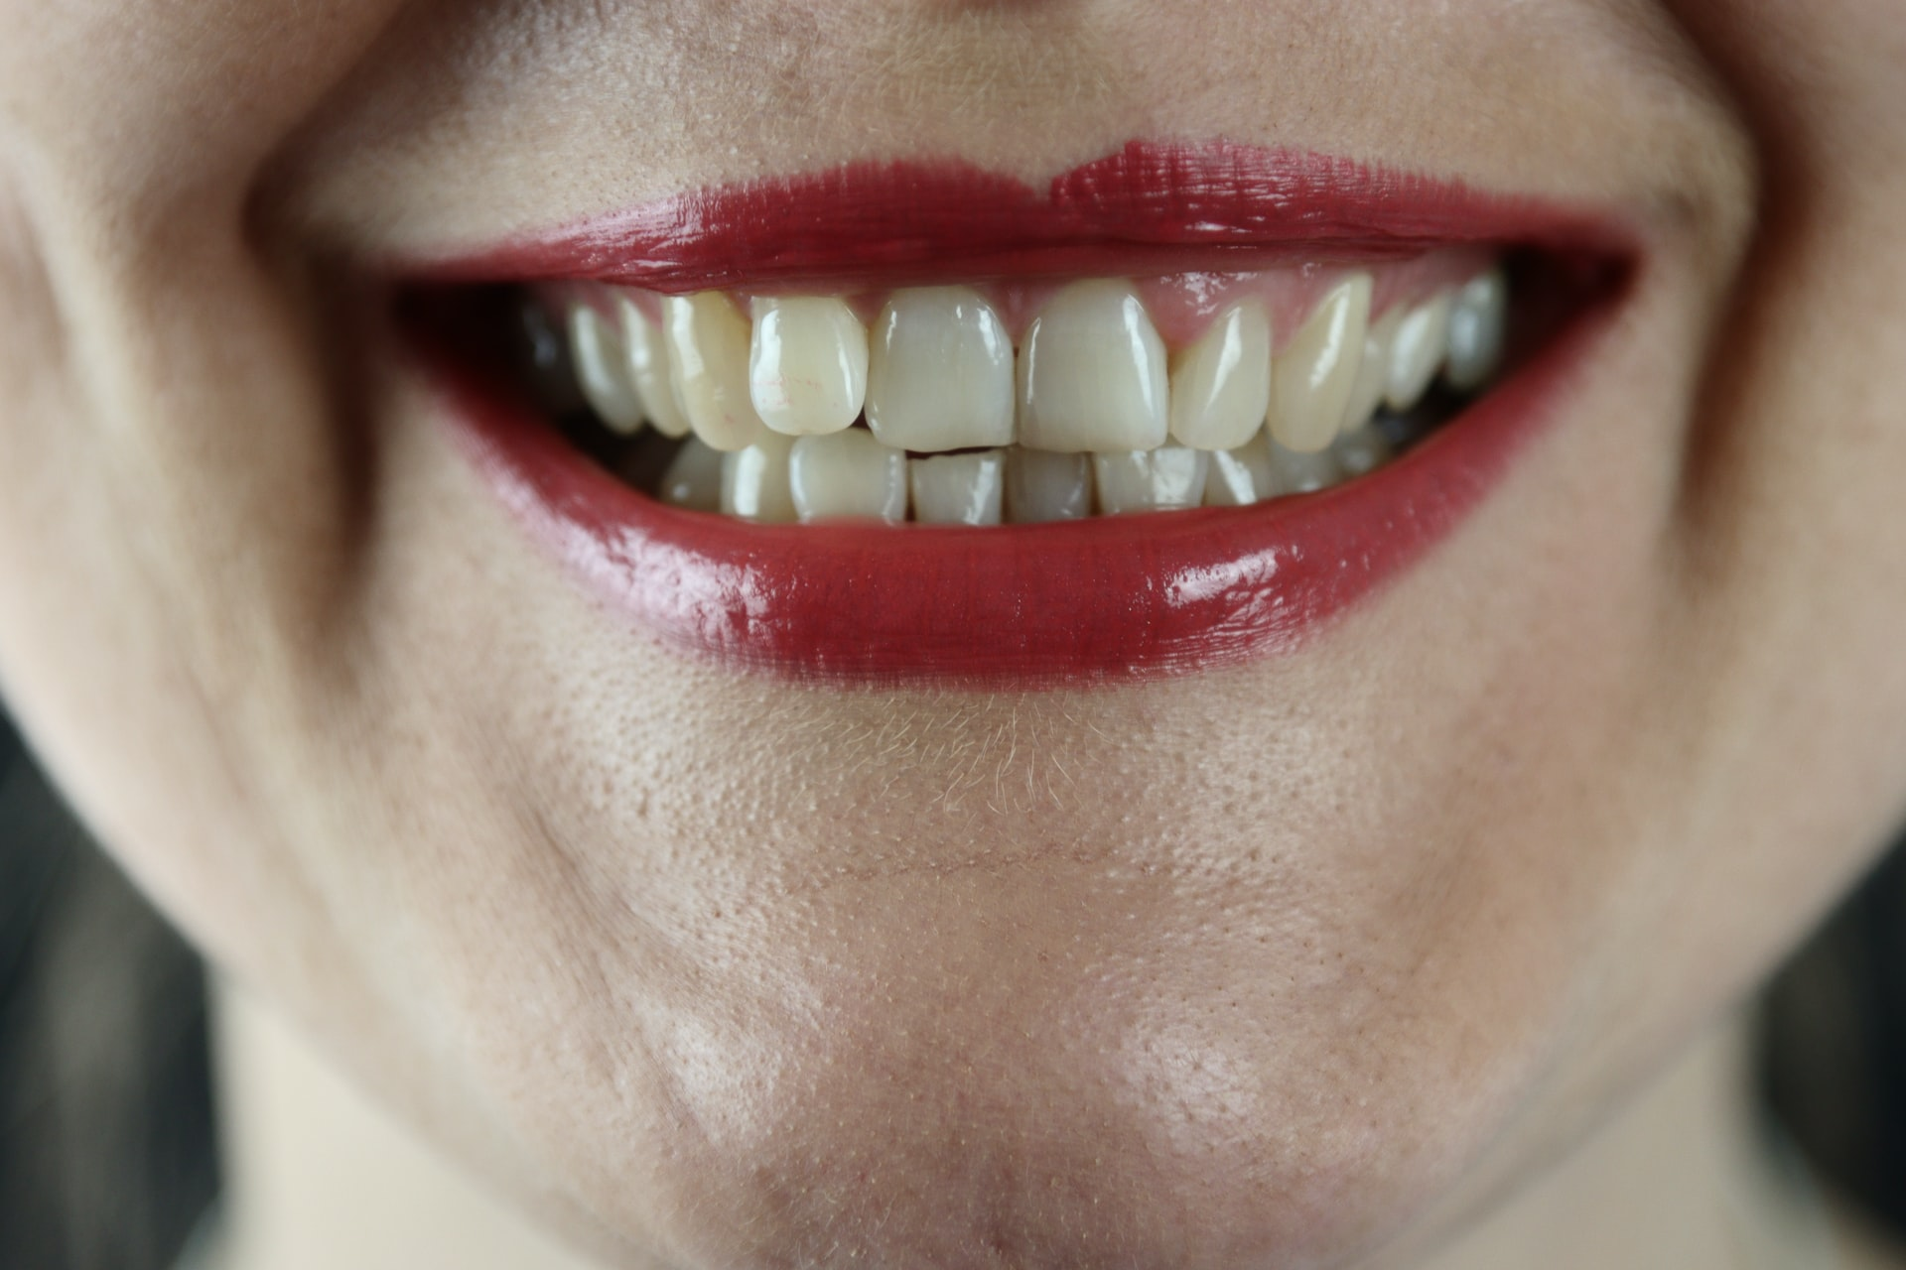

Slide 7
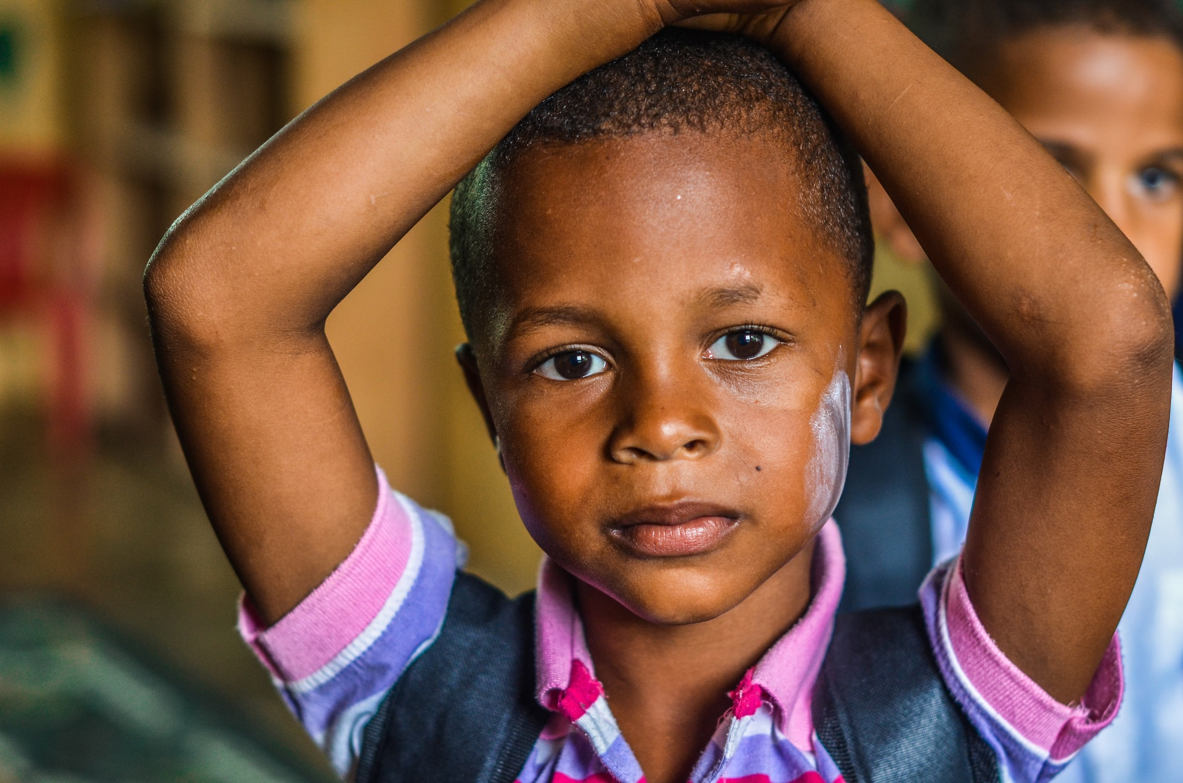

Slide 8
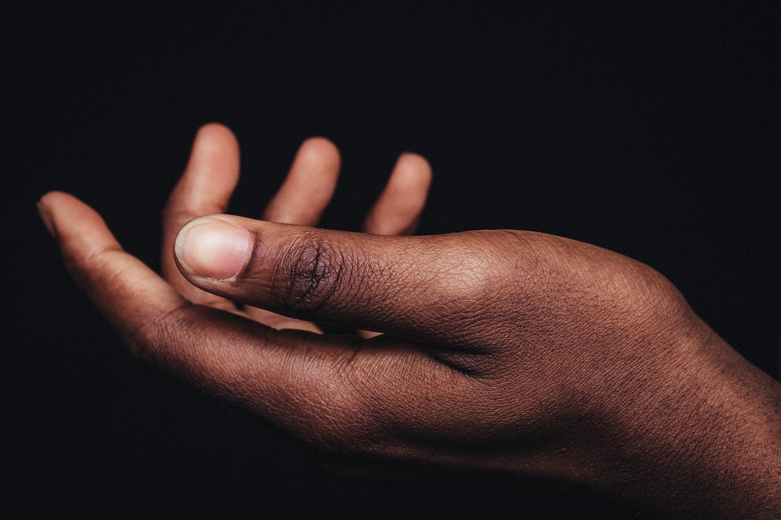

Slide 9
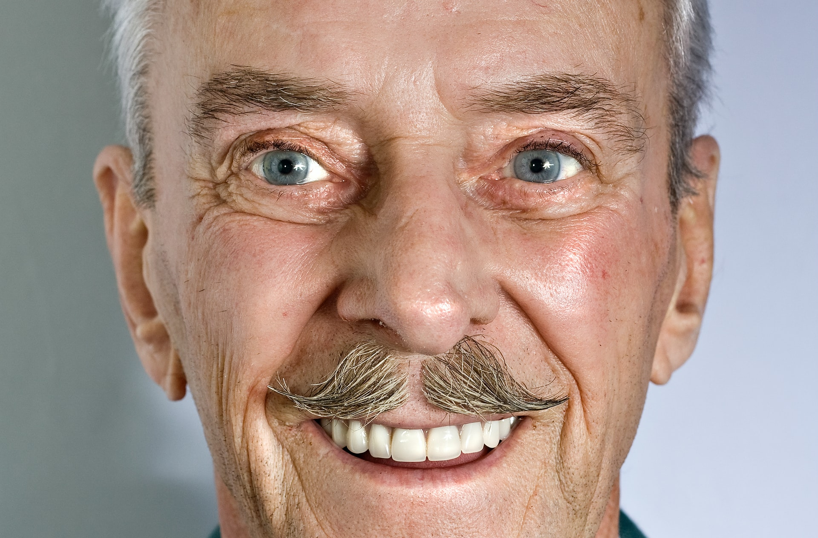

Slide 10
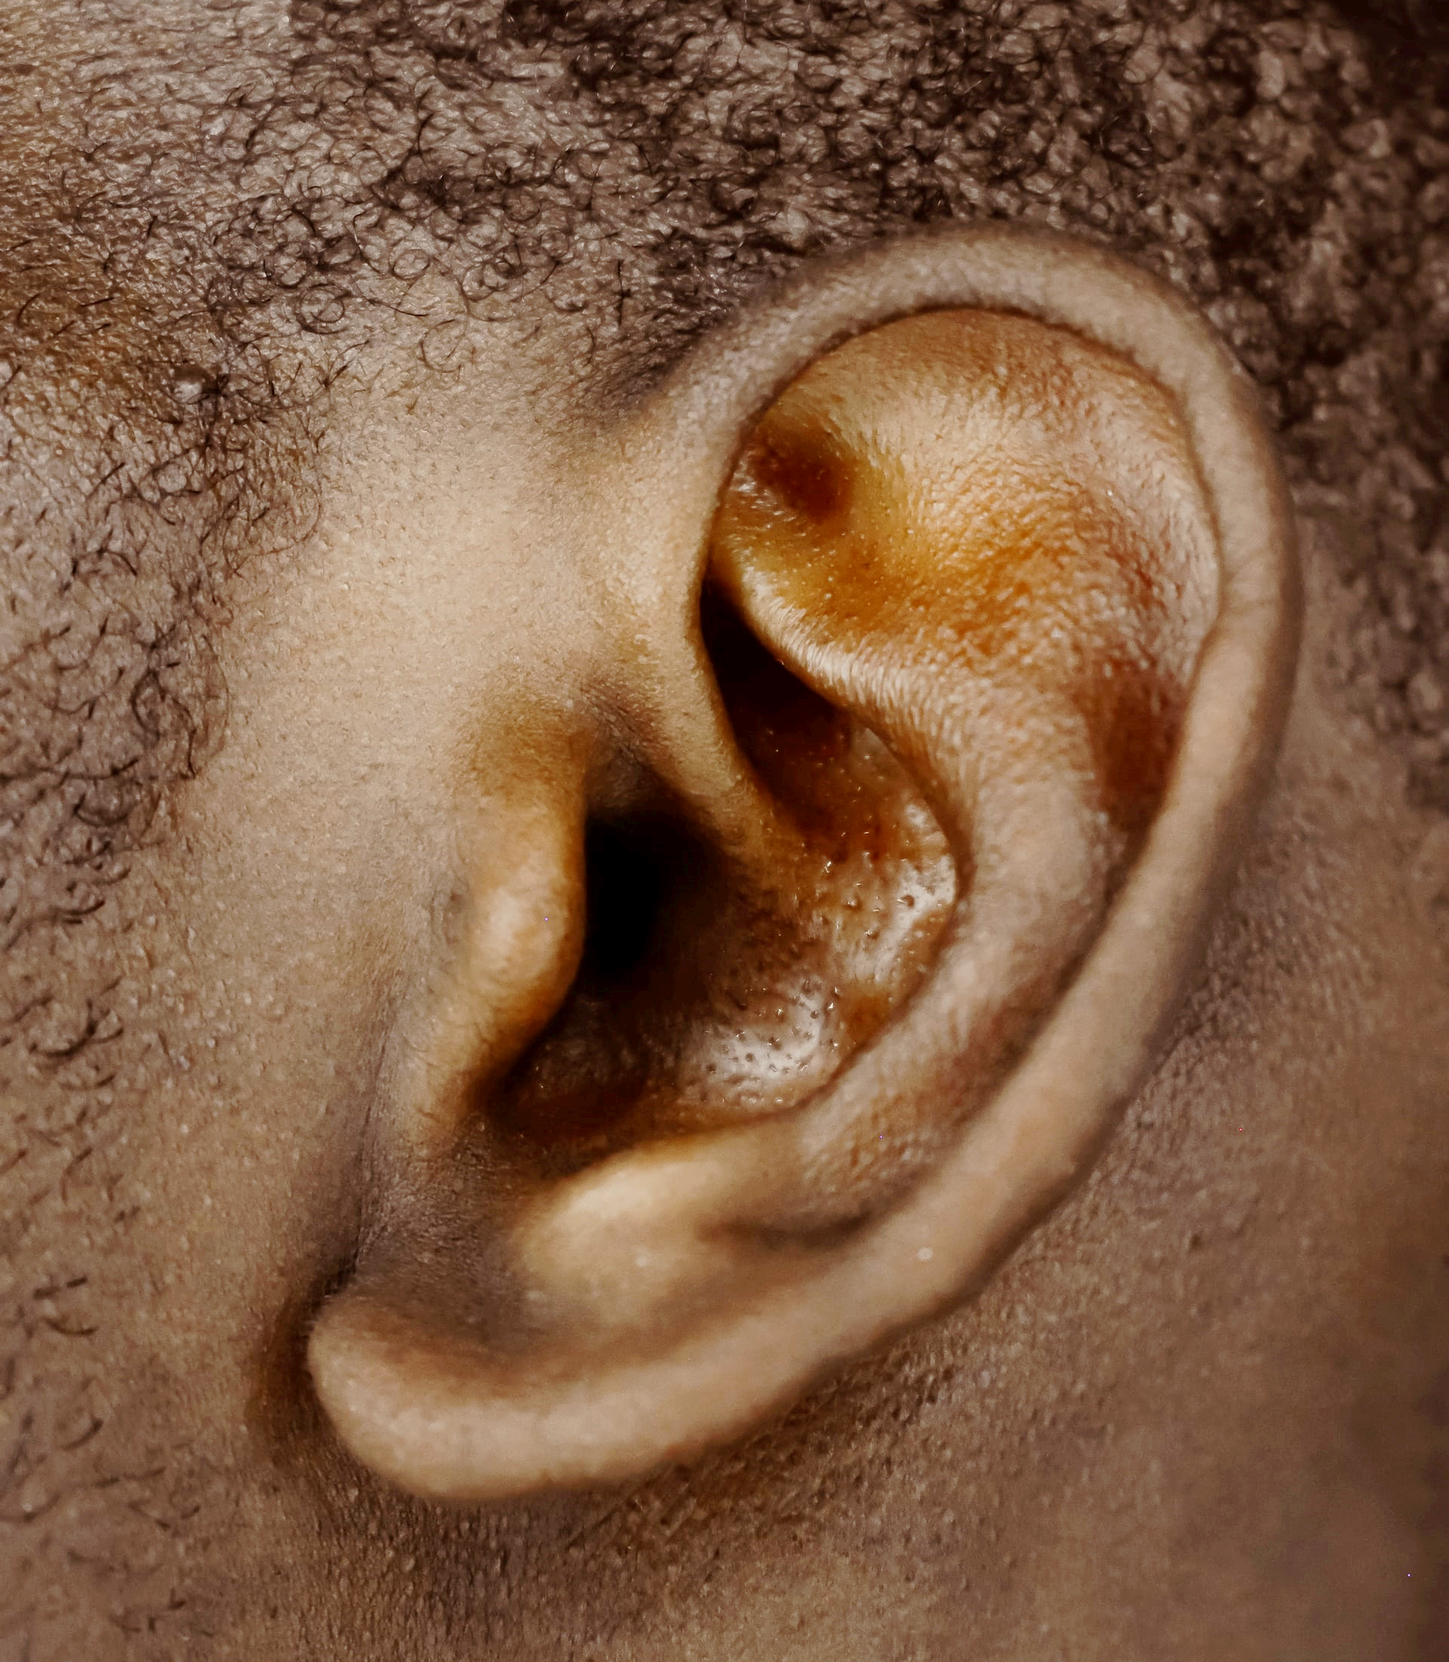

Slide 11
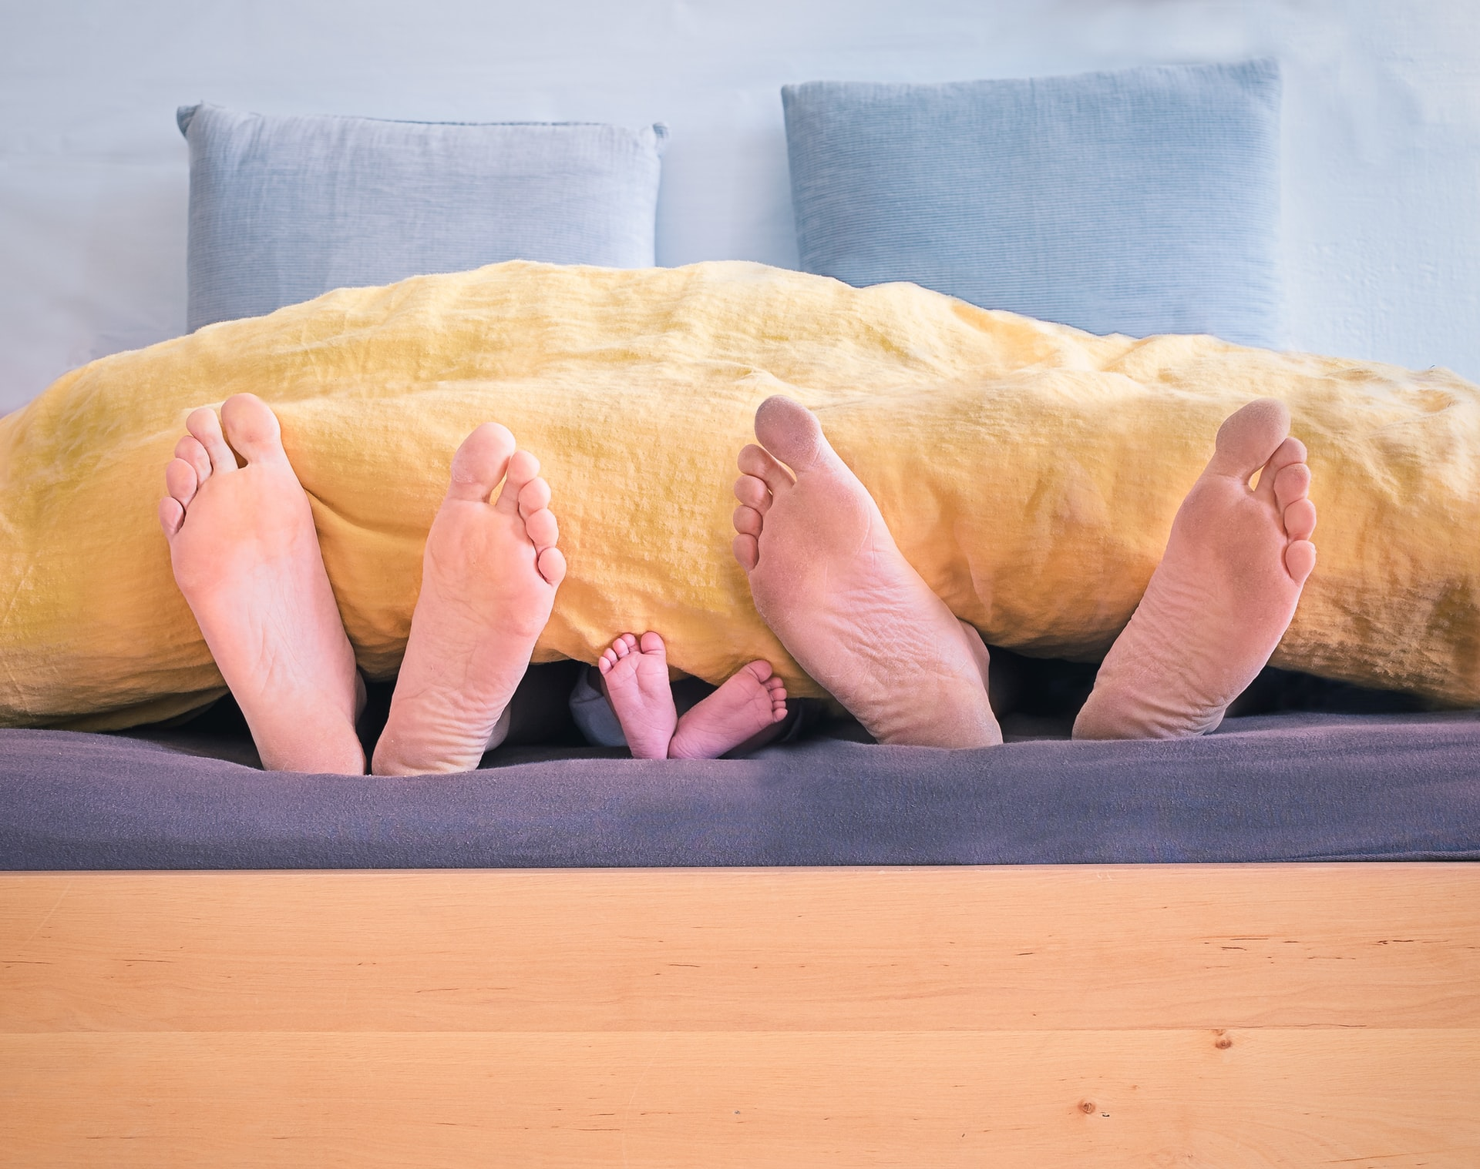

Slide 12
… all of us, have been baptized into the one body by the same Spirit …
For the body itself is not made up … of many parts. If the foot were to say, “Because I am not a hand, I don't belong to the body,” that would not keep it from being a part of the body. And if the ear were to say, “Because I am not an eye, I don't belong to the body,” that would not keep it from being a part of the body. If the whole body were just an eye, how could it hear? And if it were only an ear, how could it smell? from 1 Corinthians 12:13-18
Notes:
Look again at the reading

Slide 13
Do you think that Paul is really writing about bodies?
Talk to your neighbour and share your ideas.
Notes:
Gather up pupils’ ideas
You may like to pick out thoughts which relate to working together, or being a community.
You can introduce other questions like ‘How is our school like a body?’

Slide 14
Loving Lord,
Thank you for our school and for all that we do.
For everyone who works, plays and learns here
Help us to play our own parts in this school and always to remember to help others to play their parts too.
Amen
Prayer
Notes:
A simple prayer about playing a part in our school/community. You may like to substitute a prayer of your own, if you have a school prayer it would fit well here.

Slide 15
The grace of the Lord Jesus Christ, the love of God, and the fellowship of the Holy Spirit be with us all
Notes:
Final slide.

