Slide 1


Letters from Long Ago
Notes:
The title slide.
This is intended to be visible as the pupils enter – with some reflective music.
You may wish to include a song during the Collective Worship

Slide 2
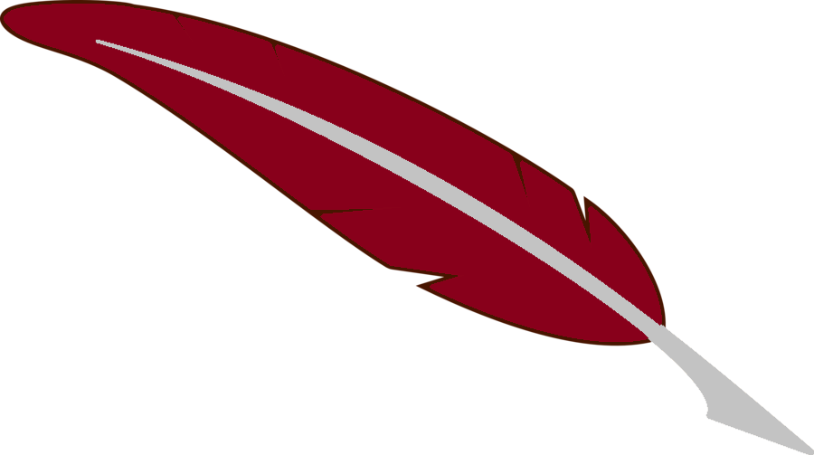
May God our Father give us grace and peace
Notes:
A simple greeting – all of the worship sequences in ‘Letters from Long Ago’ use this greeting.

Slide 3
What are important things that you might write a letter about?
Notes:
This question is for brief discussion – possibly talk to partners or buzz groups
After sharing ideas lead into the next slide with:
‘The first Christians wrote letters about what they had learned from Jesus. But they didn’t use paper can you guess what they did use?’
Gather answers if you wish.

Slide 4
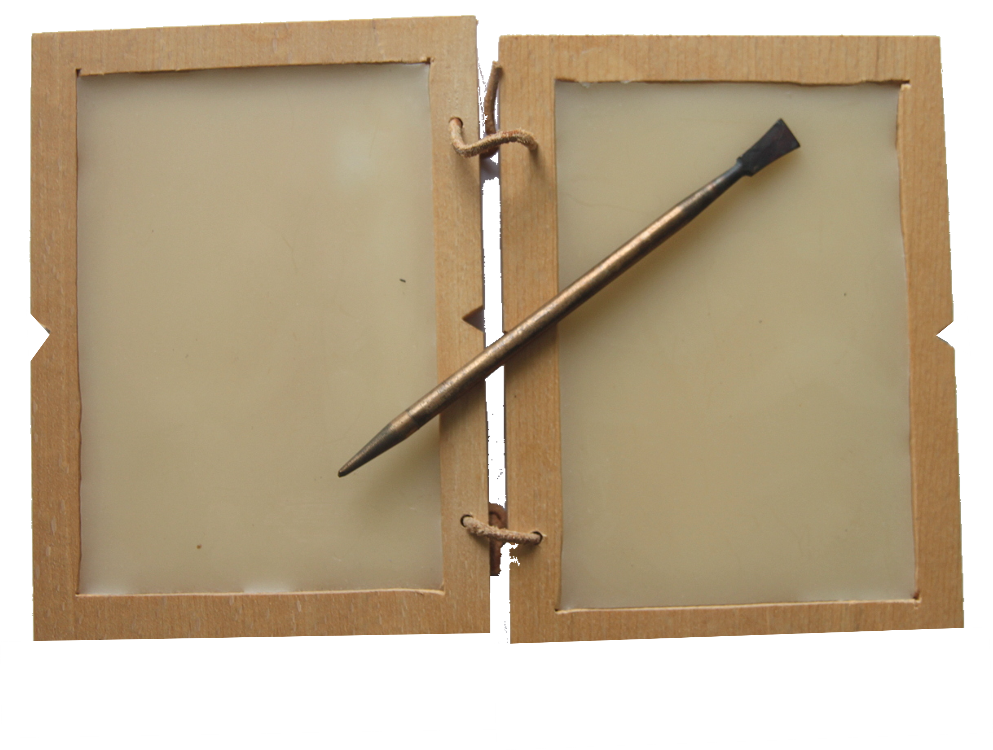
Much of the writing 2000 years ago was done on wax tablets like this -
Notes:
This is a modern recreation of the wax tablets.
The two sides are folded and then tied to protect the message. They are re-useable, just soften the wax and smooth it out.
The tablets used again and again.

Slide 5
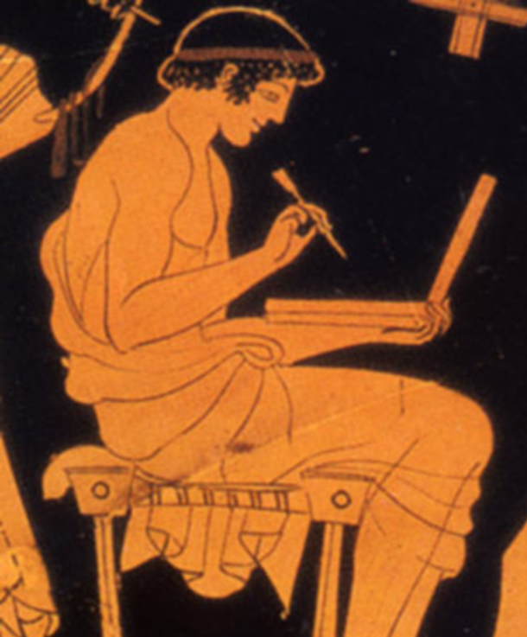
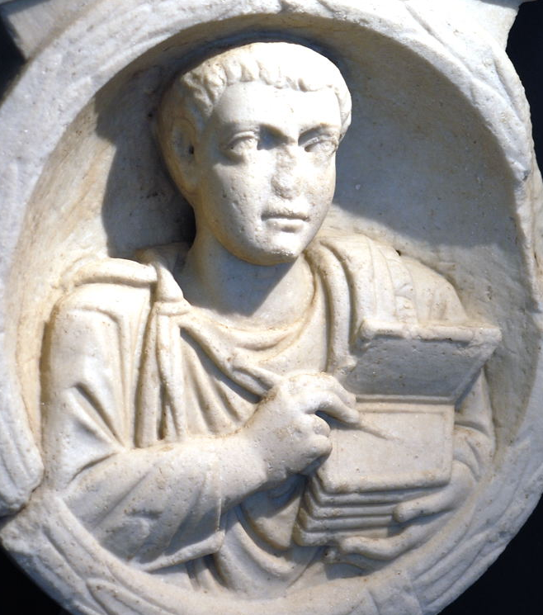
This is a statue from Roman times showing a man from Flavia Solva using wax tablets.
This Greek person looks
like he is using a laptop!
Notes:
Both the images reflect life from (approximately) the same period as the New Testament – notice that several tablets are bound to make a ‘book’.
You could ask how many pages the scribe from Flavia Solva has – and how many the Greek person has.
Enterprising pupils could find out where Flavia Solva is.

Slide 6
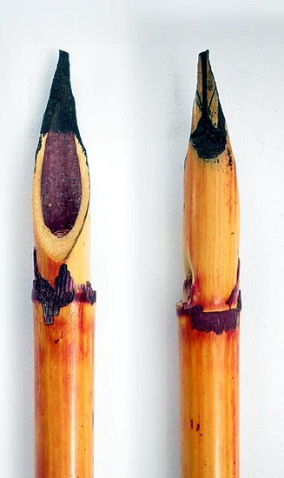
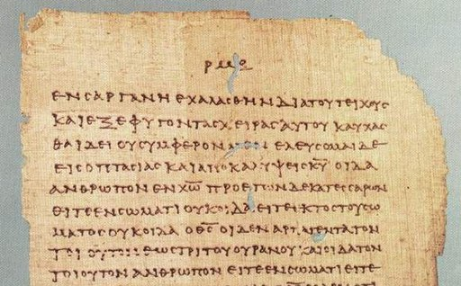
People made permanent copies of letters on papyrus using pens made from reeds
Notes:
Writing on papyrus means that there are some very early copies of the letters that Peter and the other wrote. Most of these letters were written before the gospels were written.
You may have to explain what papyrus is – or set a challenge for pupils to find this out.

Slide 7
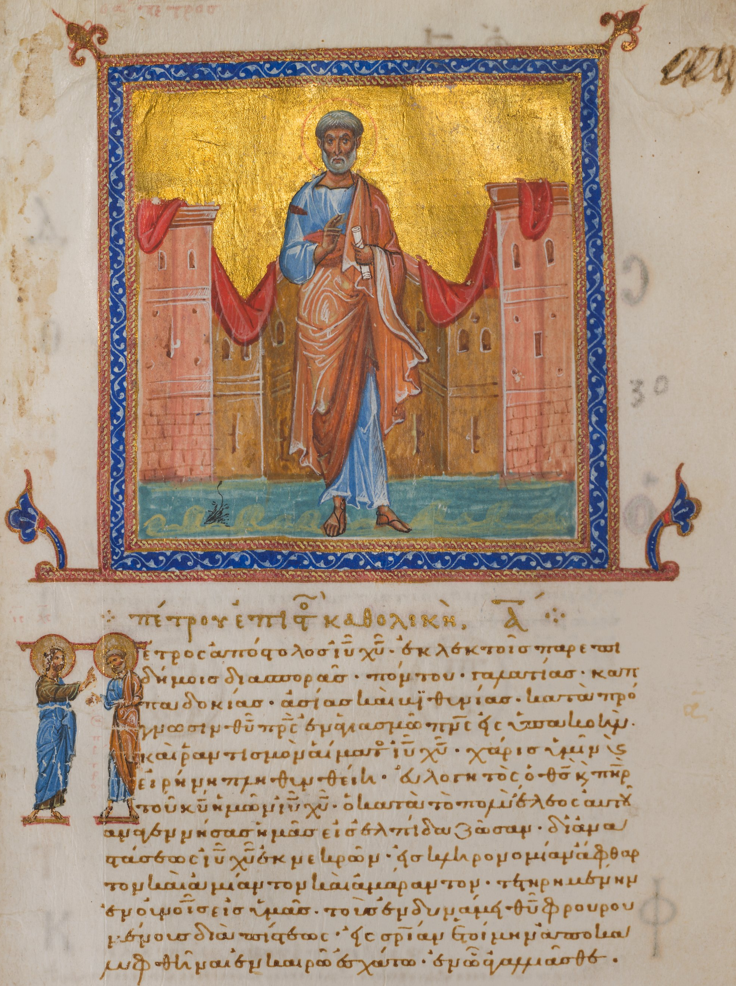
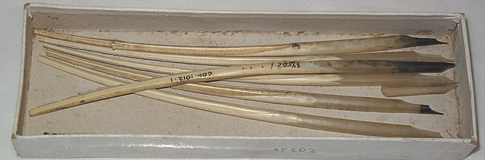
Quill pens have better nibs than reeds, they are not so stiff.
Notes:
Later, writing was (and still is) done with quills. The romantic plumed quill is largely fiction, most had the feathery bits (barbs) trimmed off like the quills in the box.
The text is in Greek – it is the first letter of Peter.
Peter and his colleagues were writing to encourage and support the churches that were springing up all around the Mediterranean.

Slide 8
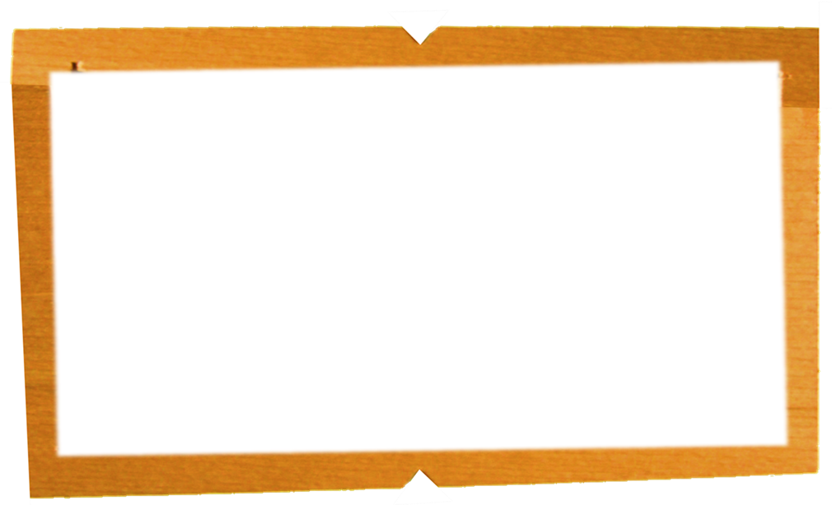
From Peter, apostle of Jesus Christ—
To God's chosen people who live as refugees scattered throughout the provinces of Pontus, Galatia, Cappadocia, Asia, and Bithynia. You were chosen according to the purpose of God the Father and were made a holy people by his Spirit, to obey Jesus Christ and be purified by his blood.
May grace and peace be yours in full measure.
Here is the beginning of one of the letters – this is from Jesus’ friend Peter.
Notes:
The opening of Peter’s first letter. Notice that it is written to many people at once.
Encourage pupils to say what they think is important from these words.
This background may be helpful, please use it with discretion.
Even in this brief beginning we can see some of the important parts of the Christian faith.
The belief that:
God has a purpose for people
Christians are made into a group by the (Holy) Spirit
Christians are to obey (be disciples of) Jesus
That Christ’s death (blood) is an essential part of the story
AND
The outcome of all of the above is that we can share grace and peace.

Slide 9
I write you this brief letter with the help of Silas, whom I regard as a faithful Christian. I want to encourage you and give my testimony that this is the true grace of God. Stand firm in it.
Your sister church, also chosen by God, sends you greetings, and so does my son Mark. Greet one another with the kiss of Christian love.
May peace be with all of you who belong to Christ.
Here is the ending of the same letter from Peter.
Notes:
The ending adds a more personal touch to the letter.
Ask what do the pupils think is important to notice from these words?
A little more background:
It may be that Silas’ help is not so much in writing but in delivering the letter, going from church to church in the provinces mentioned in the opening.
It is possible that Mark is the same person that is mentioned in other parts of the New Testament, even the person who wrote the Gospel.
Again it is very important to note the themes of love and peace in the letter. The ‘kiss of love’ was an understood greeting in the first church communities.

Slide 10

Let’s write a letter …
Peter and the first Christians wrote about their faith – what they believed about Jesus and God.
What would we write about what we believe?
Notes:
You might change ‘believe’ to ‘school’ or possibly ‘values’.
Use talk partners to come up with some sentences.
Gather the sentences. These could be collated by a school council or worship council into a proper letter. Don’t try and finish it properly in an assembly. Pupils could be prompted beforehand to help make the process smoother.

Slide 11
Our Father in heaven,
hallowed be your name,
your kingdom come,
your will be done,
on earth as in heaven.
Give us today our daily bread.
Forgive us our sins
as we forgive those who sin against us.
Lead us not into temptation
but deliver us from evil.
For the kingdom, the power,
and the glory are yours
now and for ever.
Amen.
Prayer
Notes:
The Lord’s Prayer is suggested here – you may wish to change this – or add another prayer

Slide 12

Peace be to our whole community, and love with faith, from God
Notes:
A final slide with a simple close to the sequence.

