Slide 1
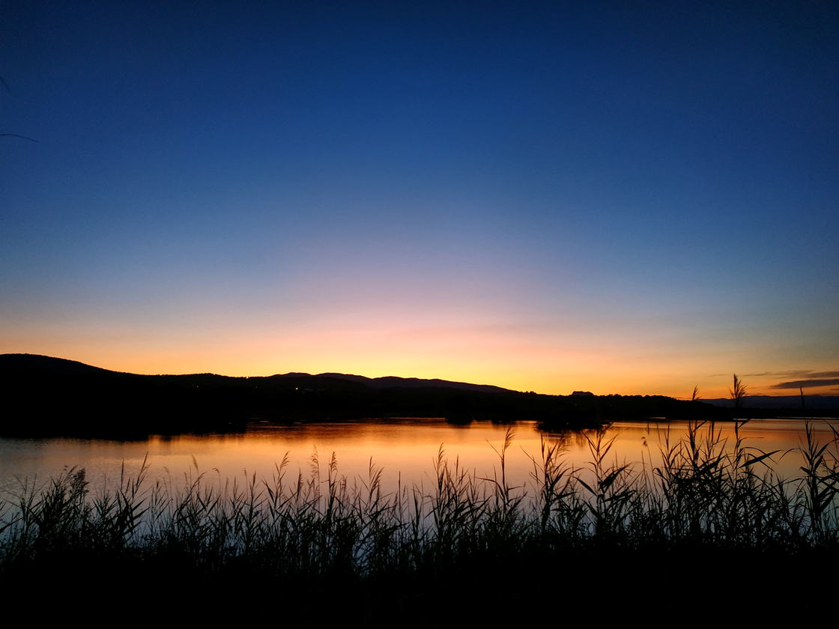
We say together: A new day has dawned;
fill us with faith and hope.
Notes:
Invite those present to join with the words of greeting. You may wish to do this as a call and response with the worship facilitator saying the first part.
It is repeated as a sending/blessing at the end of each PPT.

Slide 2
Easter Reflection 1 The Women Who might this figure be?
Notes:
Hopefully the wings will be a give away, but it is an artist’s impression of an angel. Pupils will be familiar with angels at the Nativity but may be less familiar with their role in other places in the Bible. There is potential to go deeper into this. (See
You may wish to share that all Biblical angels are male! Gabriel and Michael (other angels such as Uriah and Raphael are from other texts such as the story of Tobias (from the apocryphal book of Tobit))

Slide 3
Listen now to the word and wisdom of God
Notes:
Explore the image. It is an authentic tomb from the Middle East/ Holy Land. The stone would be rolled over the opening to prevent robbers stealing grave goods, such as expensive cloths and gifts.

Slide 4
After the sabbath, as the first day of the week was dawning, Mary Magdalene and the other Mary went to see the tomb. And suddenly there was a great earthquake; for an angel of the Lord, descending from heaven, came and rolled back the stone and sat on it.
His appearance was like lightning, and his clothing white as snow. For fear of him the guards shook and became like dead men. But the angel said to the women, ‘Do not be afraid; I know that you are looking for Jesus who was crucified. He is not here; for he has been raised, as he said. Come, see the place where he lay. Then go quickly and tell his disciples, ‘’He has been raised from the dead, and indeed he is going ahead of you to Galilee; there you will see him.’’ This is my message for you.’ So they left the tomb quickly with fear and great joy, and ran to tell his disciples.
Matthew 28 NRSV
Notes:
Read aloud, encouraging stillness. If possible invite an other voice to read, possibly an older pupil or other adult present. Unpick unfamiliar language as required. NRSV is a straightforward Bible in terms of language.

Slide 5
Going deeper
Thinkabouts:
Why were there guards at the tomb?
What is important about phrase ‘as he said’?
How can the women be afraid and happy at the same time?
Let’s wonder:
Why do you think that the first to receive the news were women and mothers ?
Notes:
Each PPT has questions to think about and an ‘I wonder’ thought. Elicit responses and be prepared to contribute with your own ideas to stimulate thinking.
Guards to sto- robbers and protect the body, As he said, meaning this was expected. Afraid because they were worried about the grave being robbed or being arrested as sympathisers with Jesus. Happy because what he said would happen appears to have been the case.
Let’s wonder – open question.

Slide 6
How do you think this person feels?
How does the picture make you feel?
How does the Bible reading link to this image?
Notes:
This photo shows someone taking a giant leap. They were frightened and excited and happy all at the same time. This is how the women felt according to Scripture.

Slide 7
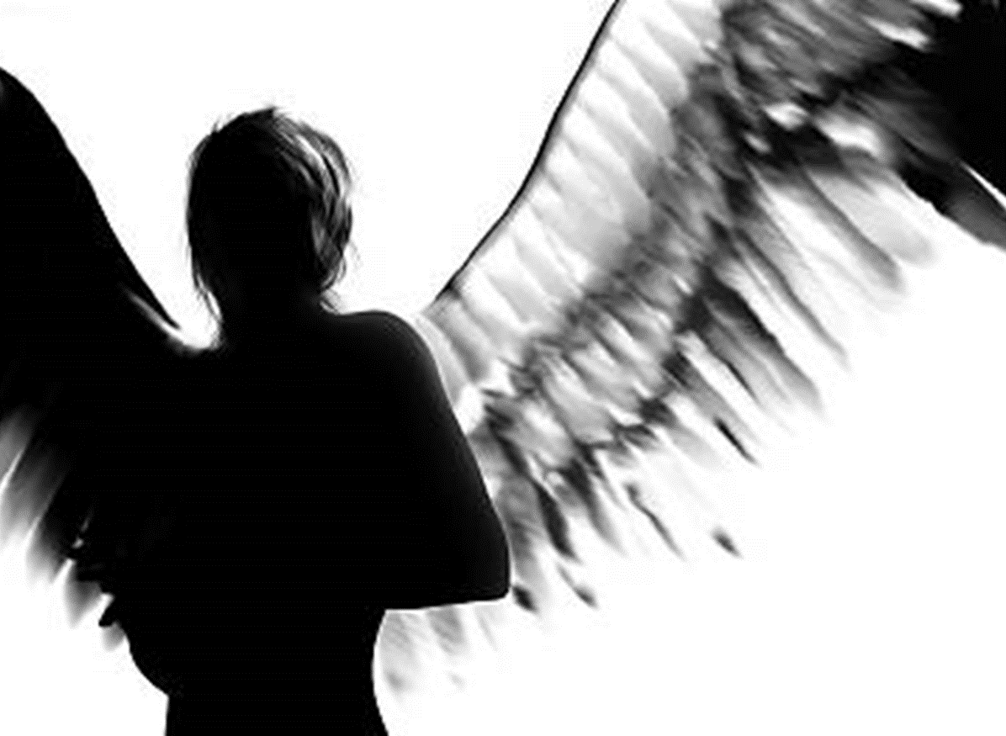
Reflection
Lord of Life,
as the angel brought good news,
help us to see the good in each
other and in your world.
Enable us to hear your message
of love and the promise of life,
through the resurrection of your Son.
Amen
Notes:
Invite those present to say the words or listen and reflect as they choose.

Slide 8
We say together: A new day has dawned;
fill us with faith and hope.
Notes:
A sending/blessing which can be call and response.

