Slide 1
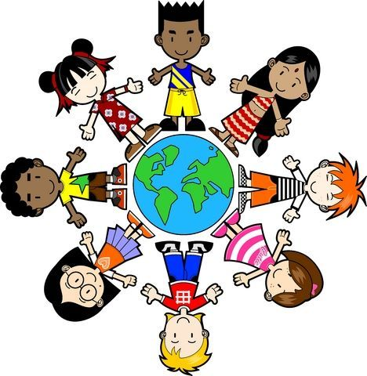
We say together:
We are invited to believe, help us to understand.
Notes:
Our greeting mirrors the sending, the invitation is to all of us to understand.

Slide 2
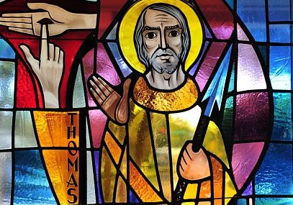
Easter Reflection 4
Thomas has doubts
This Photo by Unknown Author is licensed under CC BY-NC-ND
Notes:
What does doubt mean? When have you had doubts, been unsure. If no response from pupils, give an example when you were so – eg an exam question, starting a new club, swimming with no armbands for the first time.
Explore what helps when we have doubts.

Slide 3
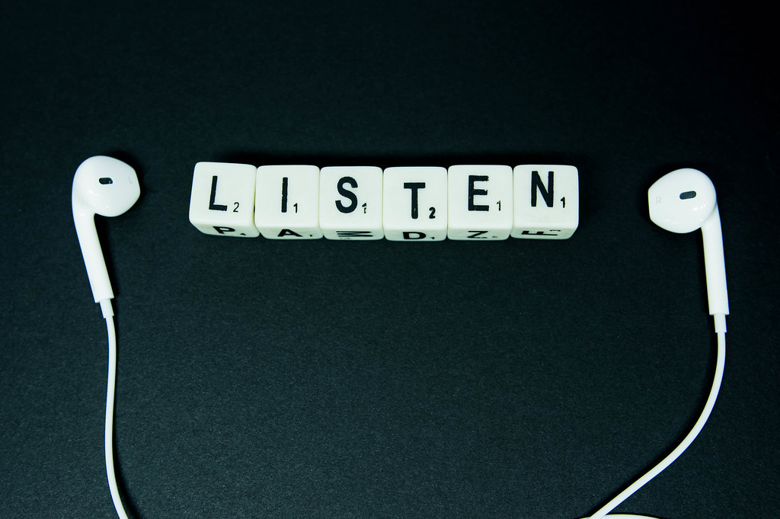
Listen now to the word and wisdom of God
Notes:
This is a familiar image to convey the message that we are going to listen to a passage from the Bible. Older pupils or other adults present might read it aloud to vary voices. Encourage stillness/focus while listening.

Slide 4
But Thomas (who was called the Twin), one of the twelve, was not with them, when Jesus came. So the other disciples told him, ‘We have seen the Lord.’
But he said to them, ‘Unless I see the mark of the nails in his hands, and put my finger in the mark of the nails, and my hand in his side, I will not believe.’
A week later his disciples were again in the house, and Thomas was with them. Although the doors were shut, Jesus came and stood among them and said, ‘Peace be with you.’ Then he said to Thomas, ‘Put your finger here and see my hands. Reach out your hand and put it in my side. Do not doubt but believe.’
Thomas answered him, ‘My Lord and my God!’ Jesus said to him, ‘Have you believed because you have seen? Blessed are those who have not seen and yet come to believe.’
John 20 NRSV
Notes:
If possible get another voice/ or a pupil to read this aloud. This might be role played/acted out.

Slide 5

Going deeper
How does the picture tell the events from John’s Gospel?
Thinkabouts:
What did Thomas ‘doubt’?
What helped him know for sure?
Why does Thomas call Jesus his Lord and God?
Let’s wonder:
Why do you think that Jesus means when he says ’Blessed’ ?
Notes:
Image is from Chinese Christian tradition of art. You may wish to explore where that is in the world, linking back to the first slide. Note the significance of the hands, both Thomas’ and Jesus’. Jesus welcomes him and he looks, toches and believes. The startles expressions of theothe rdisciples tells a story too.

Slide 6
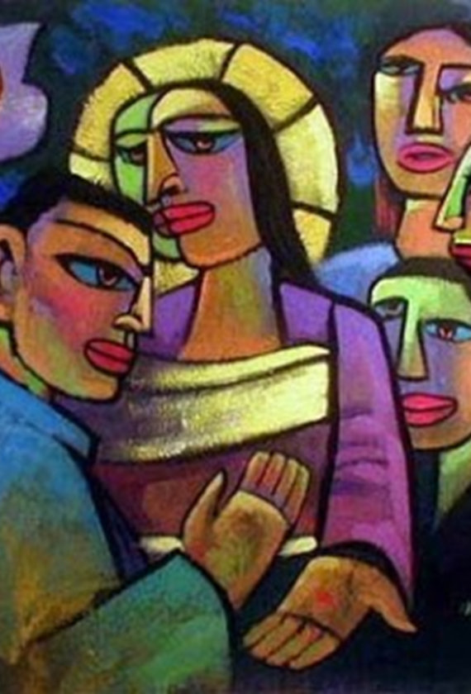

How does the picture tell the events from John’s Gospel?
What might Christians understand from Jesus’ words?
‘Blessed are those who have not seen and yet come to believe.’ John 20 NRSV
Notes:
You might wish to go deeper and consider with older pupils what Christians today understand. Having faith includes having doubt. Christians cannot see Jesus but they believe in him and his teachings.

Slide 7
Reflection
Risen Lord Jesus Christ,
When we are unsure, help us to see.
Where we doubt, guide us to understand.
Whoever we are, may we know that your love is around us and within us.
Amen.
Notes:
Ensure you invite pupils and staff present to join in or listen and relfect as they wish.

Slide 8
We say together:
We are invited to believe,
Help us to understand.
Notes:
Sending slide offers chance to say a blessing and reinforce the inclusive message that Jesus brings God’s love to all in the world who choose to believe in him.

