Slide 1
Inside and outside: Worship through the day
Original work by Shaun Burns and Allyson Taylor

Slide 2
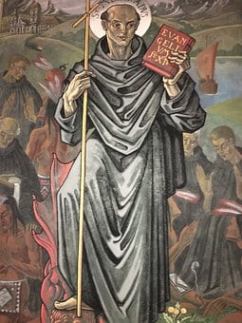
Worship
Through The Day.
“In Church of England school, collective worship is . . . the unique heartbeat of the school and is offered as part of a wider opportunity for pupils and adults to encounter faith by engaging in conversations about God, both as individual and together.”
Inclusive Invitational Inspiring
Collective Worship in Church of England Schools
Guidance Document
2021.

Slide 3
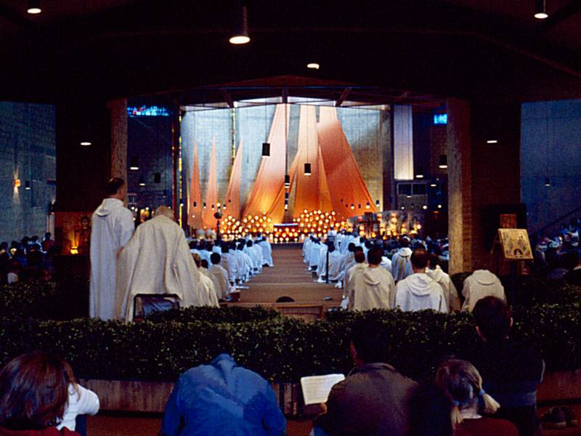
1.) Time for Worship.
Worship in school like a rhythmic heartbeat;
Daily Act of Collective Worship;
Start the day in the class with Prayer;
Grace at Lunchtime;
End the day in the class with Prayer;
Opportunities for all to lead prayer / worship;
Times of worship for Staff and other adults;
Times of Worship in INSET Days / meetings, e.g. with Governors, etc.;
Reflective Areas / Prayer Spaces for Schools;
Worship resources around the school.

Slide 4
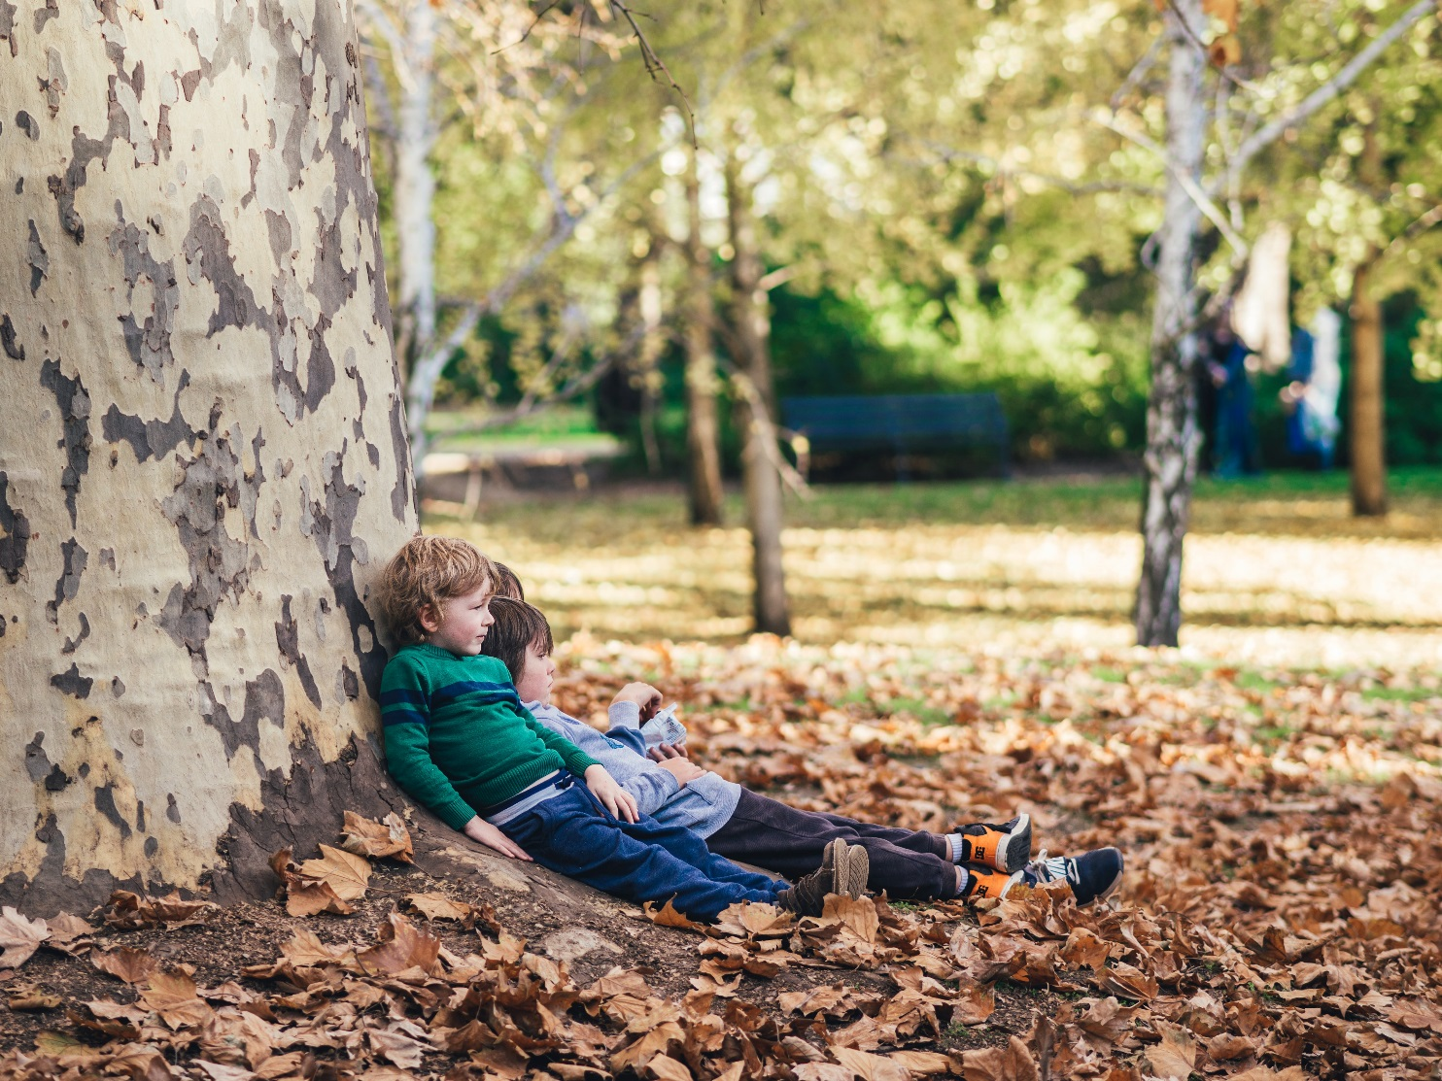
1.) Time for Worship.
Where are the opportunities throughout the school day in your school that it is appropriate to offer worship to God?
How does the school building and grounds include, invite and inspire worship through the rhythm of the day?
Pray at all times, be thankful in all circumstances. This is what God wants from you in your life in union with Christ Jesus. 1 Thessalonians 5: 17 -18

Slide 5

2.) Worship through the curriculum
Worship is a time distinct from lessons but it can be found in every aspect of the school day
An intelligent heart acquires knowledge, and the ear of the wise seeks knowledge
Proverbs 18:15

Slide 6

You might like to try this –
DT/Cooking – sing while you work, pray/reflect while you bake and eat
Art – pause to think what a piece of art is saying to you, when you create art, think of the Christian creation story and how God felt as creator
Listen to music or song and take time to express how you feel, what it makes you think, what it reminds you of, vast treasury of Christian music and song around the world, a chord/discord can be a symbol of the Trinity
(Cont.)

Slide 7
You might like to try this –
Science – WOW moments can be worshipful! Bug hunts, volcanoes, circuits, human biology, comment on the amazing world around us
PE – appreciate the strength and skill of yourself and others, use the models of strong in spirit (David and Goliath), swimming offers moments where we can recall the many examples of Jesus on the water/Noah/Red sea parting

Slide 8

3.) Using your space – Well-worn paths
Using indoor spaces for smaller group worship – Library, activity areas, classrooms, more than Hall
Appreciation of outdoor spaces that lend themselves to worship
Spiritual or Quiet gardens
Outdoor classrooms
Free flow areas for younger children
Story spaces
Shady areas on playground or field
Now his parents went to Jerusalem every year at the Feast of the Passover. And when he was twelve years old, they went up according to custom
Luke 2:41-2
Notes:
Luke 2:41-42 ESV Now his parents went to Jerusalem every year at the Feast of the Passover. And when he was twelve years old, they went up according to custom

Slide 9
You might like to try -
The God who made the world and everything in it,
being Lord of heaven and earth,
does not live in temples made by man Acts 17:24
Create a pilgrimage with stopping points for reading, reflection or prayer or song or dance around your school building and grounds
Have a theme of your vision, of stewardship, of journey, of transition, of Easter, of Christmas, of Pentecost, of Epiphany, of Advent, of a Saint’s day, Stages of the Cross…. But have a theme and use the space to deepen understanding and give an experience that nourishes each pilgrim
(Cont.)

Slide 10
You might like to try -
The God who made the world and everything in it,
being Lord of heaven and earth,
does not live in temples made by man Acts 17:24
Include points which honour the diversity of Christianity and other faiths
Get your pupils to plan and resource it
Possibly include a labyrinth, refreshments, rests, overnight camps…
Invite parents/community to join a pilgrimage
Adapt the idea to your local area beyond the school site

Slide 11

4. Forest school and Forest Church
Any place with plants/shrubs or trees can become a place for worship
If you have a designated Forest School, think of using it as a worship space and opportunity for a time of worship
If indoors, think camouflage netting, voile/fabrics, canopy and indoor tents
(Cont.)

Slide 12
4 (Cont.) Forest school and Forest Church
Create your Woodland area indoors with whatever you can find, carpet tubes/offcuts of branches…
This could be a seaside area, garden, desert, rainforest, barrier reef… think how God created the world and how so many cultures have creation stories
Day and night, make an area with starlight and lanterns
Go through a ‘Ward-robe’ aka Narnia – this could be outdoors as well as inside

Slide 13
You might like to try -
Making a rainbow of coloured leaves or natural materials to explore the story of Noah and God’s covenant and the symbolism of the rainbow
Collect materials to create a large cross or dove or wreath to sit around
Listen to the sounds around, birds, rustling, wind, voices, cars, planes; Echo these and sing back if you hear birdsong
If you have a fire, share bread (with marshmallows), even better flatbread cooked on hot stones, and reflect on the Last Supper, Feeding 4/5000 and the other times Jesus and his followers shared food together
Lie on your back and see from a new perspective, imagine you are a creature nearer the ground, connect with the earth and sky
Let the heavens be glad, and let the earth rejoice; let the sea roar, and all that fills it; let the field exult, and everything in it! Then shall all the trees of the forest sing for joy Psalm 96: 11-12

Slide 14


5.) Worship in Partnerships and Other Organisations.
Worship opportunities with: -
the parish church in school, in church, for the school community and wider church community;
other schools, e.g. ‘sister’ schools, the neighbouring school, a Special school, the twinning school, etc.;
Christian organisations such as sports teaching;
Other organisations, e.g. local care homes, inter-generational projects, etc.;
Local, national and international charities, e.g. Christian Aid, Water Aid, Comic Relief / Red Nose Day, etc.;
(Cont.)

Slide 15
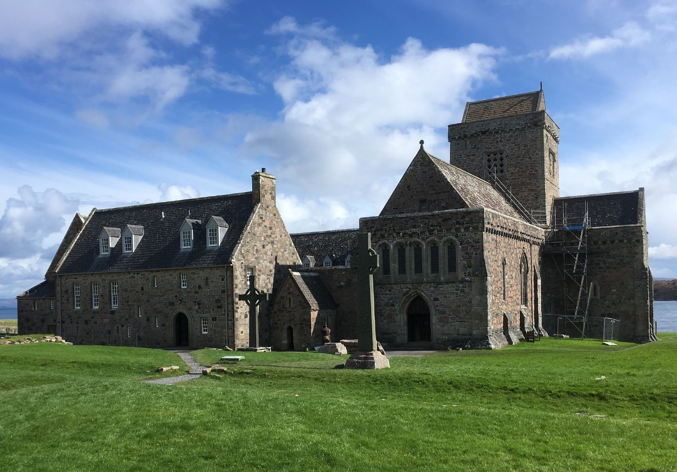
5.) Worship in Partnerships and Other Organisations. (Contd.)
Worship opportunities with: -
Global Neighbours and organisations being worked with as part of Courageous Advocacy;
Organisations set up for particular occasions, e.g. The Queen’s Platinum Jubilee;
Organisations supporting Collective Worship, e.g. Spinnaker Trust, Open The Book, BBC, etc.;
Other religious communities, e.g. the Iona community, the Taizé community;
Partnership with the diocese.

Slide 16
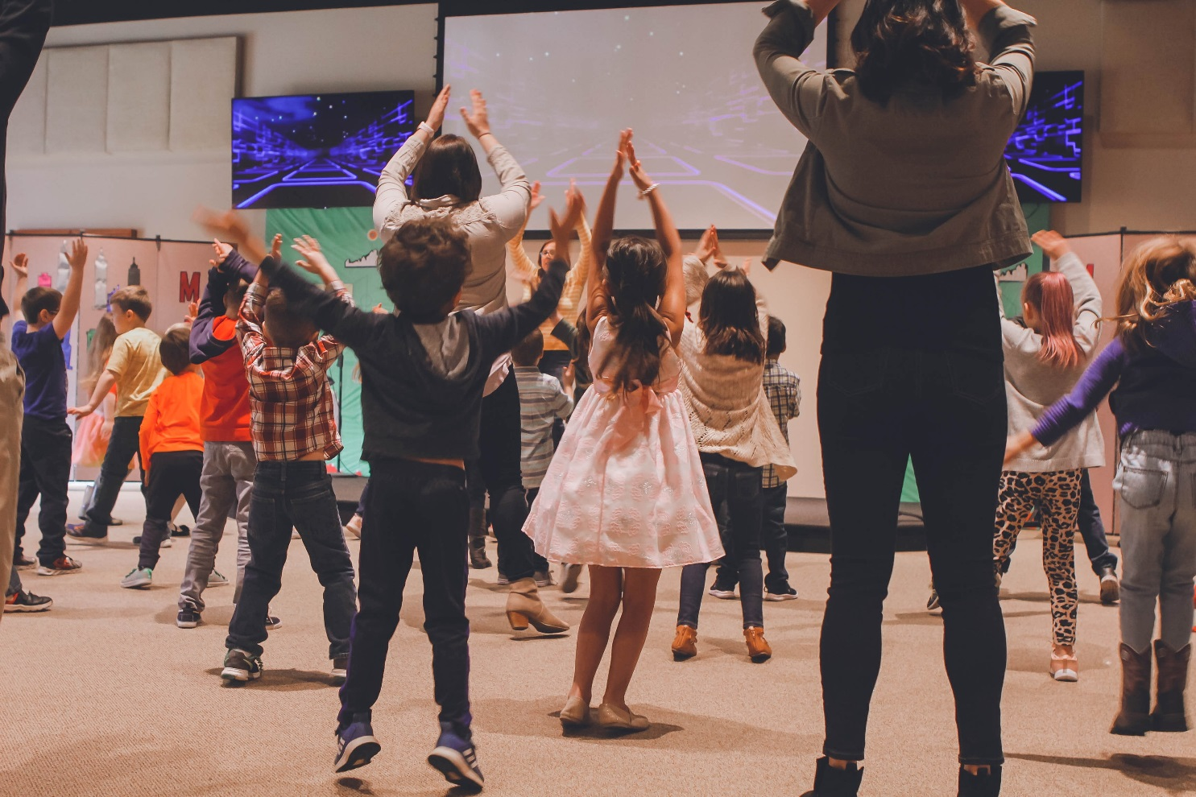
5.) Worship in Partnerships and Other Organisations.
Where are there opportunities for strengthening the mutual benefits of your school’s partnerships through worship?
How can the wisdom of your school’s partners and organisations that it works with enrich your school’s provision for worship?
Let us not give up the habit of meeting together, as some are doing. Instead, let us encourage one another all the more, since you see that the Day of the Lord is coming nearer. Hebrews 10:25

Slide 17

6.) Worship in Learning Outside The Classroom
– Day and Residential Educational Visits.
Prayer before journey to from venue;
Daily act of Collective Worship e.g. Worship at the beginning of the day after breakfast;
Planned worship opportunities across the timetable;
Unplanned individual and collective worship opportunities;
Looking for and feeling the spiritual while out of the classroom / away from the school;
Prayer before activities, e.g. challenge activities;
(Cont.)

Slide 18

6.) Worship in Learning Outside The Classroom
– Day and Residential Educational Visits.
Nightly worship, e.g. ‘Lantern Time’ – inside or outside;
Offering personal and shared experiences / memories to God in prayer;
Spiritual / Worship memento for each person to keep from the educational visit;
Personal reflection of how the educational visit has nurtured our spiritual growth (and possibly faith growth;)
Sharing of the educational visit experience with the wider school community as part of worship afterwards.

Slide 19

6.) Worship in
Learning Outside The Classroom
– Day and Residential
Educational Visits.
How are the specialness and uniqueness of experiences experienced in Learning Outside The Classroom drawn upon as opportunities for encountering worship?
How does worship allow pupils and adults to feel God’s presence alongside them in their educational visit?
Teach them to do everything that I have commanded you. “And remember that I am always with you to the end of time.” Matthew 28:20

Slide 20
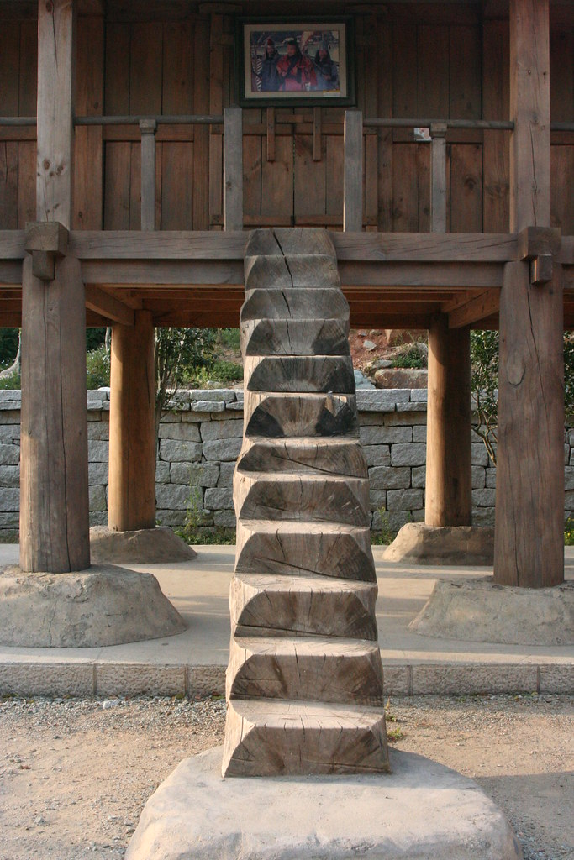
7.) Further afield -
If you go beyond your school site for any visit or purpose, integrate an element of worship wherever and whenever you go
Pray or sing or both as you travel
You gave a wide place for my steps under me, and my feet did not slip. Psalm 18:36
C

Slide 21
You might like to try - 7.) Ephesians 2:10 For we are His creation, created in Christ Jesus for good works, which God prepared ahead of time so that we should walk in them.
A Worship walk to see, hear, smell, feel and experience what you can detect – explore the big questions of how it all works together and where you fit in the wider world or just to ‘Be’.
Invite visitors into schools but go out and visit where you can – residential homes, hospices, community lunches, other schools, places of worship
Go on a Worship (not Bear!) hunt following signs /clues/breadcrumbs laid in advance
Find objects/clues which tell a Bible story – wool and a lost (toy) sheep

Slide 22

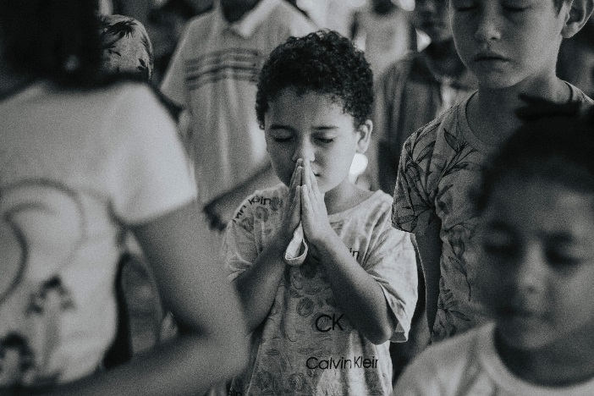

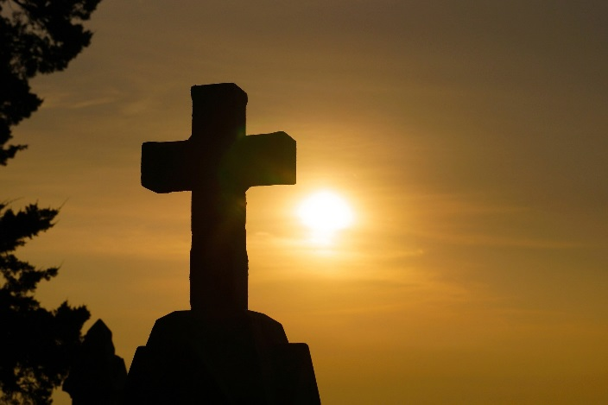
Worship Through the Day, Inside and Outside.
“ The rhythm of daily worship allows pupils and adults to step away from the target-driven culture of much of education, creating a space for an encounter with faith in God . . . These activities will help provide a rhythm and stillness and a pattern of community life.”
Inclusive Invitational Inspiring
Collective Worship in Church of England Schools
Guidance Document
2021.

