Slide 1
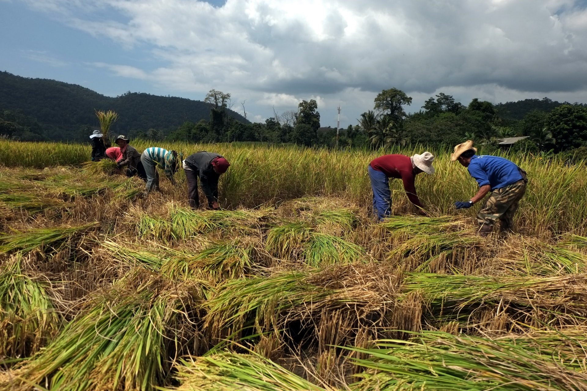
The Harvest Season
Living in the world that we have been given
Yours, Lord, is the greatness, the power,
the glory, the splendour, and the majesty;
for everything in heaven and on earth is yours.
All things come from you,
and of your own do we give you.
Notes:
Rice Harvest

Slide 2
Fruitfulness in the Water and the Air
From Day 5 of the Creation Story…
And God said, “Let the waters under the sky be gathered together into one place, and let the dry land appear.” And it was so. God called the dry land Earth, and the waters that were gathered together he called Seas. And God saw that it was good.
Notes:
Without change there would be no harvest
Some things – like apples are just picked and used but many things need a process.
Some need to rest – as in seasoning wood
Is compost a harvest? We gather waste and through a process it matures into a useful material
Could we look at all our efforts at recycling as a form of harvest?

Slide 3
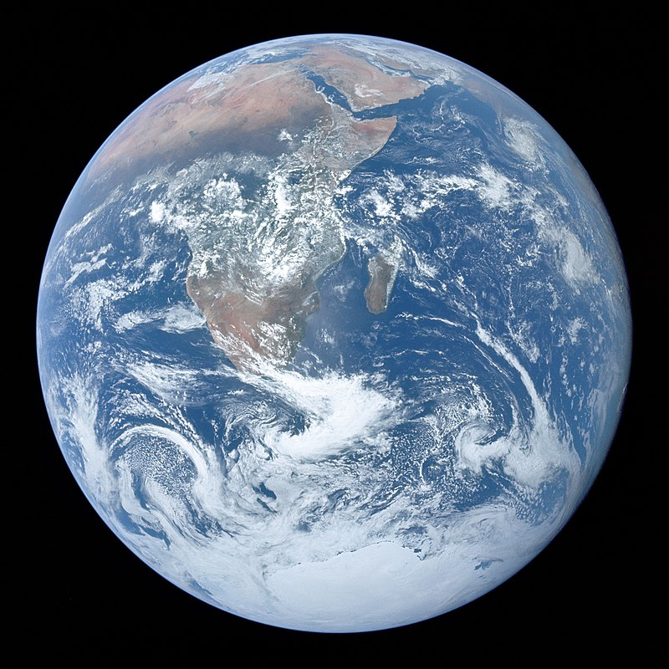
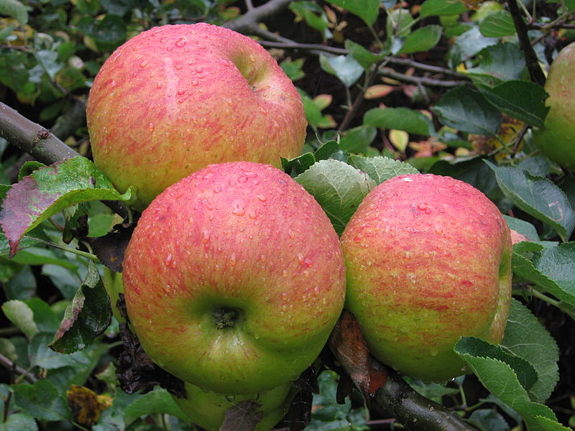
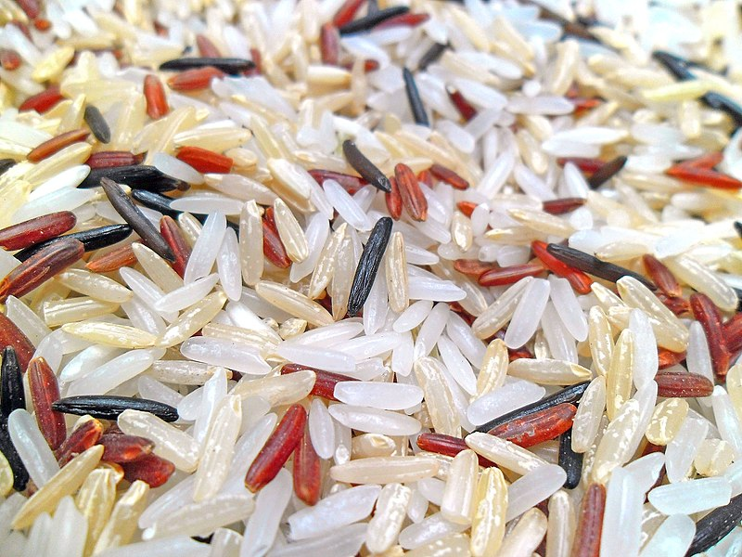
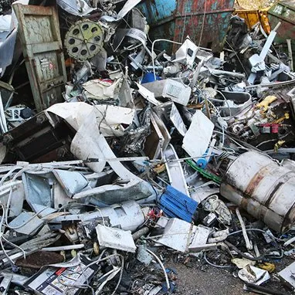
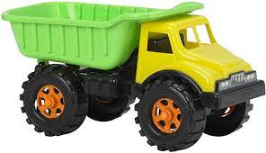
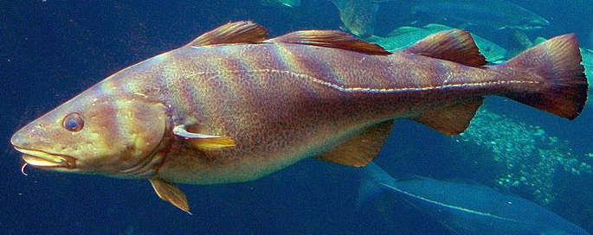
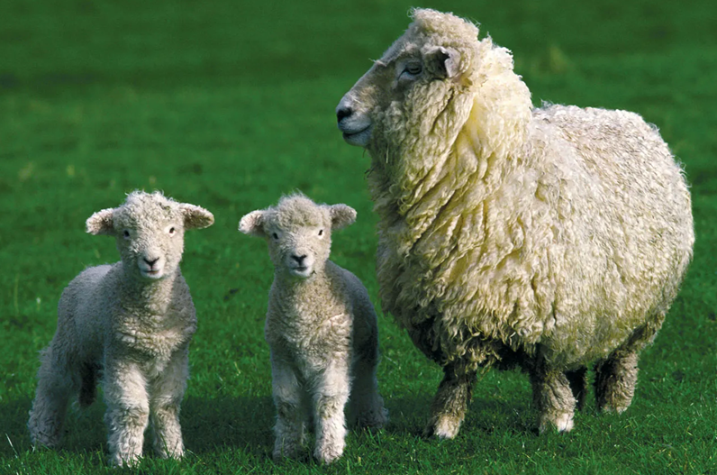
Notes:
There are harvests everywhere in the world
Well pretty much – at least where people live

Slide 4
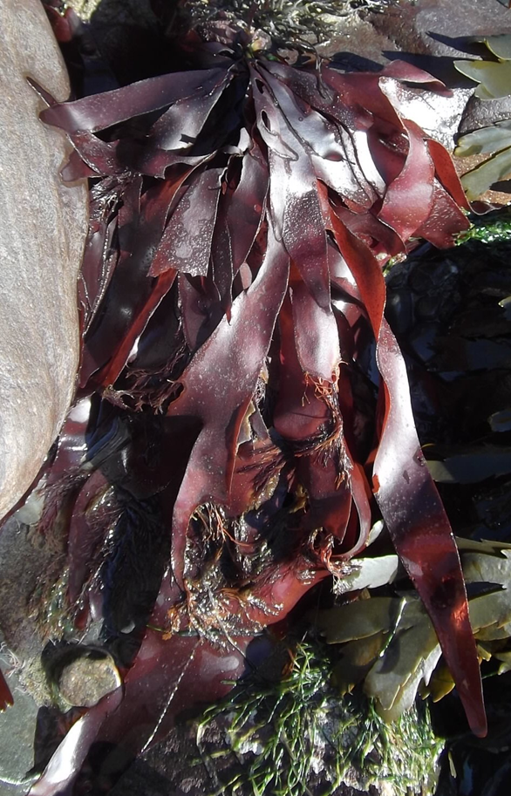
There are harvests everywhere in the world
On land and in water…
Is harvest only about food?
Notes:
There are harvests everywhere in the world
Well pretty much – at least where people live

Slide 5
Is harvest only about food?
How do we get metal things?
What about plastic toys?
Notes:
Tend to look at the creation story as being almost a creation of pictures.
But all of the created things are dynamic – they do not stay the same. The waters of the earth erode the land
Look at the days of creation and ask what happened next?
To get metal things there has to be mining, or another form of ore extraction then processing the ore – usually by heating to extract the metal
Then the metal has to be shaped/cut into the form that is needed.
Plastic starts off as oi or gas and agin is processed to create the plastic that we find in our toys.

Slide 6
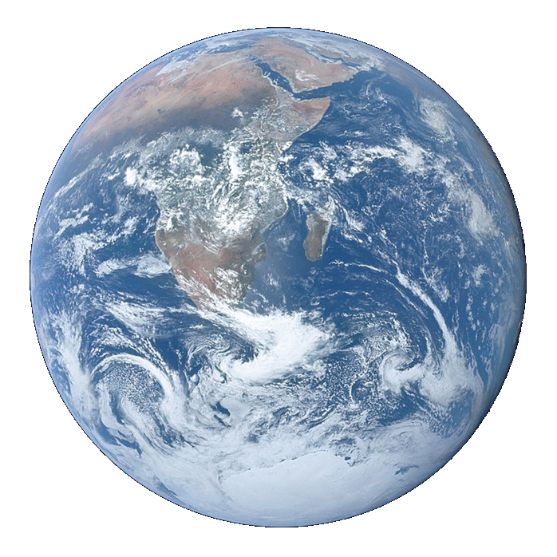
Litany of Creation
God commanded, “Let the earth produce all kinds of plants”
Plant prayers
God commanded, “Let the water be filled with many kinds of living beings, and the air filled with birds.”
Fish and bird prayers
God commanded, “Let the earth produce all kinds of animal life”
Animal prayers
God created human beings and blessed them,
People prayers
God looked at everything and was very pleased.
Thank you prayer
Notes:
An optional structure for prayer – see Developmental Prayer File page15* Pupils’ own prayers (or perhaps parents’ or staff prayers) should be inserted at the points in italics. This could be an opportunity to involve extemporary prayer or for silent prayer/reflection.
*https://www.odbe.org.uk/content/pages/documents/collectiveworship-prayerfile-doc-202175554553377.pdf

Slide 7
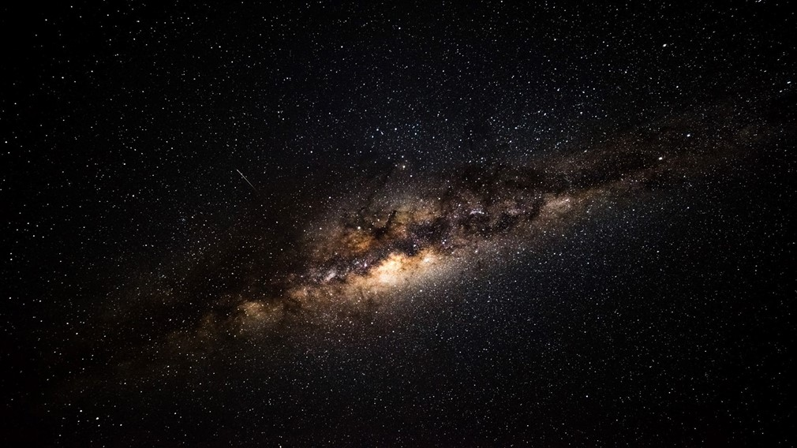
Our Father in heaven,
hallowed be your name,
your kingdom come,
your will be done,
on earth as in heaven.
Give us today our daily bread.
Forgive us our sins
as we forgive those who sin against us.
Lead us not into temptation
but deliver us from evil.
For the kingdom, the power,
and the glory are yours
now and for ever.
Amen.

