Slide 1
We are here together in our school family. May God be with us…
...and watch over us.
Notes:
Slide 1: Use these familiar gathering words for this term, or your usual greeting if you prefer.

Slide 2
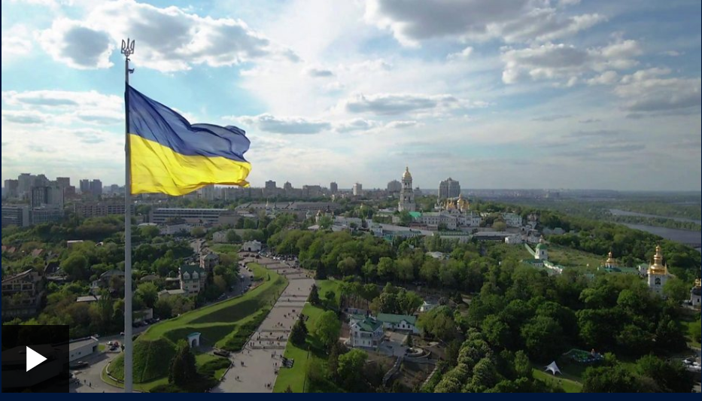
Notes:
Slide 2: We’re all seeing a lot about the situation in Ukraine and Russia on the news in recent days, and like so many others across the world, we feel helpless, sad and concerned.
We’re going to use our time today to pray about these things and bring them before God.

Slide 3
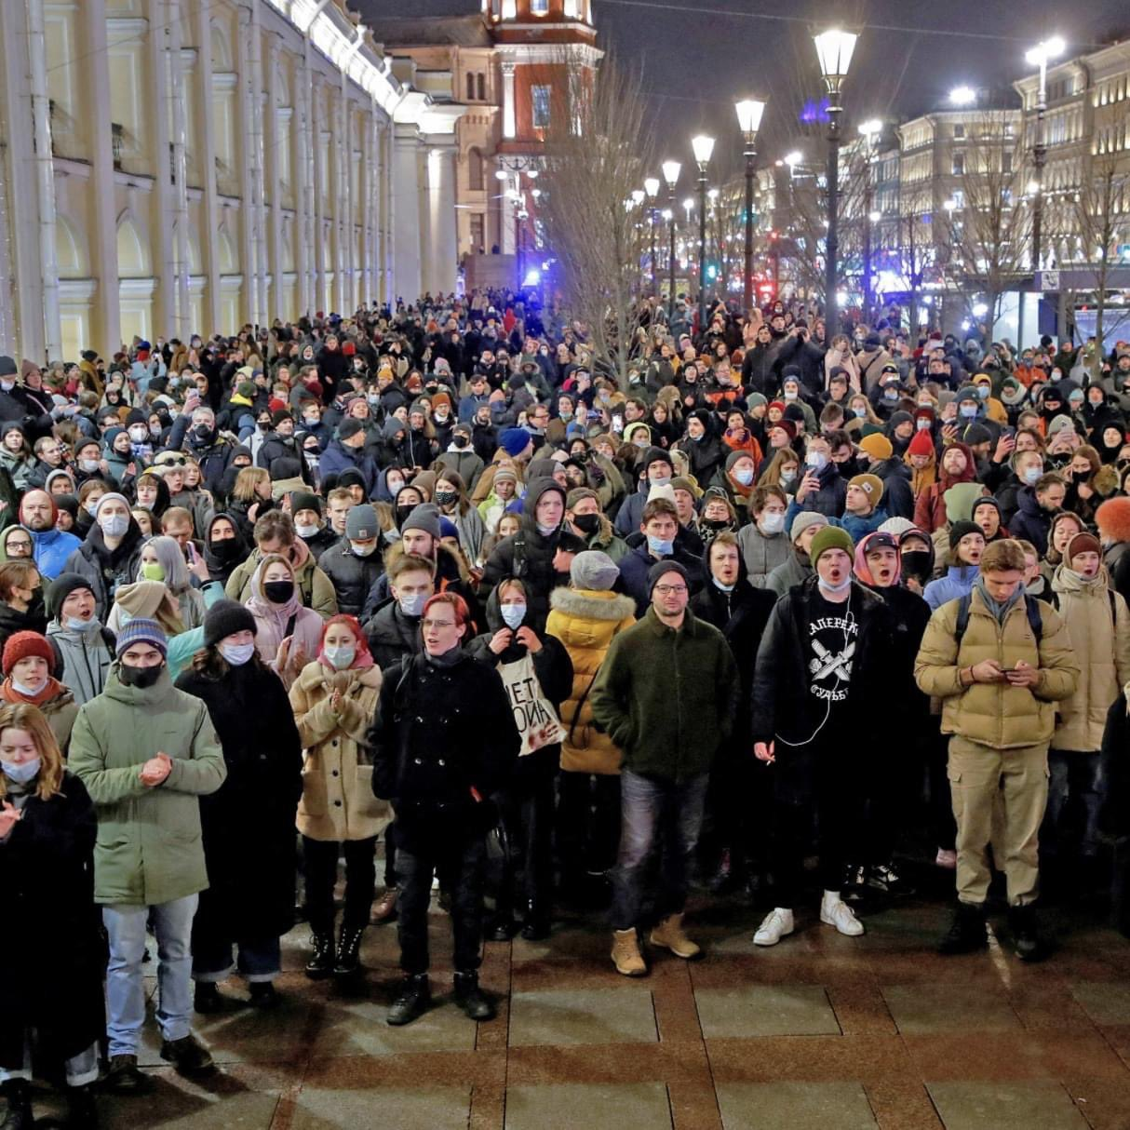
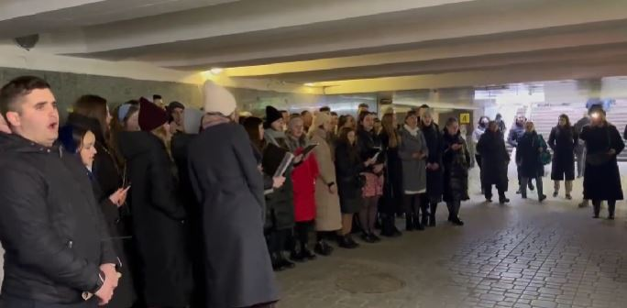
Notes:
Slide 3: It’s hard for us to watch what’s going on, and feel that we can do so little to change things.
However, we must remember that there are people in Russia who don’t agree with what’s happening in Ukraine, ordinary people like us, and Christians (and people of other faiths as well) in Russia who will be praying for peace and justice – just as there are Christians in the Ukraine praying the same….

Slide 4
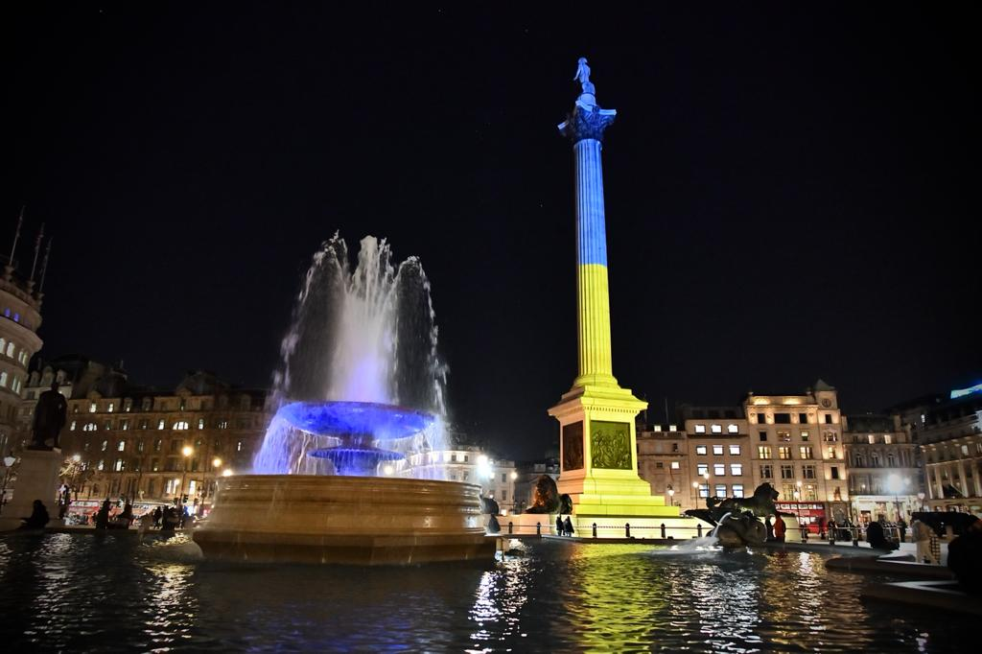
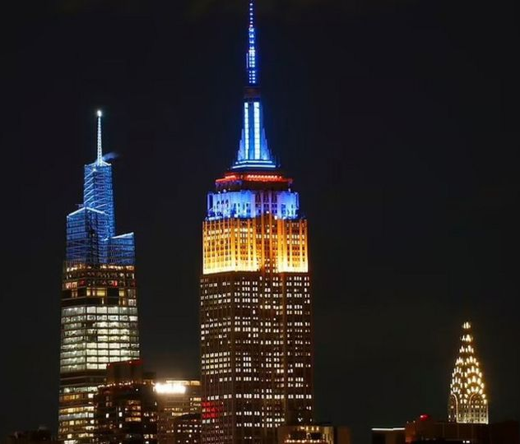
Brussels
London
New York
Rome
Berlin
Notes:
Slide 4: There are also people all over the world who are standing with the people of Ukraine: many cities have lit up their famous landmarks with the blue and yellow colours of the Ukrainian flag to show their support.
I wonder what we might do to show our concern today, and in the days that lie ahead?.... [you might want to create time to talk about this here, or at another point]

Slide 5
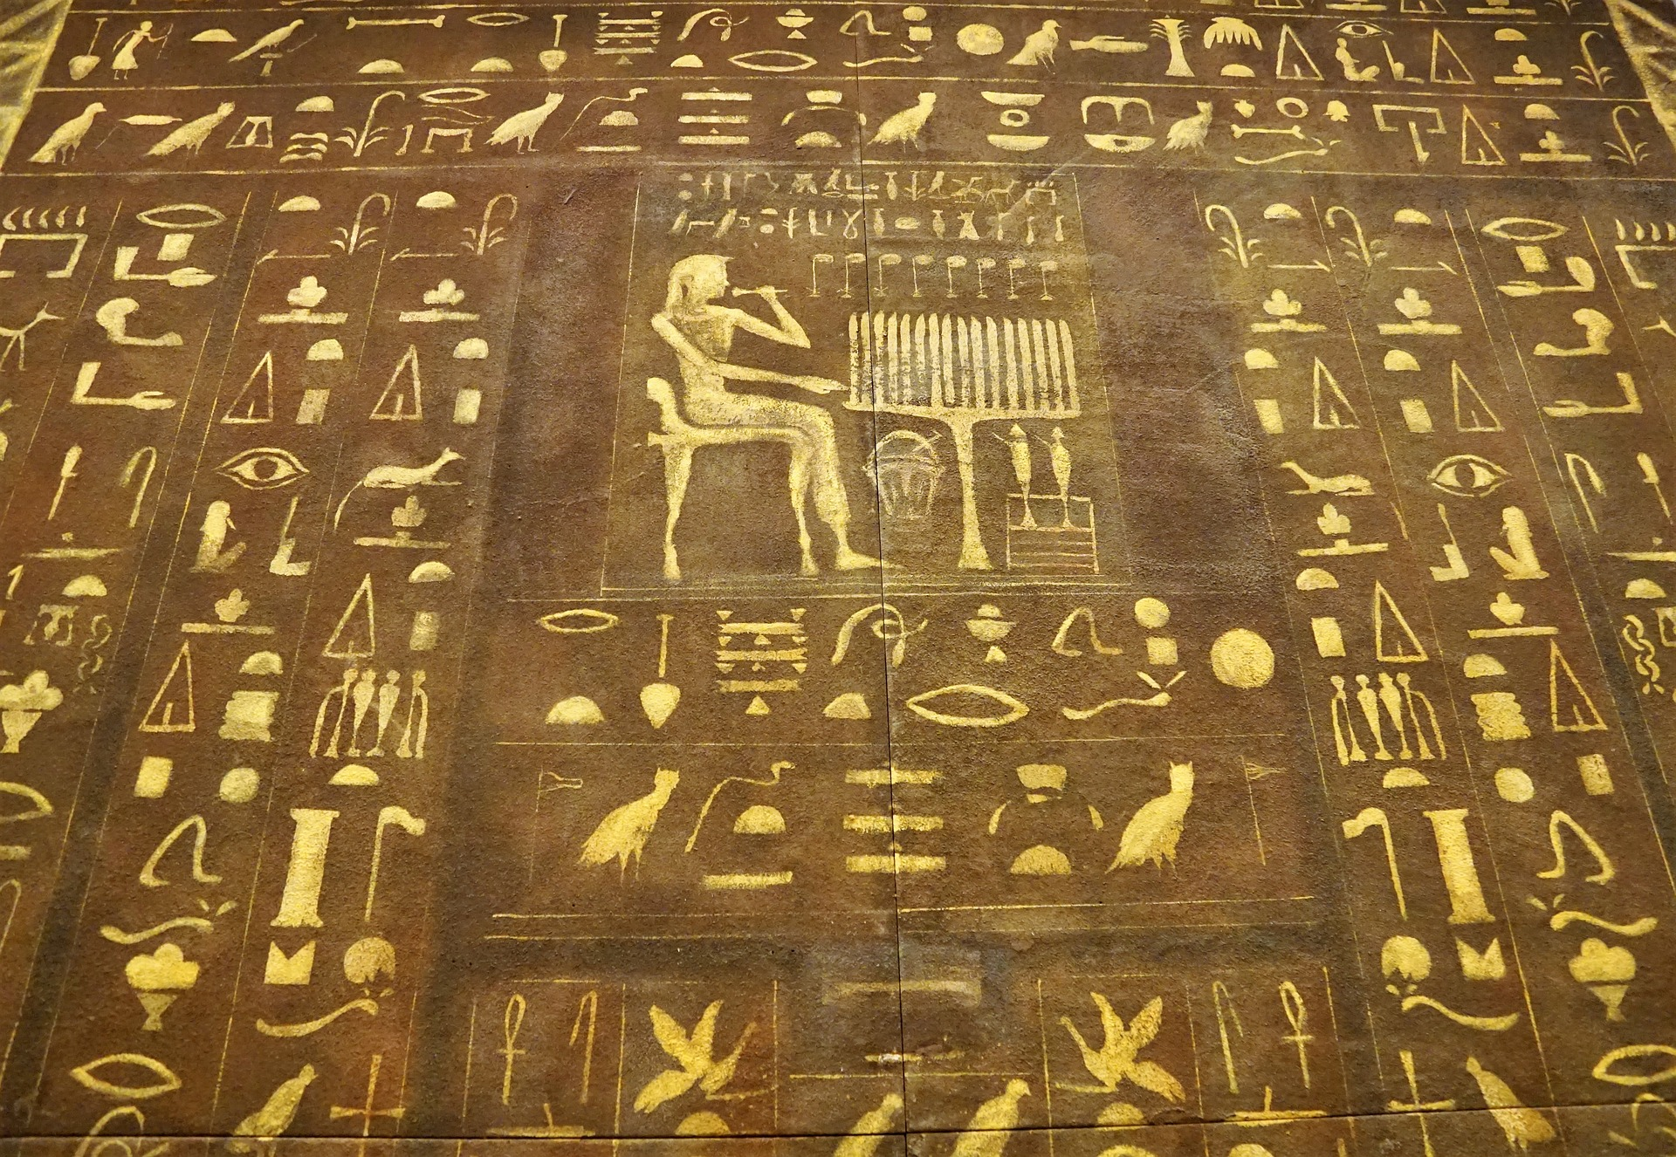
God heard…
God saw…
“God heard their cries, and he remembered the agreement he had made with Abraham, Isaac and Jacob. God saw the troubles of the people of Israel, and he was concerned about them.” Exodus 2:24
Notes:
Slide 5: A long time ago, another group of people were living in hard times.
God’s people, the Israelites, were being treated cruelly by the Egyptians. The people cried out to God for help.
Listen to these words from Exodus chapter 2 verse 24:
“God heard their cries, and he remembered the agreement he had made with Abraham, Isaac and Jacob. God saw the troubles of the people of Israel, and he was concerned about them.”
I wonder if you noticed two short phrases in particular?
God heard…. God saw…. God heard the cries of his people and saw what was going on.

Slide 6
God hears…
God sees…
Notes:
Slide 6: Christians believe that God still hears and God still sees all that’s going on in our world today. This weekend, churches all over the world will have been filled with people bringing their concerns about what they have been hearing and seeing to God, and we are going to do the same now.

Slide 7
Hear my words O Lord…
Consider my sighs…
Listen to my cry for help…
I called to you in my distress…
…and you answered me.
(Psalm 5: 1-2; Psalm 118:5)
Adapted from an Engage Worship resource
Notes:
Slide 7: But sometimes it’s hard to know quite what to say, or how to say it.
Christians will often turn to the words of King David’s Psalms to help them – and we’re going to do the same to help us. Listen to these words [each phrase animates separately. Read them out and if necessary, explain any unfamiliar words to children]
King David prayed words like these often: he lived through times of war and times of peace – and he knew from his own experience how God was with him, that God heard, God saw and God answered.
As we think about the situations we see – and the people who are caught up in the middle of them all – these words written by King David give us permission to express our concerns, and our desires for justice and peace, bringing them before God who sees and hears, and answers.

Slide 8
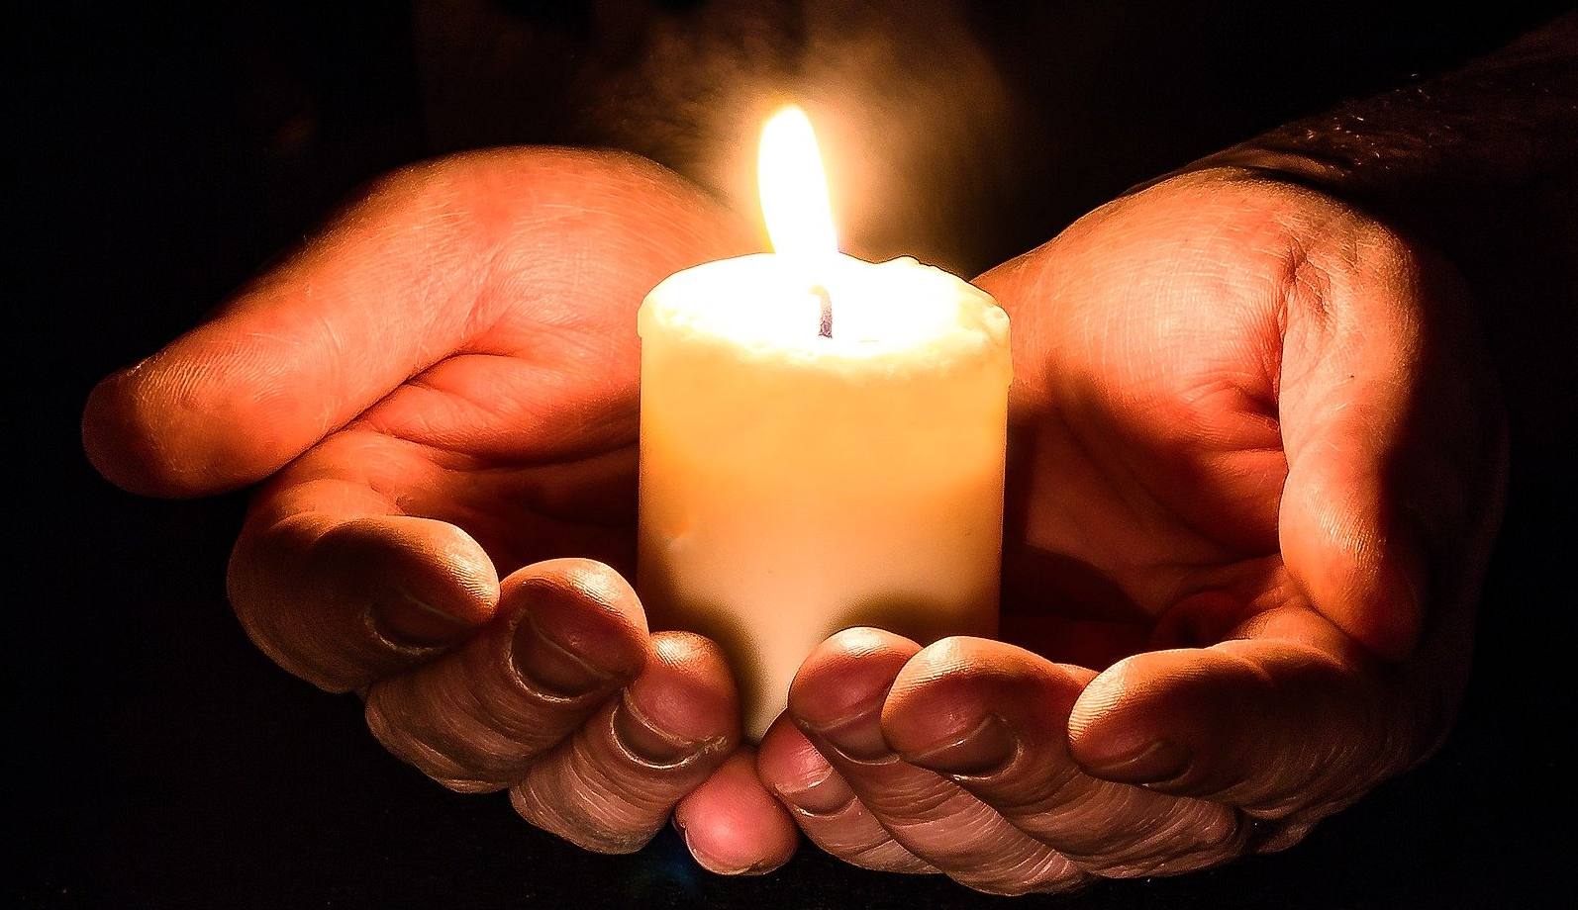
We call to you in our distress…
We trust you to answer us.
Adapted from an Engage Worship resource
Notes:
Slide 8: We’re going to use some of those words to help us to pray now; you can join me if you’d like to, or if praying is not something that you’re comfortable with, then hold your own thoughts in your head and heart.
The challenge of praying this prayer is that we may not always know that our prayers have been answered – but we can be sure that God hears what we pray. So, let’s pray with confidence and compassion….
When I say the words ‘We call to you in our distress’, you can join me with ‘We trust you to answer us.’

Slide 9
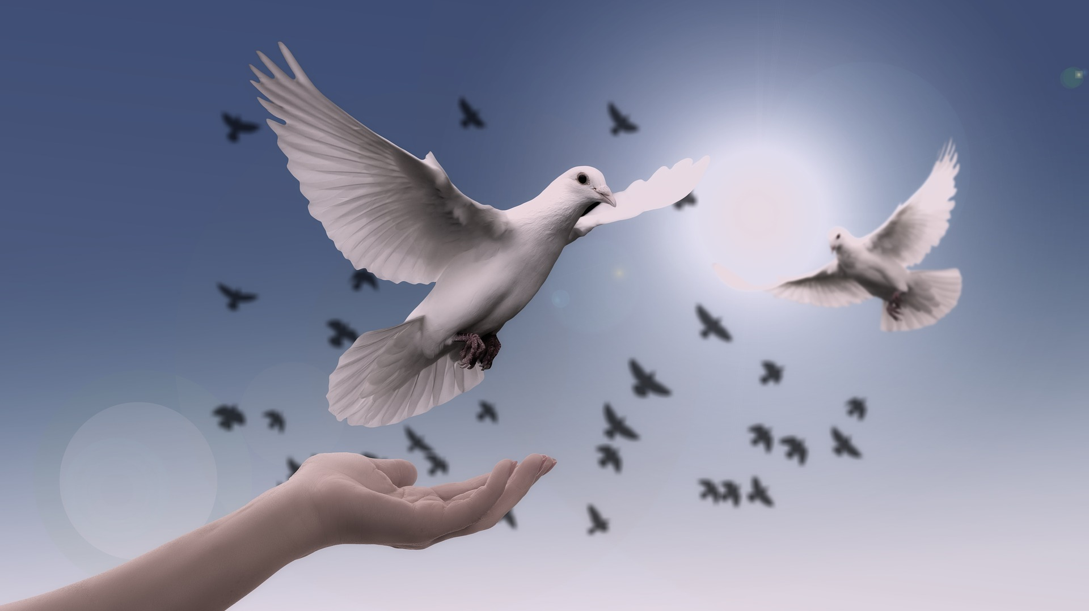
We call to you in our distress…
We trust you to answer us.
Adapted from an Engage Worship resource
Notes:
Slide 9: God who hears and sees,
We bring to you the people of Ukraine
May you comfort them and bring peace to their homes and to their hearts
‘We call to you in our distress’,
‘We trust you to answer us.’

Slide 10
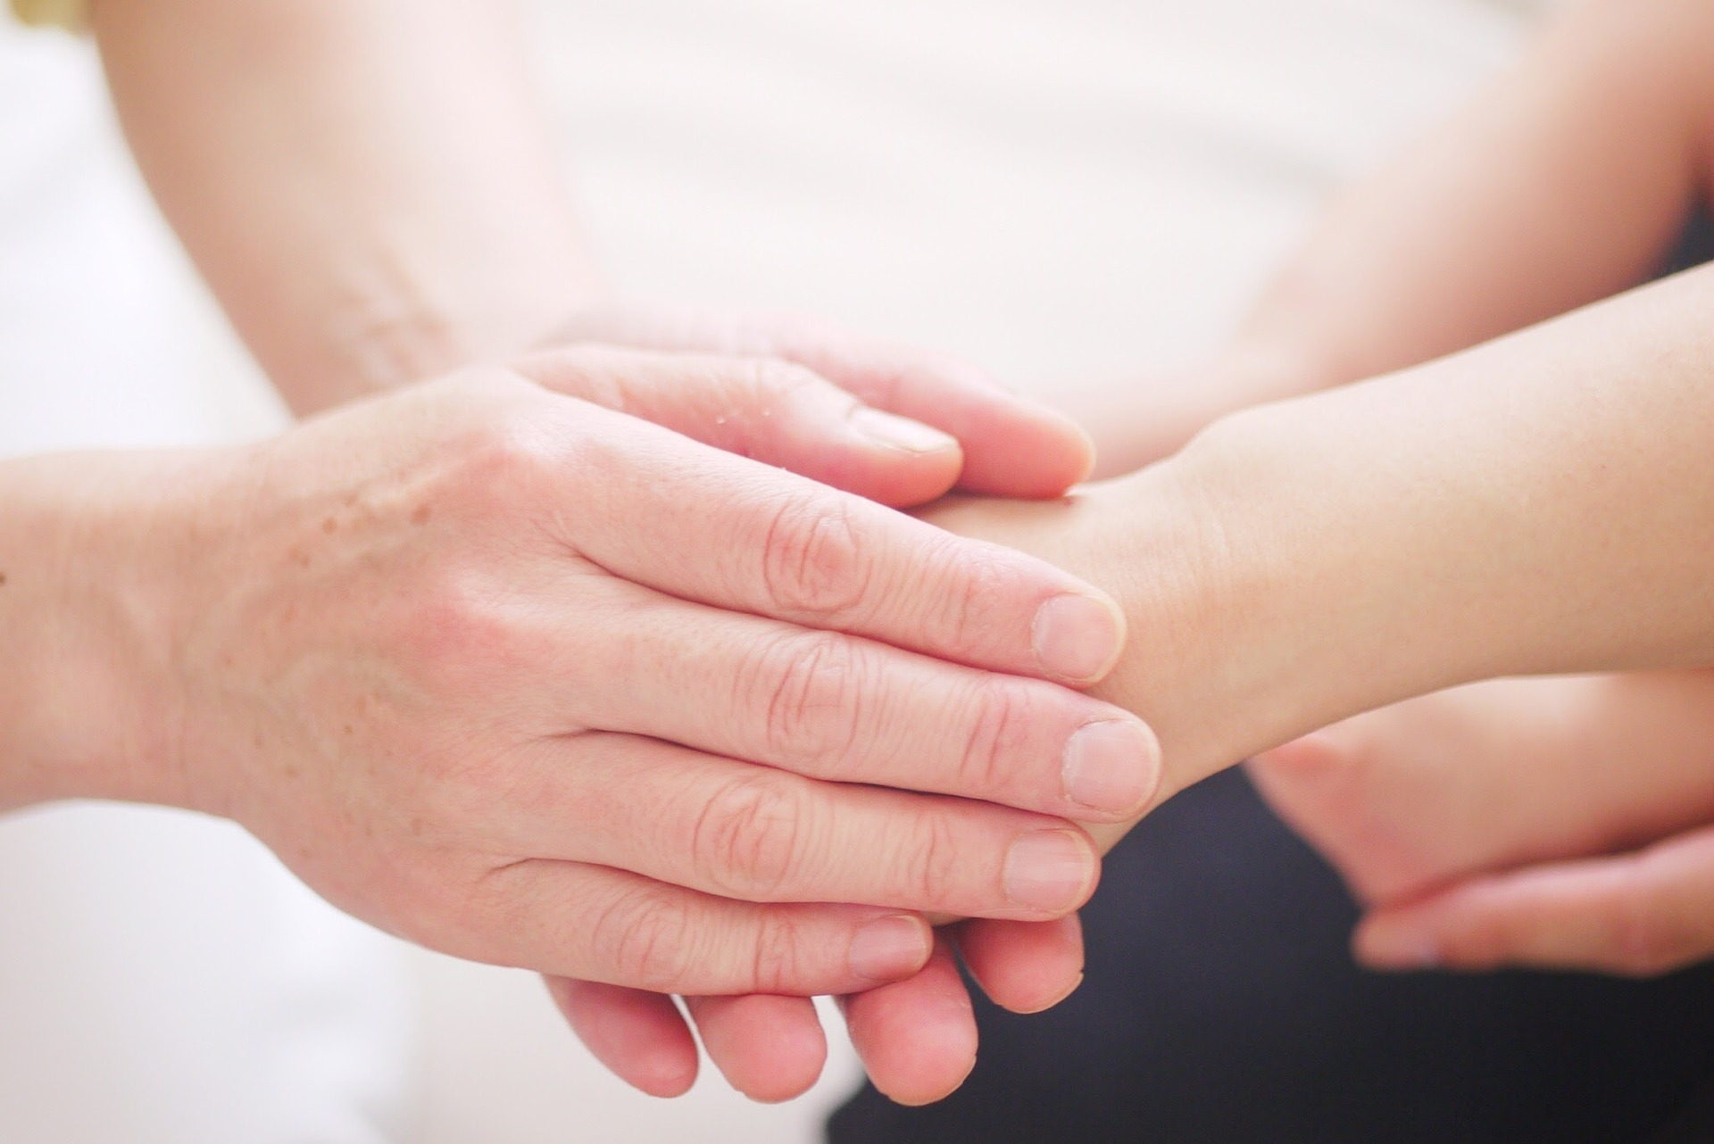
We call to you in our distress…
We trust you to answer us.
Adapted from an Engage Worship resource
Notes:
Slide 10: We pray for Christians in Ukraine and Russia
May you use their hands to bring healing and hope
‘We call to you in our distress’,
‘We trust you to answer us.’

Slide 11
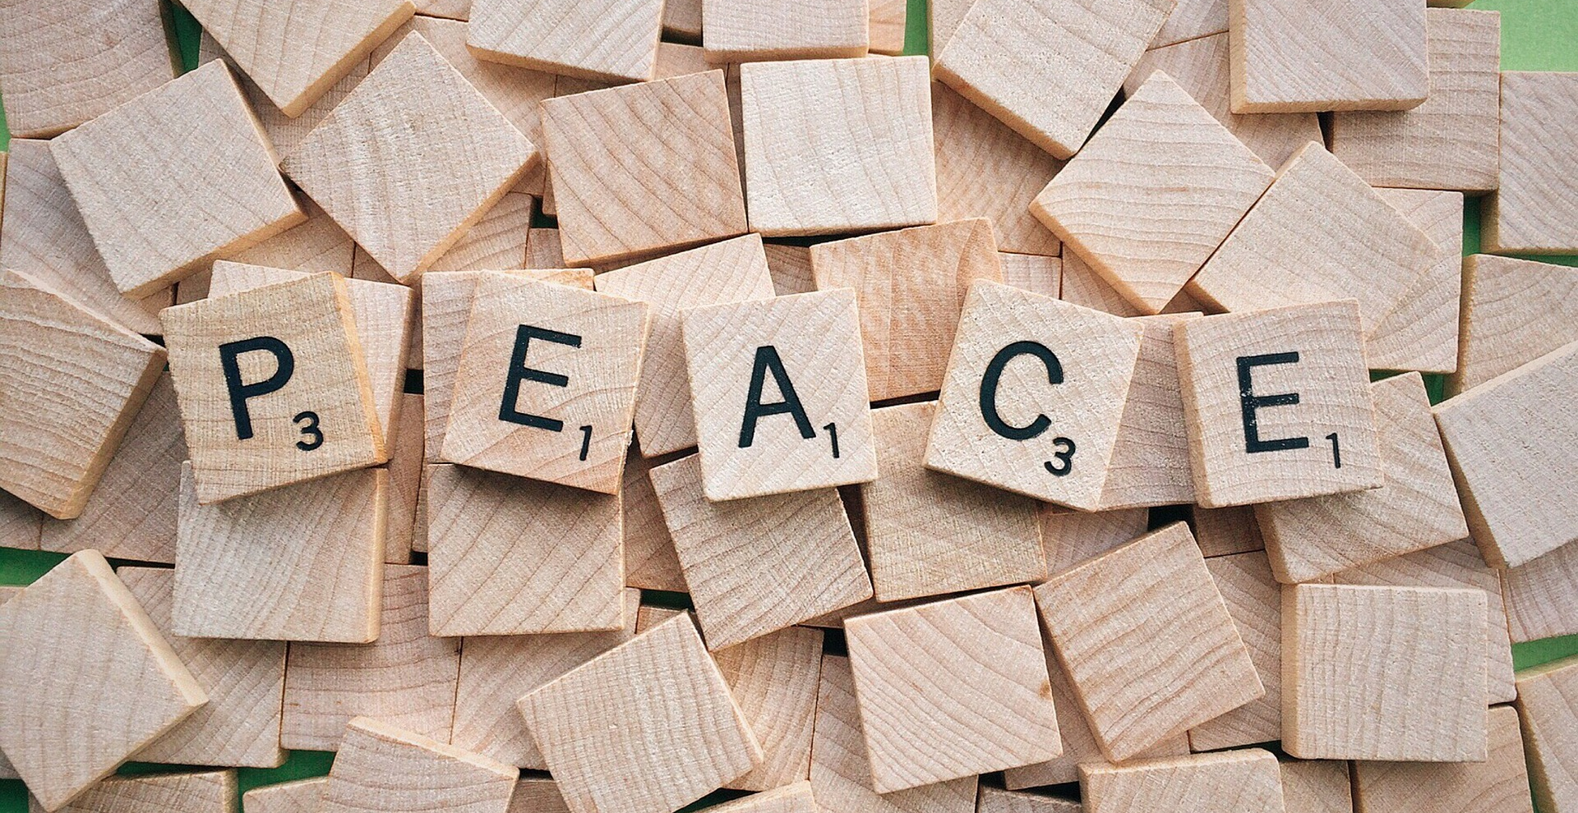
We call to you in our distress…
We trust you to answer us.
Adapted from an Engage Worship resource
Notes:
Slide 11: We pray for our world’s leaders
Guide how they react to all that is happening.
May peace and hope triumph over fear and hate
‘We call to you in our distress’,
‘We trust you to answer us.’

Slide 12
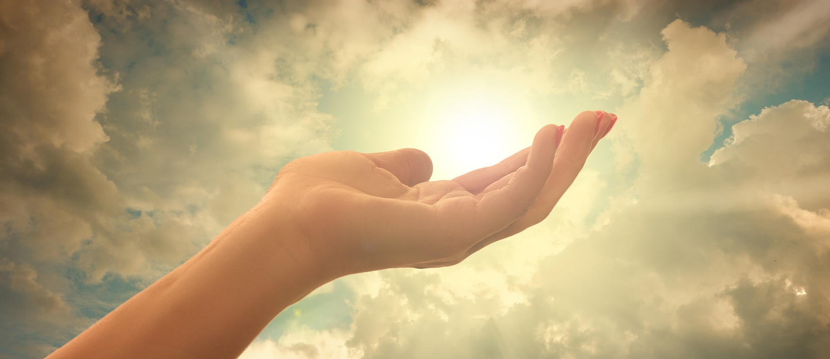
We call to you in our distress…
We trust you to answer us.
Adapted from an Engage Worship resource
Notes:
Slide 12: In a few moments of quiet, I invite you to bring your own worries, sadness and hopes to God now…..
‘We call to you in our distress’,
‘We trust you to answer us.’

Slide 13
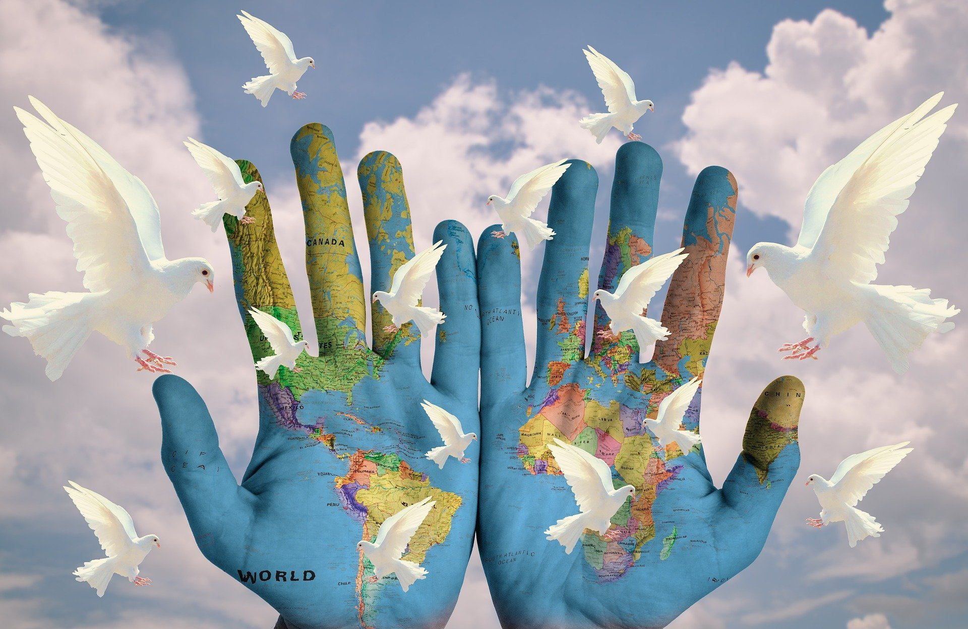
We call to you in our distress…
We trust you to answer us.
Adapted from an Engage Worship resource
Notes:
Slide 13:
God of peace and God of love
‘We call to you in our distress’,
‘We trust you to answer us.’

Slide 15
We light this candle for peace…
May its light scatter the darkness;
may its flame be a symbol of hope;
may its burning be a sign of faith joining with many other lights around your world, for peace.
Prayer by St. Paul’s Cathedral
Notes:
Slide 15: alternative prayer

Slide 16
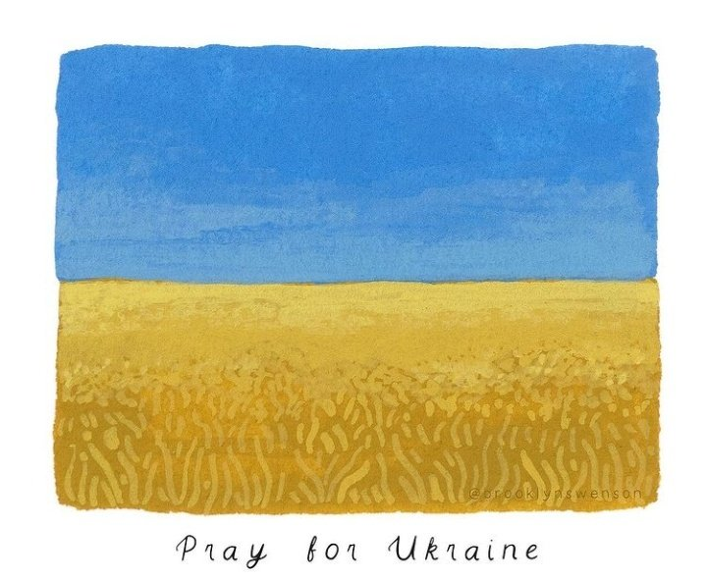
Leader: As we leave this place & time and go into the day ahead…
All: May we live peacefully.
Notes:
Alternative ending 1

Slide 17
Leader: As we leave this place & time and go into the day ahead…
All: May you grant your peace, O God.
Notes:
Alternative ending 2

