Slide 1
The Harvest Season
Living in the world that we have been given
Yours, Lord, is the greatness, the power,
the glory, the splendour, and the majesty;
for everything in heaven and on earth is yours.
All things come from you,
and of your own do we give you.

Slide 2
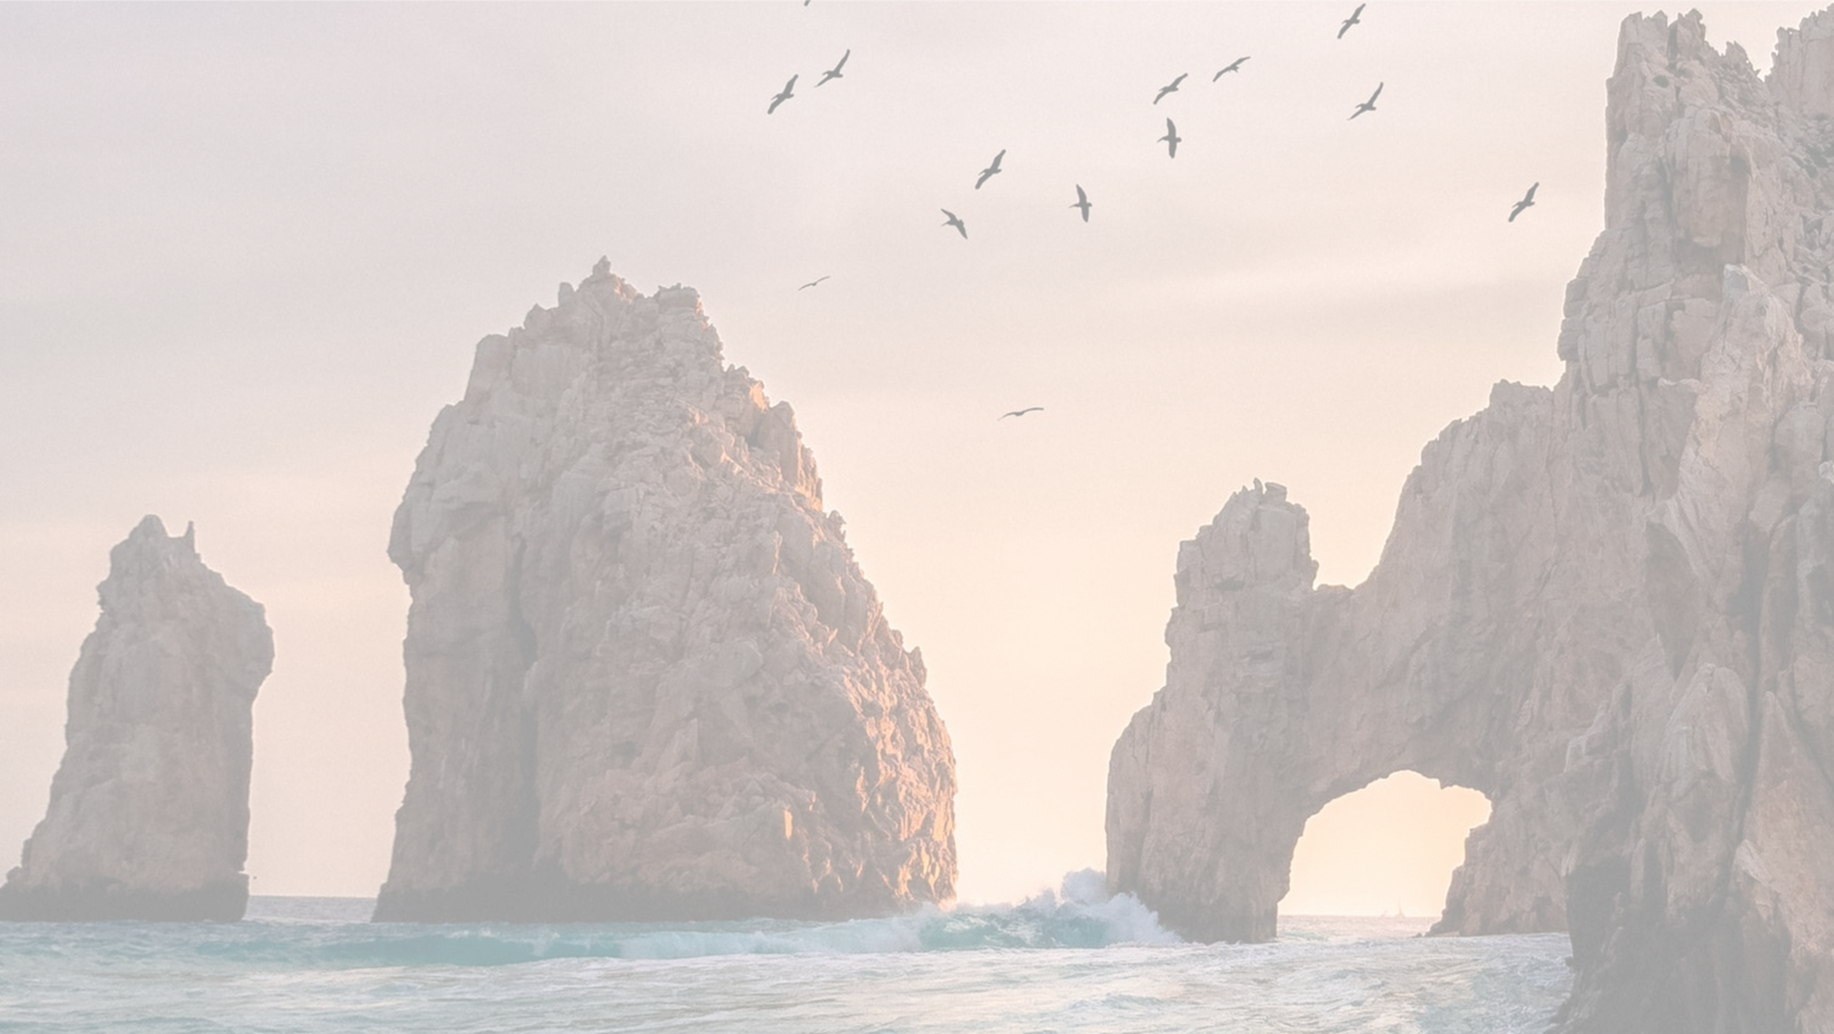
Fruitfulness in the water and the Air
From Day 5 of the Creation Story…
God said, “Let the waters bring forth swarms of living creatures, and let birds fly above the earth across the dome of the sky.” So God created the great sea monsters and every living creature that moves, of every kind, with which the waters swarm and every winged bird of every kind. And God saw that it was good. God blessed them, saying, “Be fruitful and multiply and fill the waters in the seas, and let birds multiply on the earth.”

Slide 3
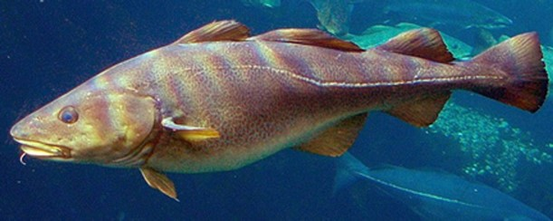
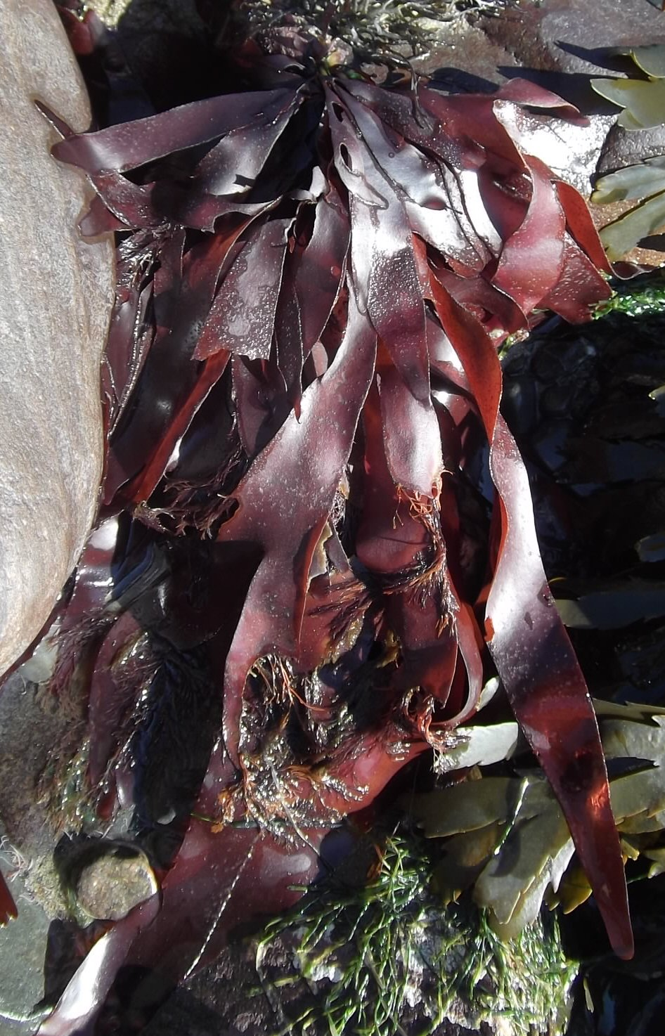
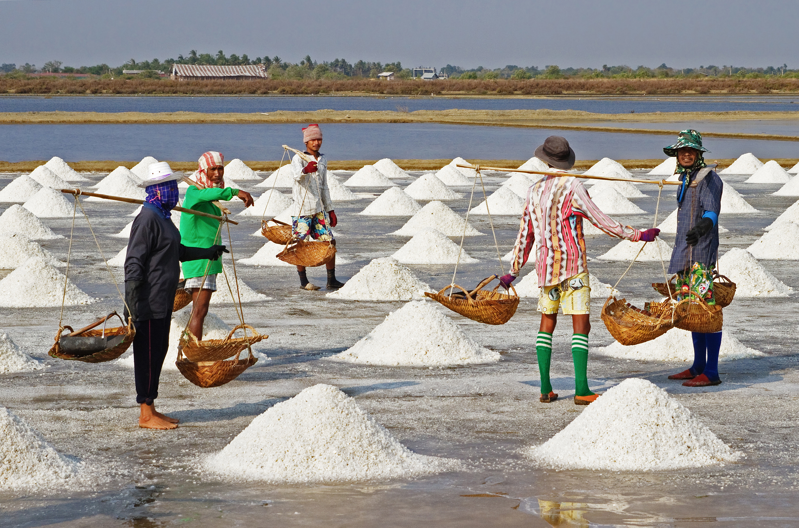
Do you have a favourite sea or water creature?
Or perhaps a bird?
Talk to a partner about it
The Harvest of the Sea
What can you see?
Notes:
Not all the harvest from the sea is fish
Many people collect seaweed
There is a big trade in sea salt

Slide 4
The Harvest of Water
What can you see?
Is this also a kind of harvest?
Notes:
Is there a ‘harvest’ of fun or fitness about water through swimming and sailing? This is a different way of thinking about harvest
It is however an expression of fulfilment.

Slide 5
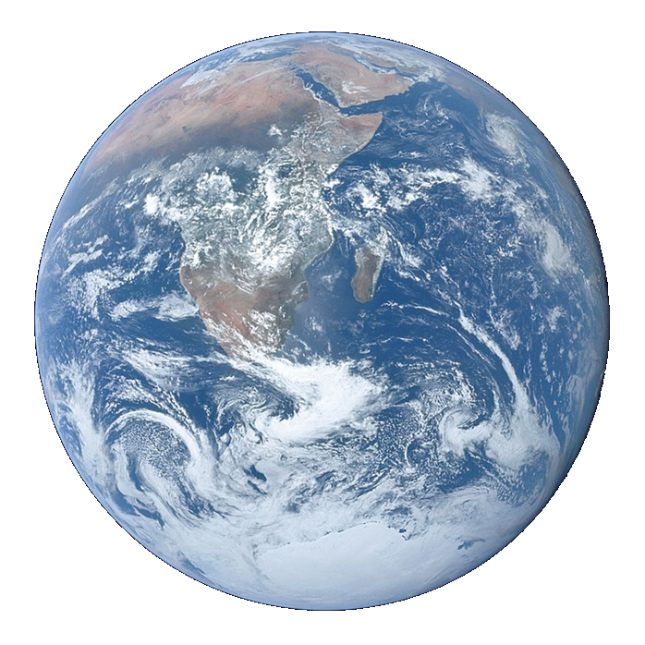
Litany of Creation
God commanded, “Let the earth produce all kinds of plants”
Plant prayers
God commanded, “Let the water be filled with many kinds of living beings, and the air filled with birds.”
Fish and bird prayers
God commanded, “Let the earth produce all kinds of animal life”
Animal prayers
God created human beings and blessed them,
People prayers
God looked at everything and was very pleased.
Thank you prayer
Notes:
An optional structure for prayer – see Developmental Prayer File page15* Pupils’ own prayers (or perhaps parents’ or staff prayers) should be inserted at the points in italics. This could be an opportunity to involve extemporary prayer or for silent prayer/reflection.
*https://www.odbe.org.uk/content/pages/documents/collectiveworship-prayerfile-doc-202175554553377.pdf

Slide 6
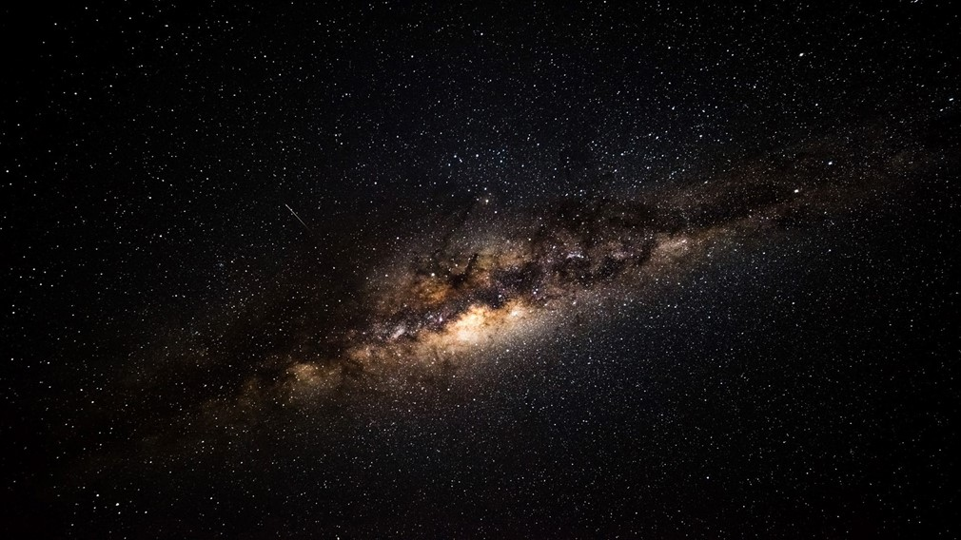
Our Father in heaven,
hallowed be your name,
your kingdom come,
your will be done,
on earth as in heaven.
Give us today our daily bread.
Forgive us our sins
as we forgive those who sin against us.
Lead us not into temptation
but deliver us from evil.
For the kingdom, the power,
and the glory are yours
now and for ever.
Amen.

