Slide 1
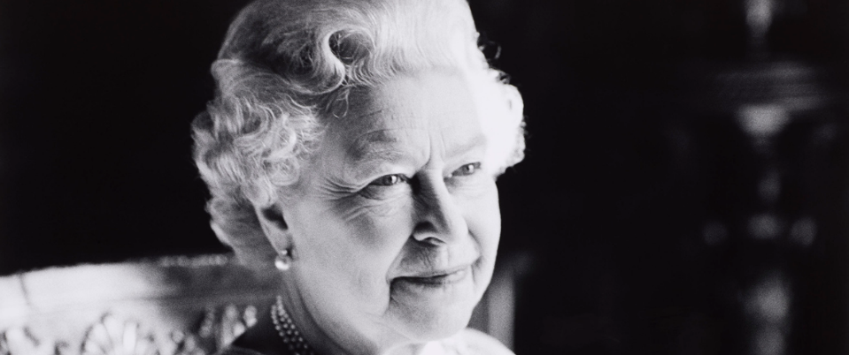
HM Queen Elizabeth II
1926 - 2022
‘I declare before you all that my whole life whether it be long or short shall be devoted to your service…’
From the 21st birthday speech of the then Princess Elizabeth
Notes:
FRONT SLIDE

Slide 2
‘There is a time for everything, and a season for every activity under the heavens….
There is a time to mourn…’
Ecclesiastes 3:4
Notes:
Slide 2: ‘There is a time for everything, and a season for every activity under the heavens. There is a time to mourn.’
These are ancient words from the Book of Ecclesiastes, one of the books of wisdom, and they acknowledge that it’s OK for us to be sad.

Slide 3
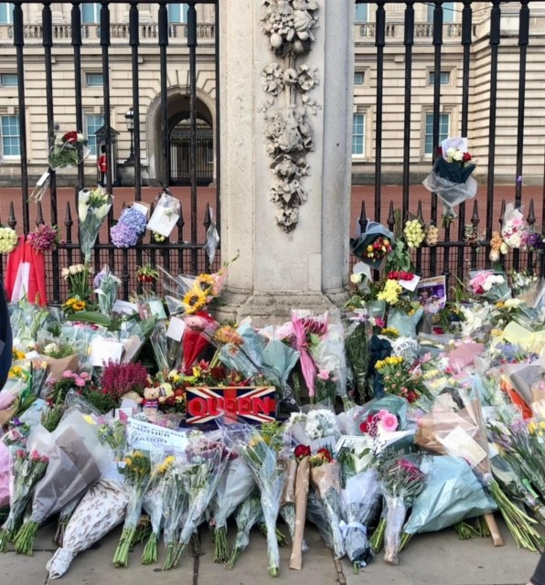
Notes:
Slide 3: Over recent days, people have travelled from all over the world as a way of sharing their sadness with others, to pay their respects to the Queen for all that she did and to show their support for King Charles III and the Royal Family as they mourn.

Slide 4
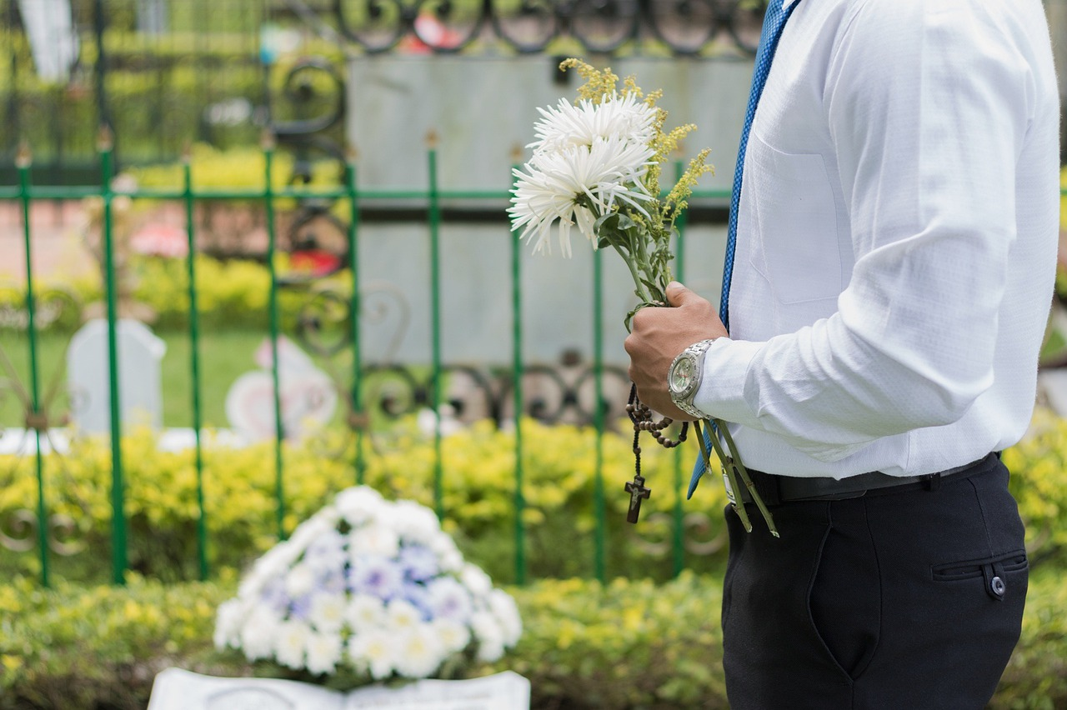
Notes:
Slide 4: [Insert photo from news feed if preferred] I wonder if you watched the Queen’s funeral service yesterday? What do you remember about it? [talk together, in pairs or as appropriate]
A funeral is a time when people gather to say goodbye to the person who has died. The words spoken at the Queen’s funeral may have sometimes been hard to understand, but the Queen herself would have chosen some of them because they were special to her. Some of them are from the Bible and some are traditions that have been handed down from previous monarch’s funerals.
As a follower of Jesus, the Queen had a Christian funeral, and believed that her final destination was heaven, where she would be with God.

Slide 5
‘We present you with this book, the most valuable thing that this world affords. Here is wisdom….’
Notes:
Slide 5: At her coronation, wearing all of her precious jewels, the Queen was presented with a Bible, with these words: ‘We present you with this book, the most valuable thing that this world affords. Here is wisdom….’
Let’s hear some words about heaven from this book, the book that the Queen treasured so much, in Revelation 21 (which is at the very end of the New Testament):

Slide 6
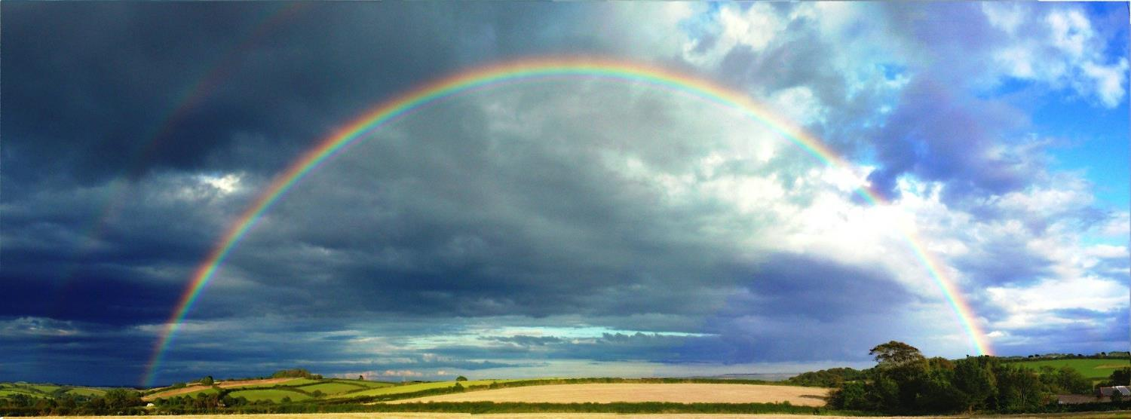
‘God's home is now with his people. He will live with them, and they will be his own. Yes, God will make his home among his people. He will wipe all tears from their eyes, and there will be no more death, suffering, crying, or pain. These things of the past are gone forever.’ Revelation 21:3-4
Notes:
Slide 6: ‘God's home is now with his people. He will live with them, and they will be his own. Yes, God will make his home among his people. He will wipe all tears from their eyes, and there will be no more death, suffering, crying, or pain. These things of the past are gone forever.’ Revelation 21:3-4
The Queen believed this with all her heart, and so for her, this next big adventure is not sad, because she is with God. But it leaves us with that strange mix of emotions, which all people feel at and after funerals. People often gather after the funeral service to chat and share memories of the person, and so that’s what we are going to do now [you may have stories from your school or local community]

Slide 7
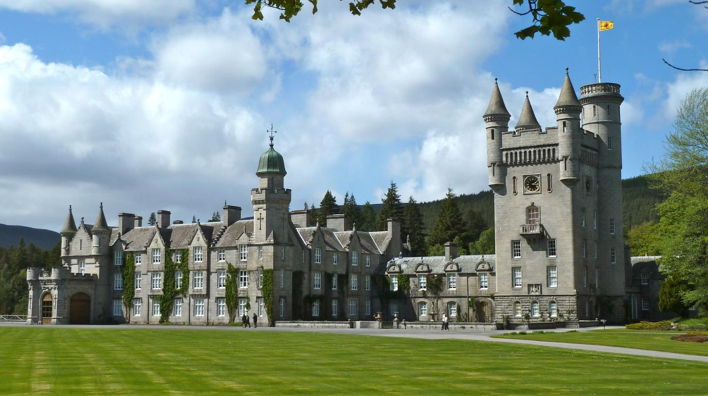
Heartwarming story of the Queen’s encounter with two American tourists (yahoo.com)
Notes:
Slide 7: Memory of the Queen, from Richard Griffin, one of the Queen’s protection officers, from Sky News: Heartwarming story of the Queen’s encounter with two American tourists (yahoo.com) – these words are actually very appropriate for all ages but there is also a link to a video of Richard Griffin talking: Sophy Ridge on Twitter: "My favourite story about the Queen… just lovely https://t.co/xueTVRU7oB" / Twitter

Slide 8
‘how to give, how to love and how to serve’
Notes:
Slide 8: In the book ‘Badger’s Parting Gifts’, Badger’s friends talk about their friend Badger who has died, and they all find comfort remembering the special gifts that Badger had given them when he was alive. Although she is no longer here, there are many ‘gifts’ that the Queen has left with us – some people may have actual physical treasures (like the Windlesham chair), but she has left us all with other gifts to remember her by. Here are a few words from one of the recent tributes to get us started [one screen – they are the words of Boris Johnson, which you may wish to acknowledge or not!] ‘She showed the world not just how to reign over a people, she showed the world how to give, how to love and how to serve...’
I wonder what these special gifts might be for us? [talk together – you might want to link these with your school’s values]

Slide 9
Notes:
Slide 9: Coins Although we don’t use real money as much these days, all our money shows the Queen’s head (facing right – Charles III will apparently face left!) – and we will continue to see it even once they make new money with his head on. Maybe these might be a reminder to us over the weeks, months and years that lie ahead to live as she did, with faith, hope and love – giving to and serving others.

Slide 10
‘Each day is a new beginning, I know that the only way to live my life is to try to do what is right…..to give of my best in all that the day brings, and to put my trust in God.’
Notes:
Slide 10: Responding (and words for worship):
And so as we come to the end of our time together, some things to think about.
Let’s be still and quiet together now, and pause to reflect again….
….I wonder what you will take away from today?....
…maybe some words of hope….
….maybe values that you saw in the life of the Queen…
…..
…our Queen was always keen to tell others that she followed the example of Jesus…
…she once said ‘Each day is a new beginning, I know that the only way to live my life is to try to do what is right…..to give of my best in all that the day brings, and to put my trust in God.’
…I wonder if these words might help us as we go into the day ahead?....
I’m going to turn my thoughts into a prayer now, as I talk to God about some of these things. Make the prayer your own if you’d like to…or if you’d prefer not to pray, then just sit quietly with your own thoughts.

Slide 11
HM Queen Elizabeth II
1926 - 2022
‘I declare before you all that my whole life whether it be long or short shall be devoted to your service…’
From the 21st birthday speech of the then Princess Elizabeth
Notes:
Slide 11: [Image to display whilst you pray]
Dear God
Thank you for the remarkable life of our Queen, whose life was such an example to us all. Help us as we live our lives to serve others, following your example. As her reign passes to King Charles III, we pray that he too would serve with wisdom, integrity and faith. May he know that the prayers of your people, the Church, with him at this time.
We ask all these things in the name of Jesus.
Amen

