Slide 1

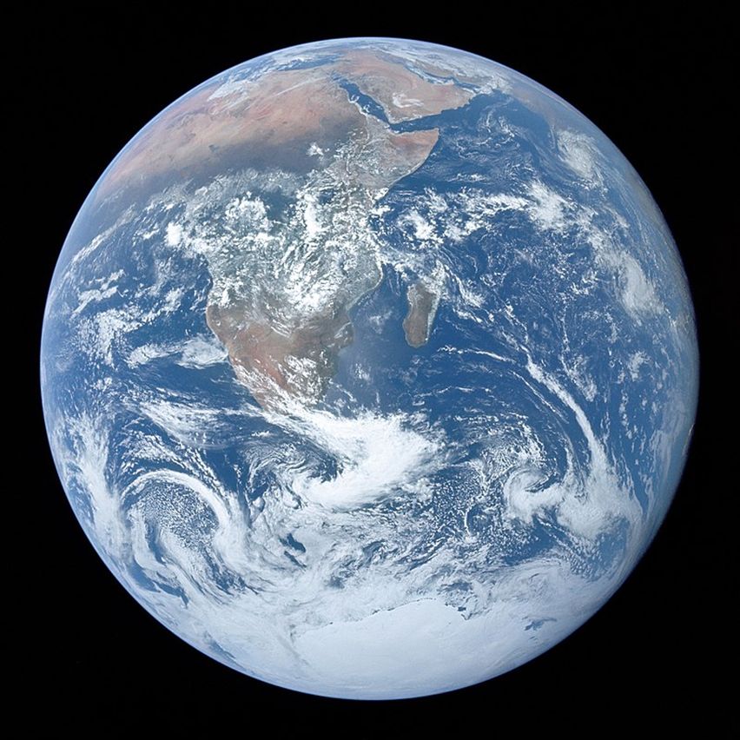
The Harvest Season
Living in the world that we have been given
‘Nature is the art of God’ —
Dante Alighieri

Slide 2
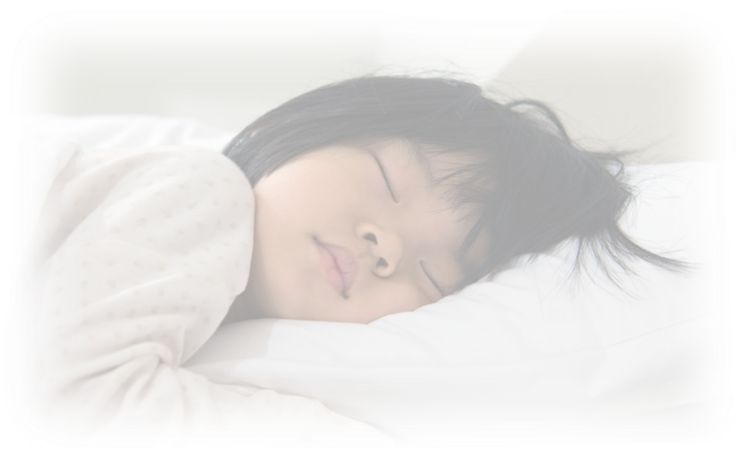
Rest – the final part of the creation story is special…
From Day 6 of the Creation Story…
On the sixth day God finished the work that he had done, and he rested on the seventh day from all the work that he had done. So God blessed the seventh day and hallowed it, because on it God rested from all the work that he had done in creation.
Notes:
Rest is a very special part of the story.
It is so special that it is ‘made holy’ by God. (Holy meaning, special to God or devoted to God)

Slide 3
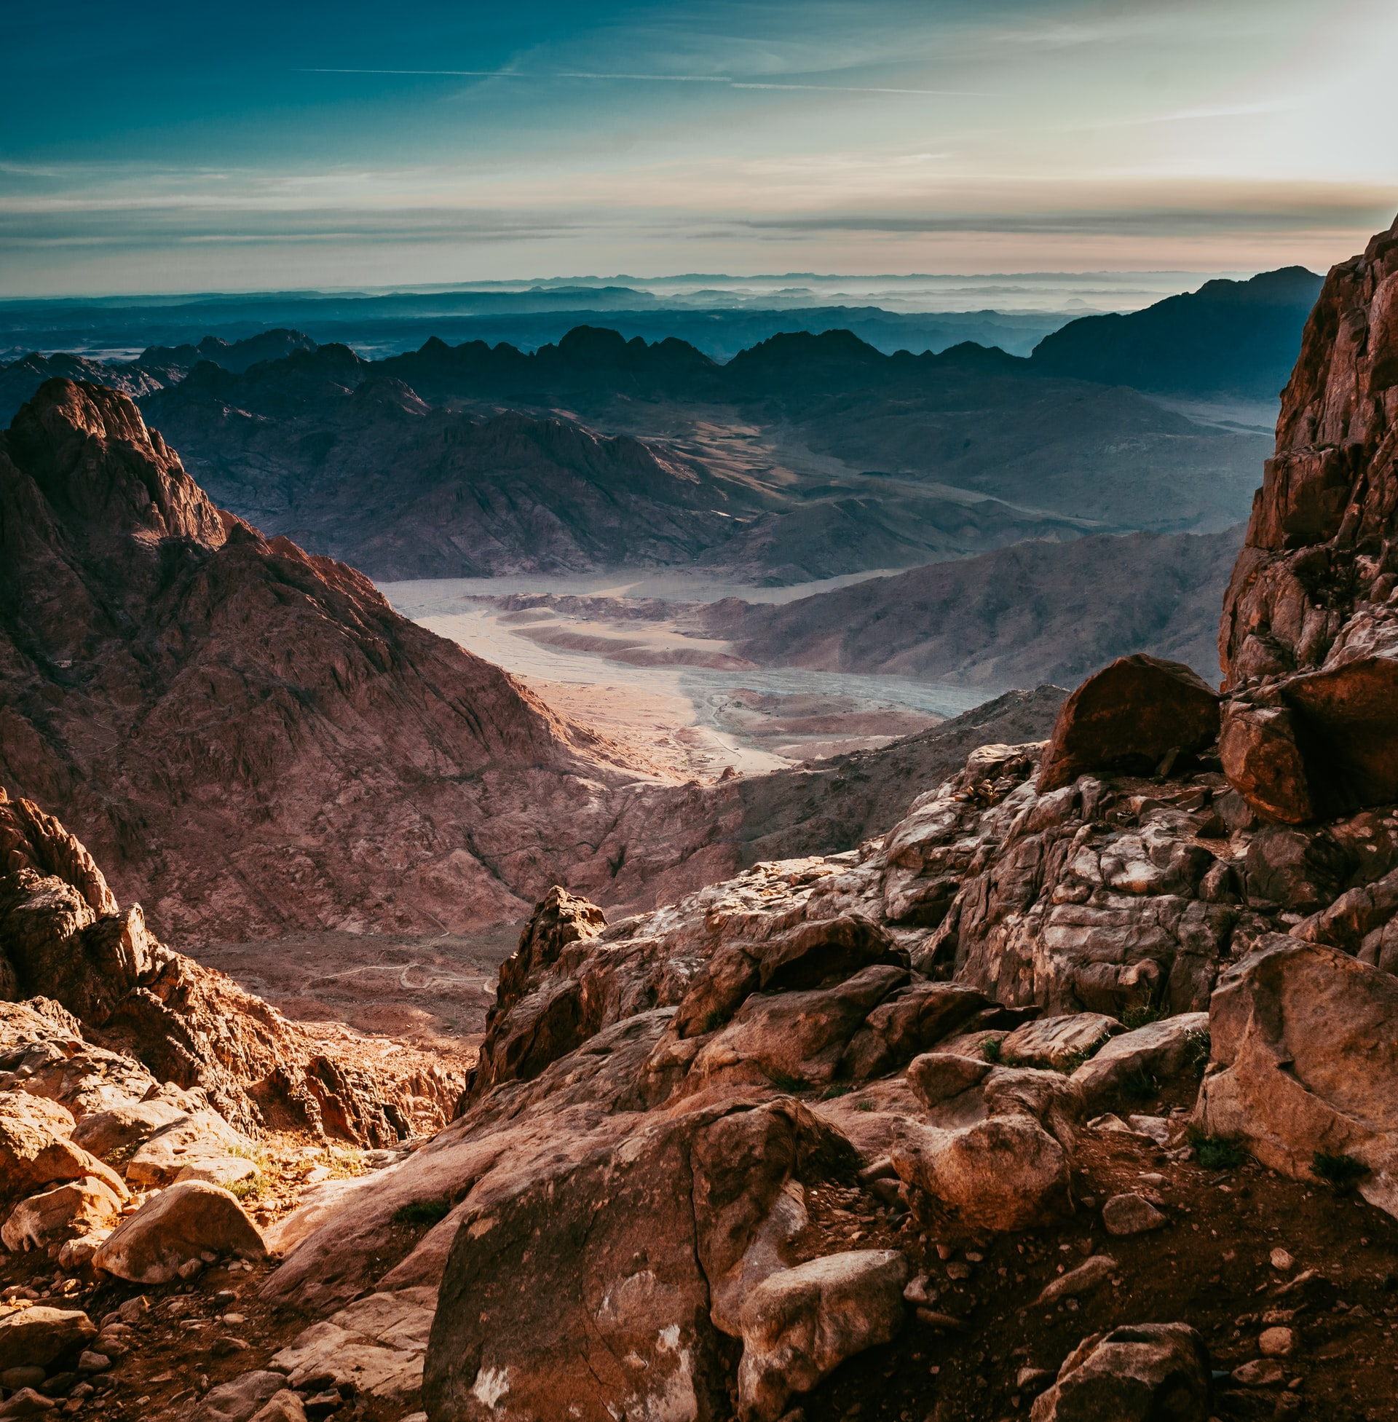
The Ten Commandments
Number 4 …
“Observe the Sabbath and keep it holy. You have six days in which to do your work, but the seventh day is a day of rest dedicated to me. On that day no one is to work—neither you, your children, your slaves, your animals, nor the foreigners who live in your country. In six days I, the Lord, made the earth, the sky, the seas, and everything in them, but on the seventh day I rested. That is why I, the Lord, blessed the Sabbath and made it holy.”
Notes:
This slide can be omitted
The ‘rest’ part of the creation story is so important that it is included in the 10 Commandments.
The 10 Commandments are often seen as the basis of what Christians call the ‘Law’
You may wish to paraphrase the Bible quote something like this…
“Keep the Sabbath keep it holy. You have six days in which to do your work, but the seventh day is a day of rest. In six days I, the Lord, made the earth, the sky, the seas, and everything in them, but on the seventh day I rested. That is why I, the Lord, blessed the Sabbath and made it holy. (‘Hallowed’ it)
Would it be a good idea if our laws included one which said ‘you must rest for one day a week?
(This may be a time for some history – when did it become legal for shops to open on Sundays?)
There is some disagreements among biblical scholars as to whether the law or the story comes first – but this does not diminish the importance of rest for individuals, the community or theology!
Notably Jesus’ famous summary of the law includes one of the 10 commandments but the second part ‘love your neighbour as yourself’ comes from Leviticus
The image is Mt Sinai, traditionally the place where Moses received the 10 commandments.

Slide 4

Body Rest
Spiritual rest
Resting
Brain rest
Resting our senses
Resting our feelings
How do you find rest for all these things?
Talk to your neighbour
Notes:
Is the Sabbath about just doing nothing?
Rest is essential to our wellbeingThere are all sorts of kinds of rest
What kinds of rest do we need?
We have simplified the 7 kinds of rest found in various places such as …
https://ideas.ted.com/the-7-types-of-rest-that-every-person-needs/
Gather pupils’ views about how they rest. This slide can be adapted for different ages of pupil. For instance some of the different kinds of rest could be removed – except for Spiritual Rest

Slide 5
Our Spiritual Rest
O Lord, our Lord,
your greatness is seen in all the world!
When I look at the sky, which you have made,
at the moon and the stars, which you set in their places—
what are human beings, that you think of them?
You appointed them rulers over everything you made;
you placed them over all creation:
sheep and cattle, and the wild animals too;
the birds and the fish
and the creatures in the seas.
O Lord, our Lord,
your greatness is seen in all the world!

Slide 6

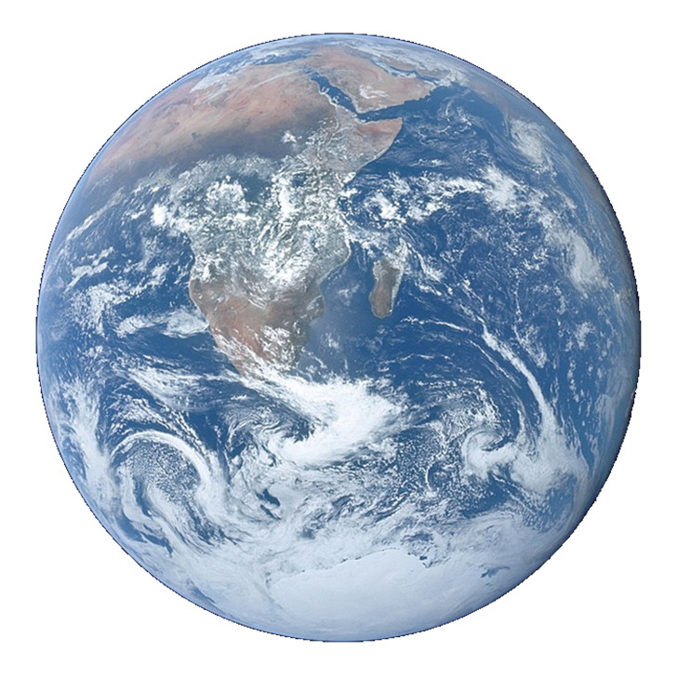
Our Father in heaven,
hallowed be your name,
your kingdom come,
your will be done,
on earth as in heaven.
Give us today our daily bread.
Forgive us our sins
as we forgive those who sin against us.
Lead us not into temptation
but deliver us from evil.
For the kingdom, the power,
and the glory are yours
now and for ever.
Amen.

